Slide 1




Introductory statistics
Type of the material
BAS4SC
Business Analytics Skills
for the Future-proofs Supply Chains
Project number – 2022-1-PL01-KA220-HED-000088856

Slide 2

Agenda
Variables
Average (mean)
Median
Modus
Variance range
Variance and standard deviation
Quantiles
Displaying statistics
Frequency distribution
Descriptive and inferential statistics
Correlation and regression
Probability distributions

Slide 3
The role and importance of statistics in analysing data in supply chains
Statistics play a key role in modern supply chains, where effective management, planning and control are essential. Statistical methods are used to collect, analyse and interpret data, enabling companies to better understand and optimise their supply chains.
In supply chain analysis, statistics are used to optimise processes, reduce costs, increase efficiency and improve customer satisfaction. It enables a better understanding of supply chain dynamics and better risk management, which is crucial for the successful operation of companies and organisations in today's global environment.

Slide 4
Variables
Variables are basic building blocks in statistics because they represent the properties or characteristics that are measured or observed in a survey, experiment or sample of data. Variables are essential for understanding and analysing data as they allow researchers, analysts and statisticians to describe, analyse and understand phenomena
Qualitative (descriptive, categorical) variables
Quantitative (numerical) variables
Dependent and independent variables
Discrete and continuous variables

Slide 5
Average (mean)
The mean, also known as the average, is one of the basic statistical measures. The mean is the arithmetic average of all the values in a data set. It is calculated by summing all the data and then dividing by the number of data.
Calculating the average:
Add up all the values in the dataset.
Divide the sum by the number of values in the set.
The equation to calculate the average (x̄) is: x̄ = (x1+x2+x3+ ... +xn) / n

Slide 6
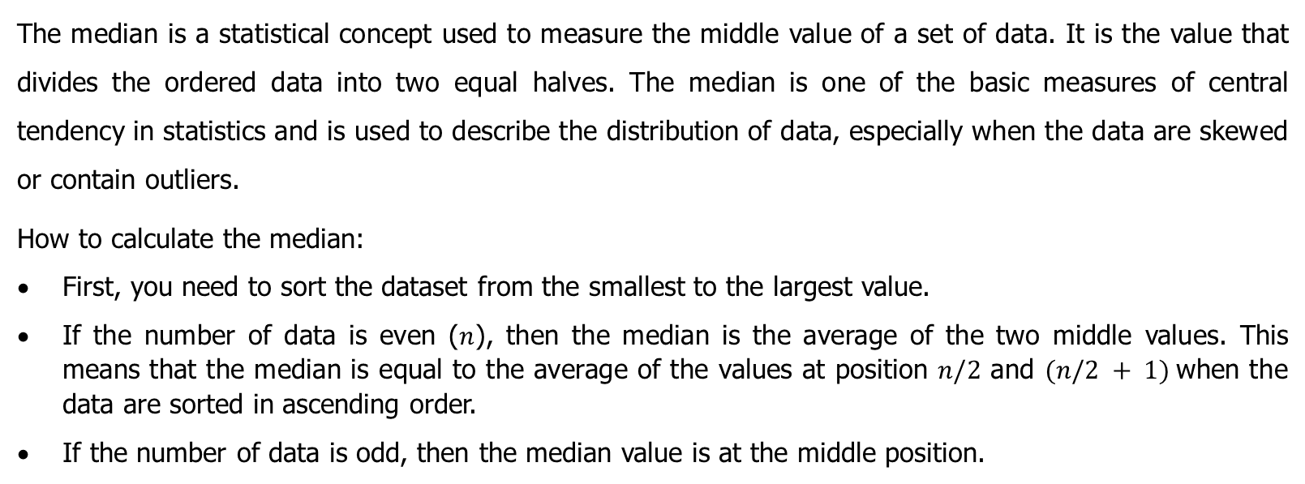
Median
The median is a statistical concept used to measure the middle value of a set of data. It is the value that divides the ordered data into two equal halves. The median is one of the basic measures of central tendency in statistics and is used to describe the distribution of data, especially when the data are skewed or contain outliers.
How to calculate the median:
First, you need to sort the dataset from the smallest to the largest value.
If the number of data is even ($n$), then the median is the average of the two middle values. This means that the median is equal to the average of the values at position $n/2$ and $(n/2 + 1)$when the data are sorted in ascending order.
If the number of data is odd, then the median value is at the middle position.

Slide 7
Modus
Modus is one of the basic statistical metrics used to measure the central tendency of a data set. The modus represents the value that occurs most frequently in the dataset. It is the value that has the highest frequency of occurrence among all the values in the data set.
Modus is useful for identifying the most frequent value in a data set and is particularly useful when analysing qualitative (categorical) variables where the values are non-numerical.
If there are multiple modes in the data set (multiple values occurring with similar maximum frequency), we speak of a multi-modal distribution. If all the data have the same frequency of occurrence, then the data set has no mode.

Slide 8
Variance range (VR, Range, range)
The difference between the maximum and minimum values in a data set is a statistical concept called the range. This measures how big the difference is between the maximum (maximum) and minimum (minimum) values in the data set. The range is a simple way to estimate the range of values in a data set and to measure the variability between the minimum and maximum values.
Calculating the variation margin is simple:
First, find the minimum value (min) and the maximum value (max) in the dataset.
Then calculate the difference between the maximum and minimum value (max - min).

Slide 9
Variance and standard deviation
Variance is the average of the squared deviations from the mean. It is the square of the standard deviation. Standard deviation is a statistical measure used to measure the dispersion or variability in a set of data. It tells how far the values are from the mean (average) in the set. Standard deviation is one of the most commonly used measures of dispersion in statistics and is calculated by calculating the square root of the variation (variance).
Calculating the standard deviation:
First, calculate the variation (variance). The variation (variance) is calculated by taking the average of all the values in the set for each value in the set, then squaring and summing these differences.
Once you have the value of the variation margin (σ2), calculate the standard deviation by calculating the square root of the variation margin. This is done by taking the square root of σ2:
Standard deviation σ = √(σ2)

Slide 10
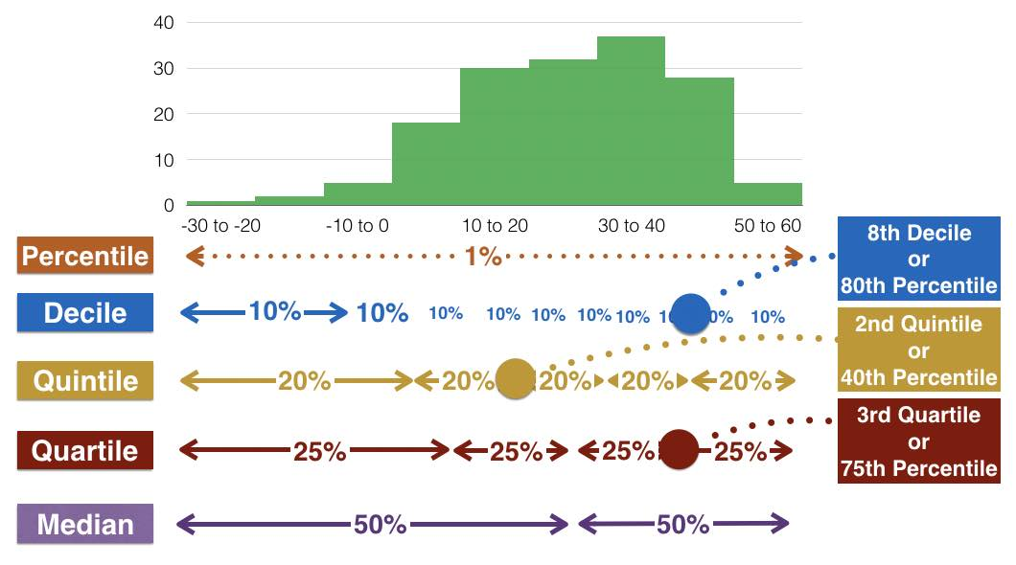
Quantiles
Quantiles are values that divide ordered data into specific parts. For example, quartiles divide data into four equal parts. The first quartile (Q1) divides the bottom 25% of the data, the second quartile (Q2) is equal to the median, and the third quartile (Q3) divides the top 25% of the data.

Slide 11
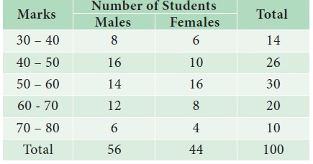
Displaying statistics
The presentation of statistics involves the use of a variety of methods and tools, with the aim of presenting data in a clear, transparent and informative way.
Here are some common ways to display statistics:
Tables
Tables are the basic method for displaying data. Examples include frequency tables, which show the number of occurrences for different values, and data tables, which show more information about the data.

Slide 12
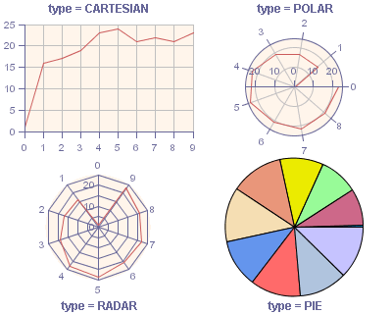
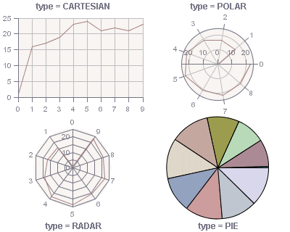
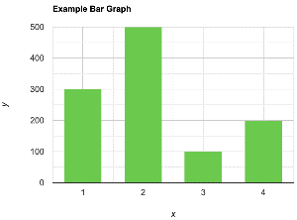
Graphical representations
Graphical displays are an effective tool for visualising data. They include different types of charts such as bar charts, line charts, pie charts, histograms, box plots, etc.

Slide 13
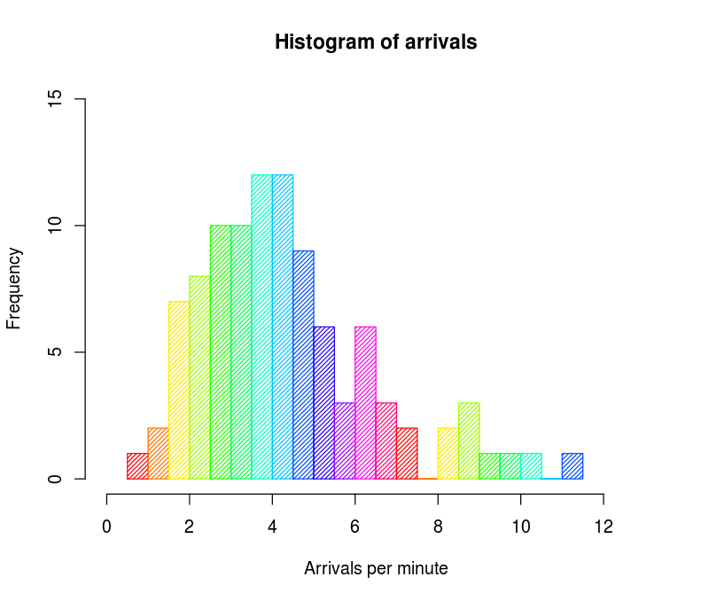
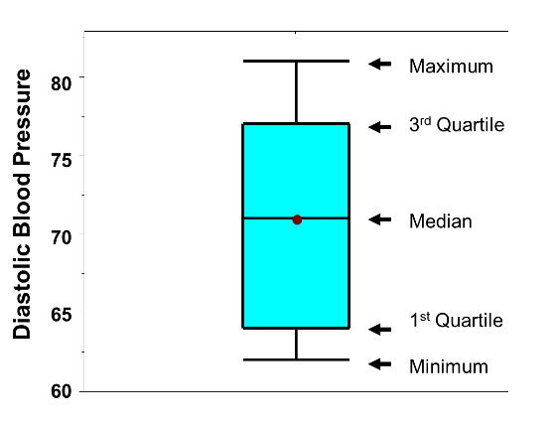
Histograms
Histograms are graphical representations of the distribution of data. They are used to show the frequency of the value of a variable at different intervals.
Quantile chart (Box plot)
A quantile plot, or moustache box, is a type of graph used in descriptive statistics as a convenient way of graphically representing groups of numerical data by summarising them with five numbers: minimum, first quartile, median, third quartile and maximum.

Slide 14
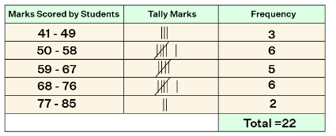
Frequency distribution
A frequency distribution, also known as a frequency table or histogram, is a way of showing the number of occurrences of different values of a variable in a data set. Using a frequency distribution, you can identify patterns, distributions and frequencies of values in the data. It is commonly used for the analysis of qualitative (categorical) variables, but can also be used to display discrete values of quantitative (numerical) variables.

Slide 15
Descriptive and inferential statistics
Descriptive statistics: descriptive statistics is concerned with describing and summarising data from the sample or population being studied. It is used to analyse and understand the data, but not to draw conclusions about the population as a whole. The main aim of descriptive statistics is to describe the characteristics of data, for example to calculate the mean, median, range, standard deviation and to create graphical representations such as histograms or graphs. It is used to create summaries and graphs that help to visualise data.
Inferential statistics: inferential statistics deals with making inferences about a population from a sample. This means that inferential statistics allows conclusions to be drawn about the population as a whole from an analysis of a sample. It uses different statistical methods such as hypothesis testing, confidence intervals and regression analysis to understand whether observed sample results can be generalised to a population. For example, if we want to find out whether the mean age in a sample is representative of the population as a whole, we will use inferential statistics.

Slide 16
Inferential statistics
The main objectives of inferential statistics are:
Estimating population parameters: inferential statistics allows us to estimate population parameters such as mean, variance, proportions and other characteristics from a sample.
Hypothesis testing: inferential statistics can be used to test hypotheses about a population based on sampled data. This involves statistical testing, where we compare the sample with assumptions about the population.
Creating confidence intervals: inferential statistics allows us to calculate intervals containing the estimated values of population parameters with a certain level of confidence.

Slide 17
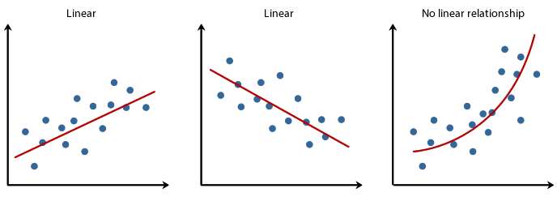
Correlation and regression
They are statistical methods used to study relationships between variables and to predict values. Both methods help to understand how one variable affects another and how well one variable can be used to predict another. Here is an explanation of each of these two methods:

Slide 18
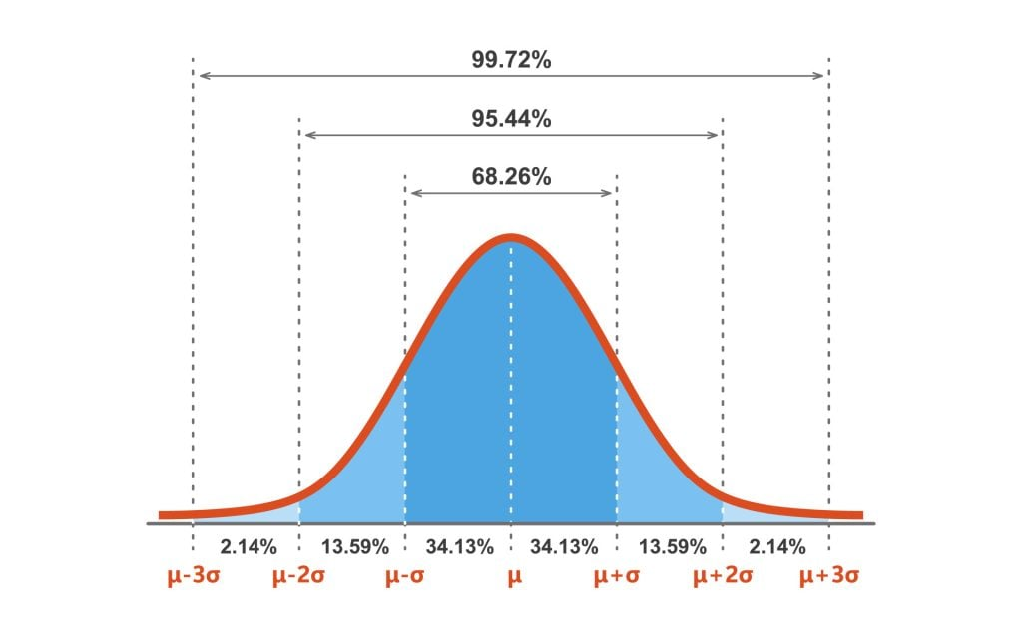
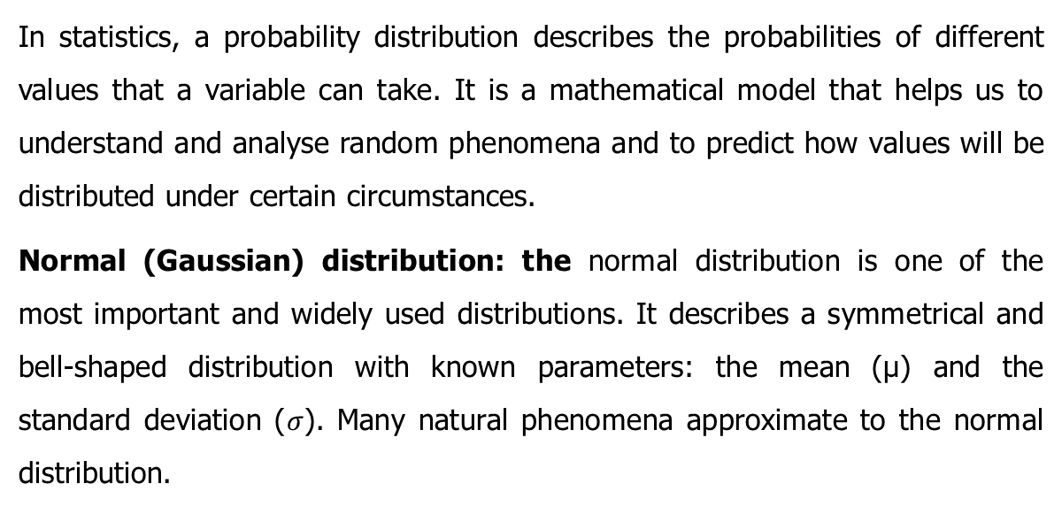
Probability distributions
In statistics, a probability distribution describes the probabilities of different values that a variable can take. It is a mathematical model that helps us to understand and analyse random phenomena and to predict how values will be distributed under certain circumstances.
Normal (Gaussian) distribution: the normal distribution is one of the most important and widely used distributions. It describes a symmetrical and bell-shaped distribution with known parameters: the mean (μ) and the standard deviation ($σ$). Many natural phenomena approximate to the normal distribution.

Slide 19
Literature:
Introductory Statistics 2e, Openstax, Rice University, Houston, Texas 77005, Jun 23, senior contributing authors: Barbara Illowsky and Susan dean, De anza college, Publish Date: Dec 13, 2023, (https://openstax.org/details/books/introductory-statistics-2e);
Introductory Statistics 4th Edition, Susan Dean and Barbara Illowsky, Adapted by Riyanti Boyd & Natalia Casper (Published 2013 by OpenStax College) July 2021, (http://dept.clcillinois.edu/mth/oer/IntroductoryStatistics.pdf );
Introductory Statistics 7th Edition, Prem S. Mann, eastern Connecticut state university with the help of Christopher Jay Lacke, Rowan university, John Wiley & Sons, Inc., 111 River Street, Hoboken, NJ 07030-5774, 2011
Introduction to statistics, made easy second edition, Prof. Dr. Hamid Al-Oklah Dr. Said Titi Mr. Tareq Alodat, March 2014
Statistics for Business and Economics, Thirteenth Edition, David R. Anderson, Dennis J. Sweeney, Thomas A. Williams, Jeffrey D. Camm, James J. Cochran, 2017, 2015 Cengage Learning®
Statistics for Business, First edition, Derek L Waller, 2008 Copyright © 2008, Derek L Waller, Published by Elsevier Inc. All rights reserved

Slide 20
Internet pages:
https://open.umn.edu/opentextbooks/textbooks/196
https://www.scribbr.com/category/statistics/
https://stats.libretexts.org/Bookshelves/Introductory_Statistics
https://assets.openstax.org/oscms-prodcms/media/documents/IntroductoryStatistics-OP_i6tAI7e.pdf
https://saylordotorg.github.io/text_introductory-statistics/
https://drive.uqu.edu.sa/_/mskhayat/files/MySubjects/20178FS%20Elementary%20Statistics/Introductory%20Statistics%20(7th%20Ed).pdf
https://dept.clcillinois.edu/mth/oer/IntroductoryStatistics.pdf
https://www.geeksforgeeks.org/introduction-of-statistics-and-its-types/
https://onlinestatbook.com/Online_Statistics_Education.pdf
https://www.researchgate.net/profile/Tareq-Alodat-2/publication/340511098_INTRODUCTION_TO_STATISTICS_MADE_EASY/links/5e8de3dc4585150839c7b58a/INTRODUCTION-TO-STATISTICS-MADE-EASY.pdf
https://byjus.com/maths/statistics/
https://www.khanacademy.org/math/statistics-probability
Youtube links:
Introductory statistics:
https://www.youtube.com/watch?v=XZo4xyJXCak
https://www.youtube.com/watch?v=LMSyiAJm99g
https://www.youtube.com/watch?v=VPZD_aij8H0
https://www.youtube.com/watch?v=TLwp5DwcqD4
https://www.youtube.com/watch?v=fpFj1Re1l84
https://youtube.com/playlist?list=PLqzoL9-eJTNAB5st3mtP_bmXafGSH1Dtz&si=z-IXQ1iKbw2-ieJW
https://www.youtube.com/watch?v=44MJyNTxaP8

Slide 21
Thank you for your attention

