Slide 1

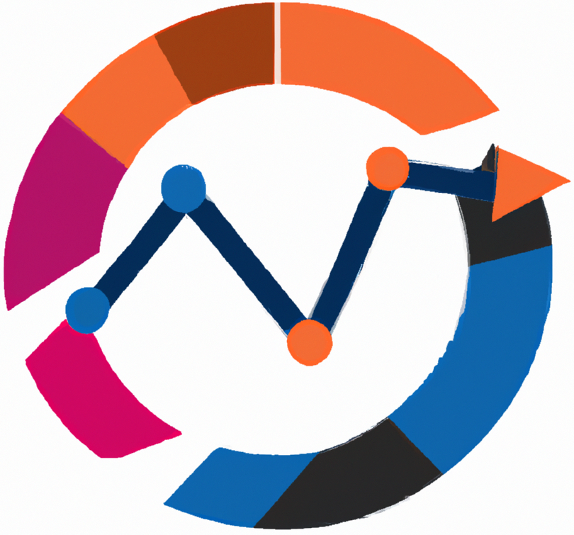


Business Intelligence
Information systems in logistics
Lecture
BAS4SC
Business Analytics Skills
for the Future-proofs Supply Chains
Project number – 2022-1-PL01-KA220-HED-000088856

Slide 2
Agenda
Enterprise Resource Planning Systems
Costs of ERP systems
ERP systems trends
Warehouse Management Systems
Transportation Management Systems

Slide 3
ERP
ERP - Enterprise Resource Planning
the backbone of a company, integrating various departments (such as accounting, procurement, sales, production etc.) and processes into a unified system
In the beginning companies were divided into different departments, depending on the functions they performed
Each department operated in isolation in such a way that it had its own data collection and analysis system
Today, organizations are considered as one system, and all the departments are its sub-systems
They all share the same, centralized database

Slide 4
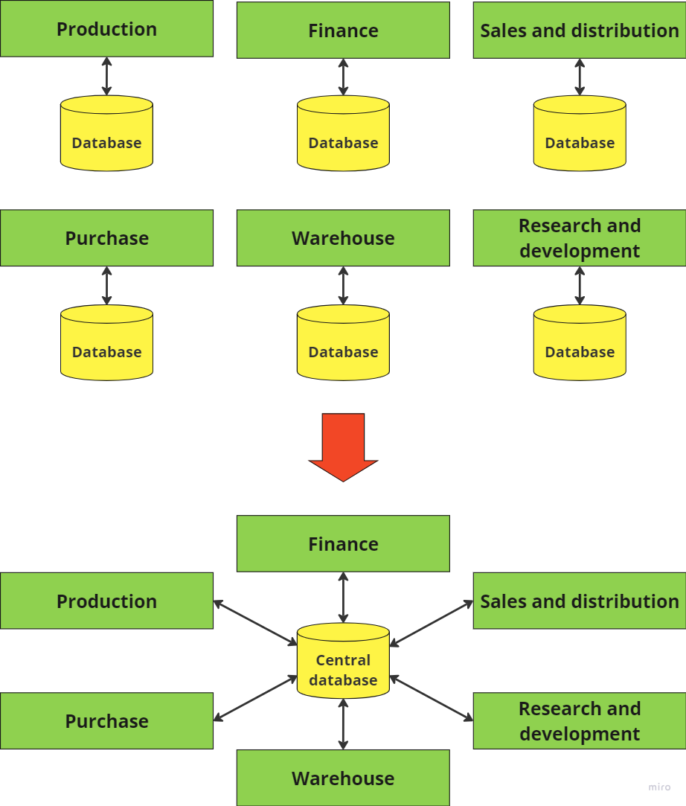
ERP systems

Slide 5
ERP
Business systems that combine and organize data from various departments within the organization to create a single, comprehensive system that serves the needs of the whole enterprise
complex, modular software solution that integrates all of the company’s business functions, helps in business process management and shares a single database for the whole system
cross-functional system that automates and integrates the essential business operations of an organization in order to maximize effectiveness and efficiency
companies can implement a module or modules of ERP software without having to buy and implement the complete package because most of it is flexible enough
Source: Bradford (2015)

Slide 6
ERP
They are sold in modules, i.e. groups of connected programs that perform certain functions within the system (accounting, production...)
Modern ERPs are flexible, so it is possible to buy only individual modules
Key ERP modules: finance, human resource management and logistics (with their subsystems)
It consists of several million lines of program code

Slide 7
Why do companies choose ERP?
Too many business problems and unresolved issues - ERP can help in business decision-making, reporting, forecasting...
Business model change – the current software cannot support the company's new business model
Desire to grow – current software cannot support the growing number of users and transactions
The need for advanced functionalities
Too many different business systems in use at the same time
Non-compliance with laws, regulations...
ERP softwares have multi-language and multi-currency capabilities, i.e. they are suitable for the global market

Slide 8
ERP advantages
Improved transparency and insights – data from every department can be accessed by executive-level employees,
Real-time access to information – data is available in real-time to all users in all departments,
Reduction of operational costs – through lower inventory costs, production costs or purchasing costs,
Single interface through all modules – modules in ERP system look the same and provide the same way of functioning,
Scalability – cloud-based ERP systems enable the use of additional computing resources in case of company and data growth,
Improved customer service - a new system such as ERP software can enable more personalized and expedited customer service because it centralizes all customer data
Source: Brackett (2015); Dalkir (2023); Cotton (2023)

Slide 9
ERP disadvantages
Complex and time-consuming implementation – the implementation of an ERP system can take between a few months and several years, depending on the size of the company,
Price – ERP systems are often very expensive, especially the popular ones: SAP and Microsoft Dynamics NAV,
Change management - it will take a lot of time and effort to make sure that every important employee is adequately trained on how to use the new system
Source: Brackett (2015); Dalkir (2023); Cotton (2023)

Slide 10
ERP
The main reason why companies implement ERP systems is to support their company’s growth.
Implementation of ERP systems is very complex and the most ERP projects fail.
According to Saunders (2022), about 80% of ERP projects fail.
25% of ERP projects were canceled or delayed, and another 55% have missed the stakeholders’ expectations for the project.

Slide 11
Most critical issues in ERP implementation
Top management support - the support, strategic direction and active involvement of top management are essential for the successful implementation and management of ERP systems
Change management - resistance, particularly from middle managers accustomed to traditional methods, poses significant challenges to adopting new ERP systems
Training and development - the complexity of ERP systems requires extensive and ongoing employee training, with insufficient training leading to potential ERP failures and often representing hidden costs for organizations.
Effective communication - clear and continuous communication and coordination among various departmental users is vital for successful ERP implementation and organizational change management
System integration - involves the complex task of integrating various ERP modules with existing business applications and legacy systems within the organization, a process essential for optimizing business processes and improving efficiency, yet often costly and complex

Slide 12
Costs of ERP system
costly and complex implementation
the total cost of implementing an ERP system includes expenses related to software licensing, hardware requirements, implementation, maintenance, consulting, formal and informal training and customization → TCO (Total cost of ownership)
  It can vary significantly depending on the scope of implementation, the complexity of the software, and the chosen ERP vendor.
  For mid-sized organizations, the investment in packaged ERP software alone can amount to a few million dollars (Leon, 2014; Tilley, 2020)
In addition to software costs, the implementation of ERP systems often requires substantial investments in IT infrastructure
  servers, storage systems, network components, and possibly upgrading existing components that are nearing the end of their life cycle
Hidden costs
  consultancy fees
Maintanance costs

Slide 13
Costs of ERP system
The cost of ERP software is influenced by various factors:
  Deployment method - ERP systems can be deployed on a cloud, on premise or as a combination of the two
  Number of users - ERP systems with a lower number of users could cost less
  Applications required - a number of modules can range from core modules to some specific modules
  Customization level - any additional upgrades of the initial software increase the price of the ERP system
  User training and support - usually, but not always, implementation fees include a year of customer support
  Hardware upgrades - companies may need to buy extra hardware (e.g. servers, storage, network infrastructure) during implementation in order to support their new ERP.

Slide 14
Choosing a pricing model
Permanent license (on-premise model) – the user buys a license to use the software
  The software is installed on the client's server, which is responsible for maintaining the hardware
  Advantages:
    Well-defined TCO
    The license is paid once
  Disadvantages:
    Additional hardware costs for small and medium businesses
    Questionable scalability due to company growth

Slide 15
Choosing a pricing model
SaaS model (cloud systems) – the user pays a fee for accessing the software
  The software is located on the supplier's servers, and the user accesses the software via a browser or mobile application
  Advantages:
    The price depends on the number of users or the number of transactions
    Lower initial costs (no server)
  Disadvantages:
    The cost of a subscription can exceed the cost of a perpetual license, especially for large enterprises that have their own infrastructure

Slide 16
ERP trends
Cloud ERP
Two-Tier ERP
Digital transformation
Integration with other technologies
Personalization
AI-Powered insights and improvements
Predictive analytics
Mobile ERP

Slide 17
Warehouse management system
monitoring and managing warehouse operations from the moment materials or goods enter a distribution or fulfillment center until they leave
provide real-time visibility into a company's entire inventory, both in transit and warehouses, and are a crucial part of supply chain management
it streamlines the receiving and put-away process using RFID technology and integrates with other software for efficient item handling
provides real-time visibility and supports advanced analytics for better stock control
for order picking, packing, and fulfillment, it guides efficient storage, retrieval, and packing, employing technologies like RF scanning and robotics to optimize order processing
it facilitates yard and dock management, improving loading efficiency, and supports cross-docking for perishable goods
provides valuable warehouse metrics and analytics, enabling better decision-making and process optimization

Slide 18
WMS benefits (SAP, n.d.)
Improved operational efficiency - WMS systems enhance efficiency and handling volumes by automating and streamlining warehouse processes from inbound receipts to outbound deliveries
Reduced waste and costs - WMS helps in minimizing waste, especially for date-restricted or perishable stock, and optimizes warehouse space utilization
Real-time inventory visibility - It offers real-time insight into inventory movement, aiding in accurate demand forecasts and improved traceability
Improved labor management - WMS aids in forecasting labor needs and optimizing task assignments based on various factors, thereby enhancing employee morale
Better customer and supplier relationships - WMS leads to improved order fulfillment and faster deliveries, increasing customer satisfaction and enhancing supplier relations

Slide 19
WMS technological advancements
Automated picking tools - technologies like voice automated order picking, robotic order picking, and pick-to-light systems, coupled with sophisticated barcoding,
Automatic Guided Vehicles (AGVs) - enhance storage and retrieval processes, crucial for tasks like pallet and rack storage, container management, and automating the receiving process,
Internet of Things (IoT) - By integrating IoT, various automated and manual elements are controlled within a unified network, enhancing inventory control, labor planning, and customer experience through faster fulfillment rates,
Augmented (AR) and virtual reality (VR) - AR technology, through devices like smart glasses, provides real-time overlays of instructions or information in a warehouse environment, aiding in tasks like route navigation and bin location without the use of hands. VR is utilized for training and safety purposes, such as training lift truck operators and improving delivery routes.

Slide 20
Transportation Management Systems
crucial software in logistics that optimizes the movement of goods across various modes of transport
optimizes load and delivery routes, tracks freight, and automates tasks like trade compliance and freight billing
there are several ways that a TMS can lower the cost of transportation:
  The shipping department can save a lot of time and effort by automating the process of booking and tracking shipments
  Routing guide capabilities ensure that shipping clerks choose the method of transport that costs the least for each shipment
  A lot of TMS products can optimize less-than-truckload shipments into full-truckload shipments, which are much cheaper

Slide 21
TMS benefits
Cost savings – TMS significantly reduces both administrative and shipping costs, optimizing load and freight management,
Real-time visibility – provides critical insights into the transportation process, enhancing route efficiency and tracking,
Greater customer satisfaction – ensures on-time delivery and improves customer experience through better tracking and billing processes,
Improved efficiency – TMS enhances the overall efficiency of transportation operations,
Enhanced decision making – offers valuable data for informed decision-making, improving strategic planning in transportation management

Slide 22
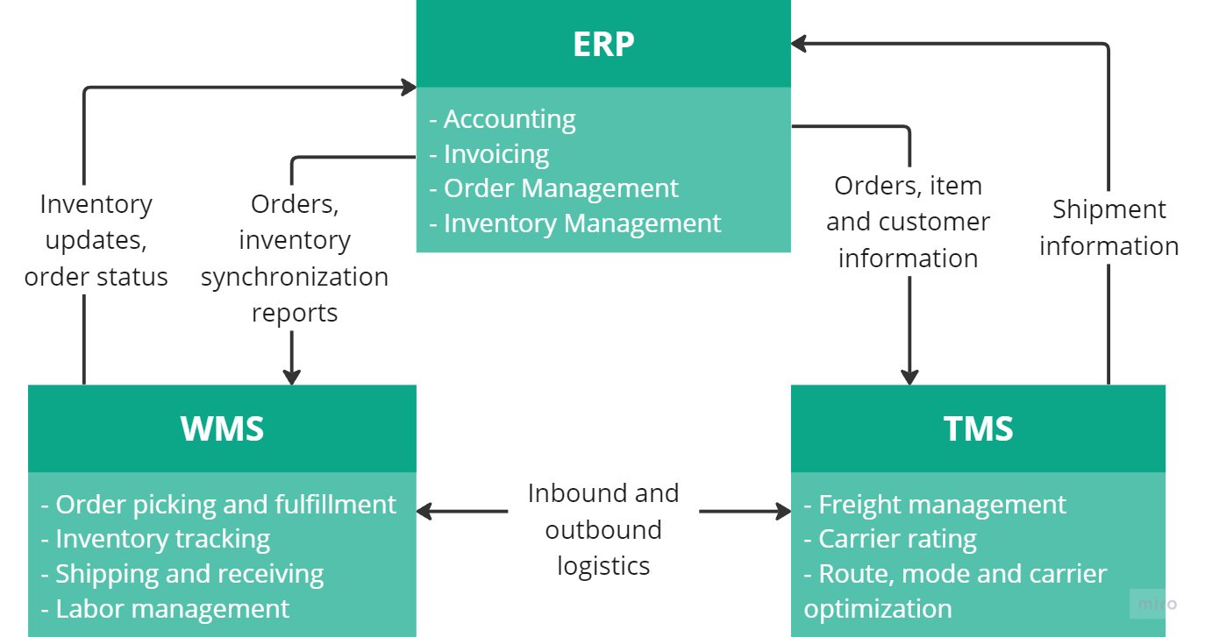
ERP vs. WMS vs. TMS

Slide 23
Summary
The integration of technology and management systems plays an important role in improving efficiency, accuracy and strategic decision making
Three essential systems for streamlining business operations in logistics are Enterprise Resource Planning (ERP) systems, Warehouse Management Systems (WMS) and Transportation Management Systems (TMS)
ERP systems form the backbone of a company, integrating various departments (such as accounting, procurement, sales, production etc.) and processes into a unified system
WMS focuses on optimizing warehouse operations, ensuring effective inventory management and storage optimization
TMS is dedicated to the planning, execution and optimization of the transport of goods

Slide 24
Thank you for your attention

