Slide 1




STATISTICAL METHODS FOR ANALYSING LOGISTICS DATA
Simulation modeling and analysis
Slides
BAS4SC
Business Analytics Skills
for the Future-proofs Supply Chains
Project number – 2022-1-PL01-KA220-HED-000088856

Slide 2
Agenda
Simulation in logistics
Discrete event simulation
System dynamics
Agent-based simulation
Network simulation
Logistics simulation projects

Slide 3
Simulation in logistics
Simulation Modeling and Analysis (SMA) can provide valuable inputs to Supply Chain (SC) and traffic network (TN) optimization.
Simulation modelling can be used to graphically visualize temporal flows through complex SC and TN processes and resources, allowing the prediction and quantification of possible outcomes from different scenarios.
This helps SC and TN entities to gain valuable insights and understand the effects of their potential decisions on SC and TN performance including SC lead-times, TN travel times and costs.
Hence, SMA in SC and TN modelling can contribute to SC and TN analysis and to the improvement of their design toward achieving higher performance and sustainability.

Slide 4
SMA entities
From SMA perspective, one can observe a SC or TN on two levels:
Macro level
  self-organization,
  co-evolution of entities,
  dependency on connections/transport routes.
Micro level
  multiple and heterogeneous entities,
  local interactions among entities,
  structured entities,
  adaptive entities.
Source: (Gumzej & Rakovska, 2020)

Slide 5
Discrete event simulation (DES)
Process-oriented;
Focuses on detailed process modelling;
Heterogeneous entities;
Micro-entities are passive objects;
Events introduce dynamics into the system;
Discrete time-progression;
Flexibility is achieved by changing the structure of the model;
System structure during simulation is fixed.
Source: (Gumzej & Rakovska, 2020)

Slide 6
DES Constructs
Flow units represent simulation units (e.g., orders, materials, etc.) which enter the system on the input(s) and progress through the system model.
Processors represent mobile (e.g., people, forklifts, etc.) and fixed (e.g., machines, production lines, etc.) resources which process the simulation units.
Queues store the flow units until their transition to the next available processor.
Connectors define the promotion of units through the system model.

Slide 7
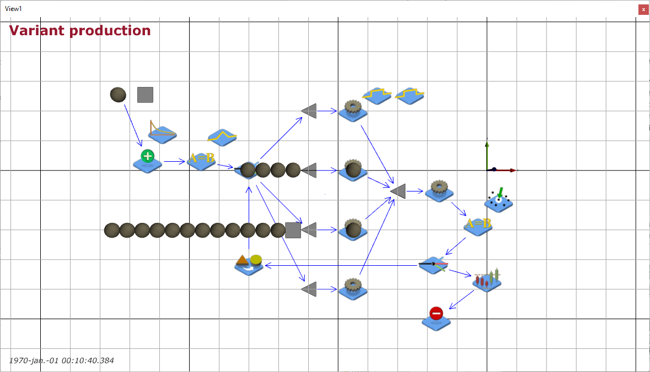
DES in production example
products
production lines
start
quality control
finish
Source: screenshot from JaamSim (Jaamsim, 2023)

Slide 8
Discrete event simulation
The following process parameters can be analysed and optimized by DES:
  Production cycle-time and performance;
  Utilization of production cells and spaces;
  Capacity of storage spaces as well as storage unit's dwell-times;
  Utilization of mobile resources (e.g., operators, conveyors, forklifts).
DES analysis offers the production manager the most detailed insight into a logistic (production) process by a consistent and coherent model.
Source: (Gumzej & Rakovska, 2020)

Slide 9
System dynamics (SD)
System-centred;
Key performance-indicators’ oriented modelling of system variables;
Homogeneous entities;
Entities on micro-level are disregarded;
Dynamics is introduced by feedback loop coupling;
Continuous time-progression;
Flexibility is achieved by changing the structure of the model;
System structure during simulation is fixed.
Source: (Gumzej & Rakovska, 2020)

Slide 10
SD Constructs
Stocks represent buffers which can store delivery items on the supply chain.
Flows represent supply channels.
Feedback loops represent fine-tuning parameters for stock replenishment.

Slide 11
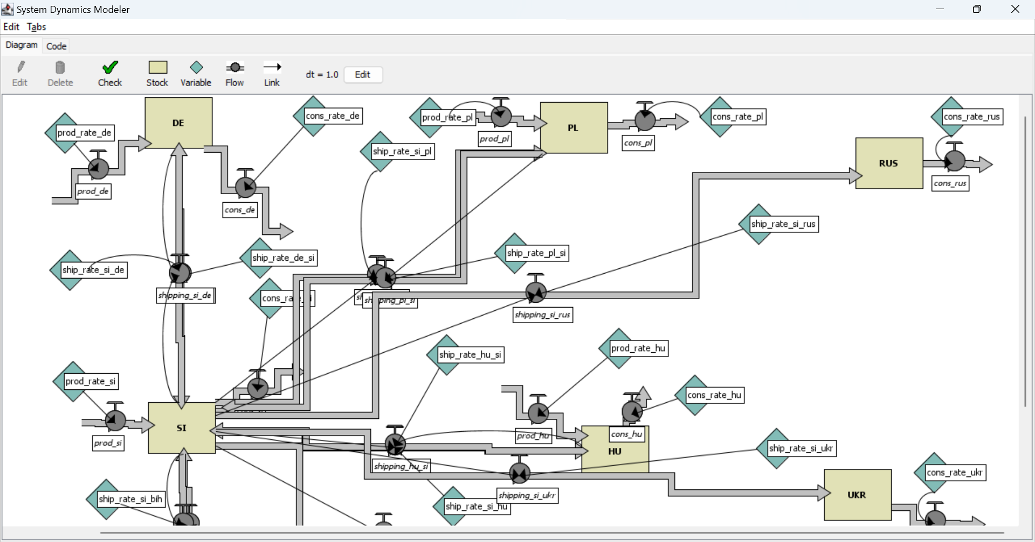
SD in SC example
production site
distribution channels
Source: screenshot from NetLogo (Wilenski, 1999)

Slide 12
System dynamics
Systems dynamics simulation allows for:
  Planning the layout of a SC;
  Optimization of production and distribution capacities;
  Estimation of distribution channels’ loads and associated costs.
SD is best suited to determine the structure as well as optimal volumes of SC node’s inputs, stocks, and outputs.
Source: (Gumzej & Rakovska, 2020)

Slide 13
Agent-based simulation (ABS)
Entity-centred;
Problem-oriented modelling of entities and their interactions;
Heterogeneity of entities;
Micro-entities are active objects that act in their environments, communicate among each other and autonomously make decisions;
Decisions and interactions between agents introduce dynamics into systems;
Agents and their environments constitute formal models;
Time flow is discrete and universal on model-level;
Model flexibility is achieved by changing the system structure and behaviour of agents;
System structure during simulation is variable.
Source: (Gumzej & Rakovska, 2020)

Slide 14
ABS Constructs
Agents representing supply chain nodes (e.g., suppliers, retailers and inspectors) with their properties, relations and behaviour.

Slide 15
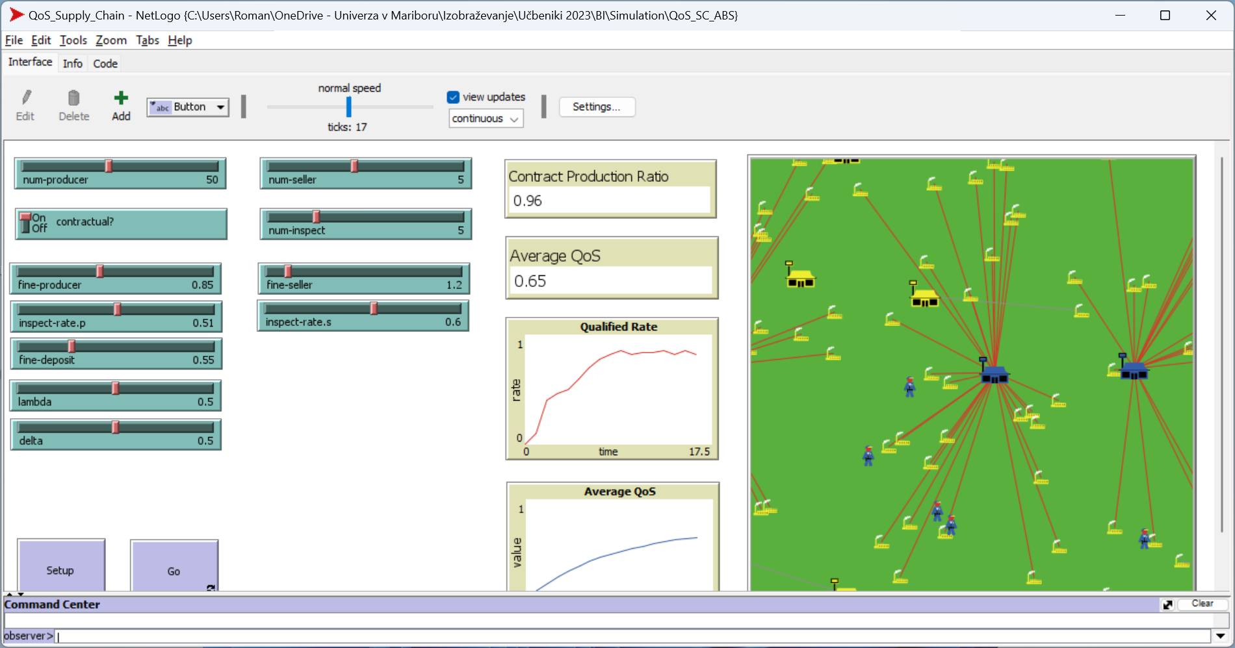
ABS SC example
Source: screenshot from NetLogo (Wilenski, 1999)

Slide 16
Agent-based simulation
Agent-based simulation allows for:
  Planning the layout of an SC;
  Modelling the dynamic growth of an SC;
  Modelling the behaviour of partners within SCs;
  Optimization of global indicators.
ABS analysis offers a strategic manager’s or market regulator’s view of the marketplace.
Source: (Gumzej & Rakovska, 2020)

Slide 17
NS Constructs
Agents representing the flow objects with their properties, relations and behaviour.
Network representing the overlay network (e.g., traffic network) on which the flow objects commute.

Slide 18
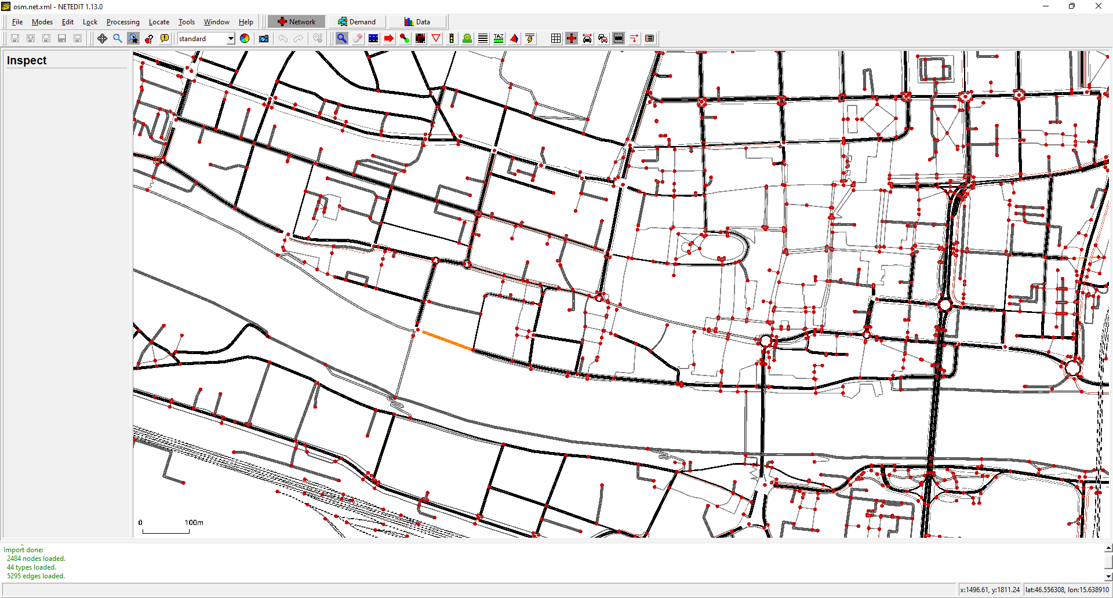
NS TN example
blockage
Source: screenshot from SUMO (Pablo et. Al., 2018)

Slide 19
Network simulation
Network simulation allows for:
  Planning the layout of a network;
  Modelling the dynamic behaviour of a network to determine bottlenecks and weak links;
  Modelling the flow of network items;
  Optimization of global network indicators.
NS analysis offers a network regulator’s view of the network.
Source: (Šinko and Gumzej, 2021)

Slide 20
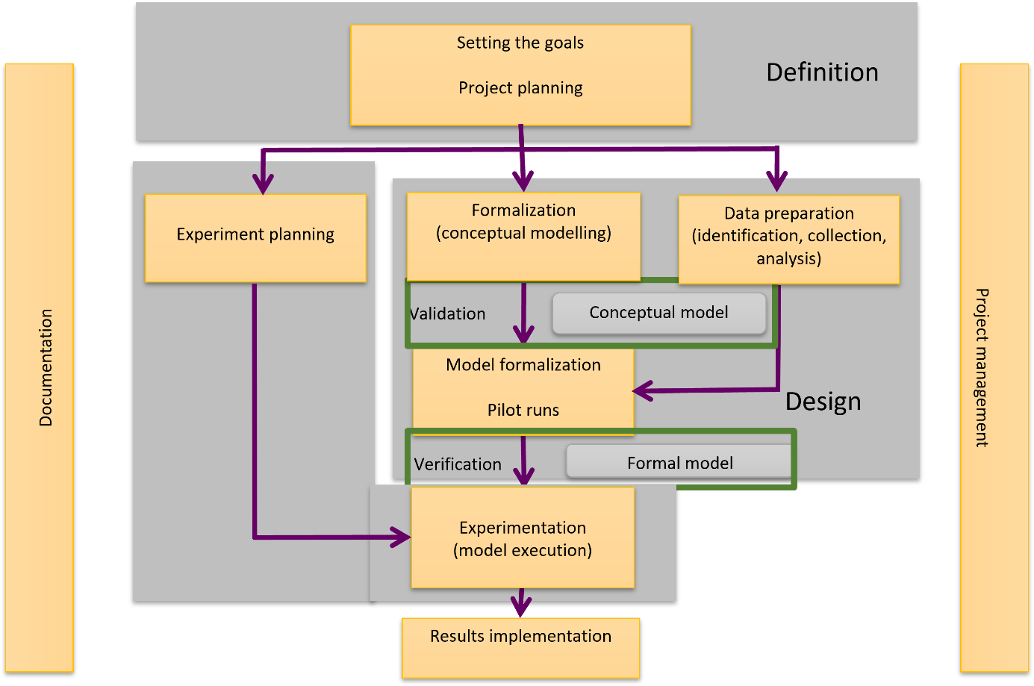
Overview of simulation projects

Slide 21
Simulation system
A model of the real world (good regulator).
A decision support system (DSS).
A laboratory (controlled environment).

Slide 22
Experiments, scenarios and replicas
Experiment
Scenario1
Scenario2
Scenario3
Replica1
Replica2
Replica3
Replica1
Replica2
Replica3
Replica1
Replica2
Replica3
Replica4
Replica4
Replica4

Slide 23
Simulation results
Each experiment needs to be carefully planned; it consists of scenarios and their replicas.
An experiment usually encompasses multiple scenarios being differentiated by the values of input variables, numbers of units in the system and/or temporal frames.
Each scenario is run multiple times - these replicas produce results, based on unique values of input variables, numbers of units in the system and duration.
The results of simulation runs (KPIs) need to be checked by sensitivity analysis, considering their standard deviation, minimum and maximum values, and joined (usually on median values).

Slide 24
Summary
A holistic approach of applying SMA in logistics contributes greatly to complex process design decisions, where there are many variables interacting with each other.
This approach includes SD, DES and ABS methodologies which can quantify the workflows on different supply chain levels.
In traffic flow analysis and optimization, the NS methodology provides for the necessary framework, regarding the monitoring and fine-tuning of key performance indicators (KPI).

Slide 25
References
Gumzej, R. and Rakovska, M. (2020). Simulation modeling and analysis for sustainable supply chains. In Ecoproduction – Sustainable logistics and production in industry 4.0 : new opportunities and challenges, Grzybowska, K., Awasthi, A., Sawhney, R. (ed.). Springer Nature, pp. 145-160.
JaamSim Development Team (2023). JaamSim: Discrete-Event Simulation Software. Version 2023-08. [Available at: https://jaamsim.com, access November 8th, 2023]
Šinko, S. and Gumzej, R. (2021). Towards smart traffic planning by traffic simulation on microscopic level. International journal of applied logistics, 11(1), pp. 1-17.
Wilensky, U. (1999). NetLogo. Center for Connected Learning and Computer-Based Modeling, Northwestern University, Evanston, IL. [Available at: http://ccl.northwestern.edu/netlogo/, access November 8th, 2023]
Pablo A.L., Behrisch, M., Bieker-Walz, L., Erdmann, J., Flötteröd, Y.-P., Hilbrich, R., Lücken, L., Rummel, J., Wagner, P. and Wießner, E. (2018). Microscopic Traffic Simulation using SUMO. In: 2019 IEEE Intelligent Transportation Systems Conference (ITSC), IEEE. The 21st IEEE International Conference on Intelligent Transportation Systems, 4.-7. Nov. 2018, Maui, USA, pp. 2575-2582.

Slide 26
Thank you for your attention

