Slide 1




Chapter 6
Introduction to Operations Research
Slides
BAS4SC
Business Analytics Skills
for the Future-proofs Supply Chains
Project number – 2022-1-PL01-KA220-HED-000088856

Slide 2
Agenda
Strategic logistics planning
Business intelligence
Decision support systems
Knowledge based engineering

Slide 3
Strategic logistics planning
Strategic logistics planning comprises all activities which need to be performed on the strategic, tactical and operational levels to provide for:
  Total quality management (TQM) and
  Just-in-time production (JIT).
Operations research methods are used in strategic logistics planning to
  enable complex what-if analysis,
  manage complexity: interdependence + variability + dynamics,
  involve less costs and interference with the process than by experimentation with a real system,
  focus on details,
  improve the understanding of a system and
  improve communication between management and experts.
Source: (Ciampa, 1992), (Britannica, 2023), (Robinson, 2004)

Slide 4
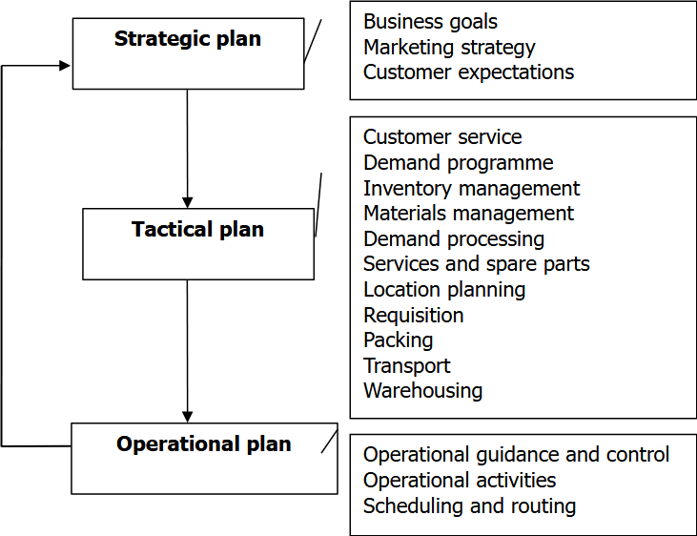
Strategic logistics planning
Source: (Ciampa, 1992)

Slide 5
SCOR
The SCOR reference model (planning, sourcing, making, delivering, enabling, as well as handling returns) helps businesses evaluate and perfect supply chain management for reliability, consistency, and efficiency – (lean) 6-sigma.
Six Sigma business improvement projects follow two distinct methodologies, each with five phases:
  DMAIC (define, measure, analyze, identify and control) is used for projects aimed at improving an existing business process;
  DMADV (define, measure, analyze, design and verify) is used for projects aimed at creating new product or process designs.
The DMADV methodology is also known as Design for Six Sigma (DFSS).
Source: (AIMS, 2021), (Tennant, 2001)

Slide 6
Design for Six Sigma (DFSS)
The Design for Six Sigma (DFSS) phases are:
Define design goals that are consistent with customer demands and the enterprise strategy;
Measure and identify characteristics that are Critical to Quality (CTQ), measure product capabilities, production process capacity, and measure risks;
Analyze to develop and design alternatives;
Design an improved alternative, best suited per analysis in the previous step;
Verify the design, set up pilot runs, implement the production process and hand it over to the process owner(s).
Source: (Chowdhury, 2002)

Slide 7
Business intelligence
Business intelligence (BI) comprises all strategies and technologies used by enterprises for the data analysis of past and current business information.
Business analytics (BA) is a process based on BI, enabling new insights into the business process and better strategic decision making for the future; it builds on Data Mining (DM), being the process of finding anomalies, patterns, and correlations in larger data sets, to predict the results.
Example: Sales and operations planning (SOP) is a flexible tool based on BI to forecast and plan production activities; it comprises sales, production and capacity planning.
Source: (Tableau, 2023)

Slide 8
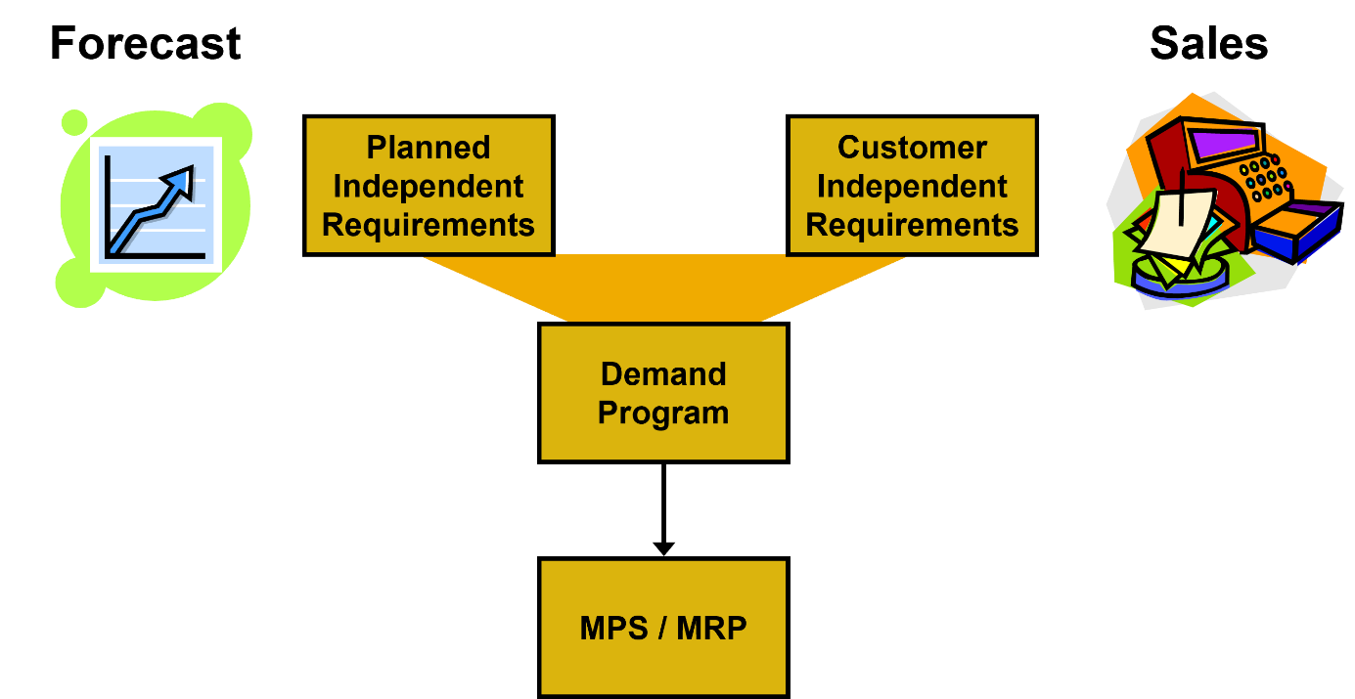
SOP (1/2)
Institutional knowledge

Slide 9
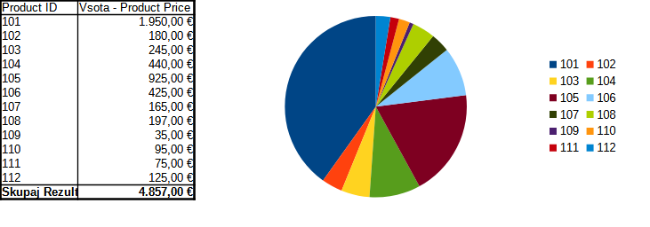
SOP (2/2)
Institutional knowledge
Source: dataset DM (2024) from Chapter 3

Slide 10
Business analytics
Data Aggregation: prior to analysis, data must first be gathered, organized, and filtered, either through volunteered data or transactional records;
Data Mining: data mining sorts through large datasets using databases, statistics, and machine learning to identify trends and establish relationships;
Association and Sequence Identification: the identification of predictable actions that are performed in association with other actions or sequentially;
Text Mining: explores and organizes large, unstructured text datasets for the purpose of qualitative and quantitative analysis;
Forecasting: analyses historical data from a specific period in order to make informed estimates that are predictive in determining future events or behaviors;
Predictive Analytics: predictive business analytics uses a variety of statistical techniques to create predictive models, which extract information from datasets, identify patterns and provide a predictive score for an array of organizational outcomes;
Optimization: once trends have been identified and predictions have been made, businesses can engage simulation techniques to test out best-case scenarios;
Data Visualization: provides visual representations such as charts and graphs for easy and quick data analysis.

Slide 11
Decision support systems
Decision support systems (DSS) are interactive systems which assist decision makers in their use of the data and models for solving unstructured or partly structured problems.
Expert System (ES) is an application program or environment, which effectively supports problem solving in a specialized problem area, requiring expert knowledge and skills.
In addition to statistical and simulation methods, used in BA, DSS often include models that enable decision making, based on a set of distinctive criteria, weighs, utility function and variant data.
Example: Multicriteria decision making (MCDM) evaluates multiple (possibly) conflicting criteria in decision making over a set of candidate solutions or variants.

Slide 12
Multicriteria Decision Making
A MCDM decision model is composed of:
  Criteria – the parameters of input variants, critical for our design;
  Weighs – the relative importance of selected criteria;
  Utility function – the function that combines the weighted parameters of variants into a fitness value;
  Data – the data representing the variants; input data to our MCDM model.

Slide 13
MCDM procedure
Representation of variants (V) by their characteristic parameters (P): {V_{i} (P_{i,1}; P_{i,2}; … P_{i,n}); i=1...m};
Normalization of parameters by calculating the relative local grade p_{i,j} for each P_{i,j} (j=1...n), with reference to the j^{th} parameter maximum P_{i,j} value from all i samples:
  p_{i,j}=P_{i,j}/max {P_{i,j}} if a greater value of P_{i,j} is more beneficial;
  p_{i,j}=1 - P_{i,j}/max {P_{i,j}} if a smaller value of Pi,j is more beneficial;
The grades are weighted according to preferences: x_{i,j}=p_{i,j}*U_{j} for each j=1...n, by weighs U_{j} which need to sum-up to 1, i.e. 100%;
The weighted grades of all variants are summed up: X_{i}=∑ x_{i,j} for each i=1...m to obtain composite grades according to our utility function;
The best variant is chosen Y=max {X_{i}}.

Slide 14
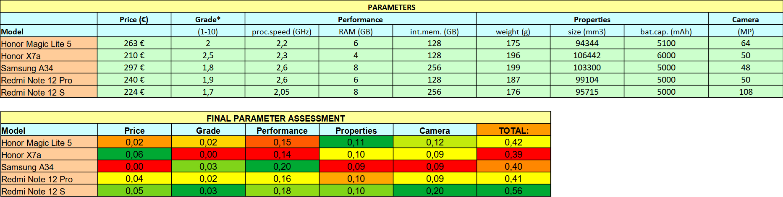
MCDM example (1/2)

Slide 15
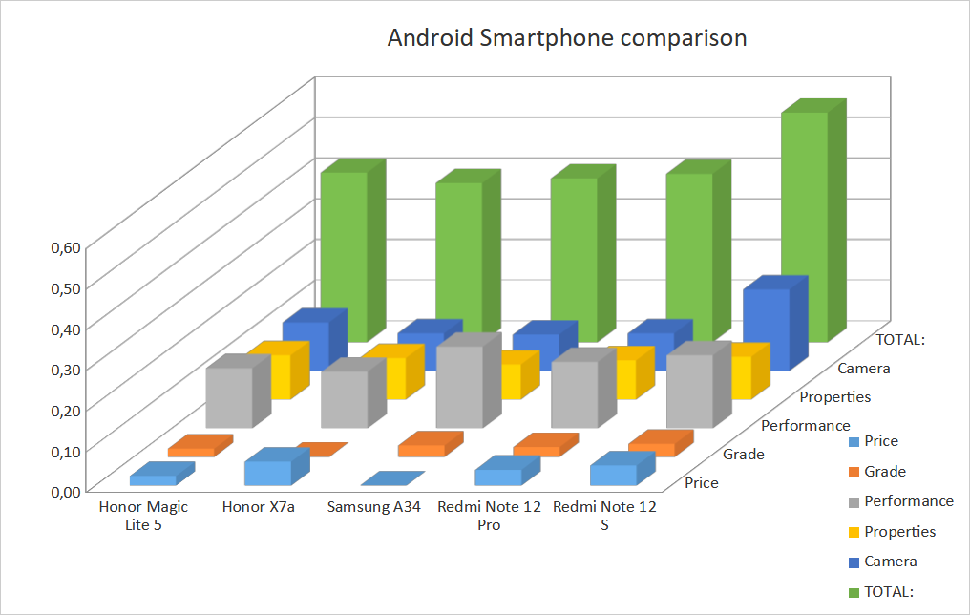
MCDM example (2/2)

Slide 16
Knowledge based engineering (KBE)
Knowledge Based Engineering (KBE) is an engineering methodology to integrate engineering knowledge systematically into the design system.
Lifecycle of knowledge management:
  Identify: a non-conformance with the desired state that appears in the manufacturing process due to an ill-defined product or process is selected;
  Capture: the experience with its properties is captured;
  Analyze: a root cause analysis of the captured experience is made to identify an appropriate remedy strategy and its re-use to prevent recurring anomalies;
  Store: insights from the analysis are archived with the experience;
  Search & Retrieve: the experience is searched for and retrieved;
  Use: an element of the experience is used;
  Reuse: concludes the cycle of knowledge management and starts a new one.
DFSS is consistent with KBE.
Source: (Andersson & Larsson & Ola, 2011)

Slide 17
Summary
Applications of OR are found in Knowledge Management Systems (KMS), comprising:
  Decision support systems (DSS),
  Business analytics (BA) as an upgrade to Data Mining (DM) and
  Knowledge-based Engineering (KBE) as an upgrade to Computer-aided Engineering (CAE).

Slide 18
References
AIMS (2021). SCOR - Supply Chain Operations Model. [available at: https://aims.education/study-online/supply-chain-operations-reference-model-scor/, access June 20, 2023]
Ciampa, D. (1992). Total Quality: A User's Guide for Implementation, Addison-Wesley.
Britannica, T. Editors of Encyclopaedia (2023). Just-in-time manufacturing, Encyclopedia Britannica. [available at: https://www.britannica.com/topic/just-in-time-manufacturing, access June 20, 2023]
Chowdhury, S. (2002). Design for Six Sigma: The revolutionary process for achieving extraordinary profits, Prentice Hall,
Tableau (2023). Comparing Business Intelligence, Business Analytics and Data Analytics. [Available from: https://www.tableau.com/learn/articles/business-intelligence/bi-business-analytics, access June 20, 2023]
Tennant, G. (2001). SIX SIGMA: SPC and TQM in Manufacturing and Services, Gower Publishing, Ltd.
Robinson, S. (2004). Simulation: The Practice of Model Development and Use, Wiley.
Andersson, P. & Larsson, T. & Ola, I. (2011). A case study of how knowledge based engineering tools support experience re-use. In Research into Design – Supporting Sustainable Product Development, Chakrabarti, A. (Edt.), Research Publishing, Indian Institute of Science, Bangalore, India.

Slide 19
Thank you for your attention

