Slide 1




Business Intelligence
ARTIFICIAL INTELLIGENCE AND MACHINE LEARNING IN SUPPLY CHAINS
Lecture
BAS4SC
Business Analytics Skills
for the Future-proofs Supply Chains
Project number – 2022-1-PL01-KA220-HED-000088856

Slide 2
Agenda
What is artificial intelligence (AI)? Is it really an “alive” creature capable of thinking and making its own decisions based on one its mind, past experiences, ethics, beliefs, etc? How is it connected to machine learning (ML)? Are AI and ML the same thing?
What tools are used in AI & ML? What role do AI and ML play in the business context and how can it be used in everyday business operations and optimizations? Are there specific architectures and examples of applying AI and ML to supply chains?

Slide 3
What is artificial intelligence?
AI began in the 1950s with the goal of teaching computers to think like humans. Researchers developed various algorithms, leading to the definition of AI as the effort to automate intellectual tasks typically performed by humans (Chollet, 2021). Today, machine learning (ML) and deep learning are the most prominent subsets of AI, but early AI was dominated by non-learning algorithms.
This early phase, known as Symbolic AI, focused on programming computers with explicit rules to solve problems. Symbolic AI was effective for logical, well-defined tasks like playing chess but struggled with complex real-world problems. The approach relied on "if-then" rules, which were easy to understand but difficult to apply to all possible scenarios.
Symbolic AI peaked in the 1980s with expert systems (ES), a subset of decision support systems (DSS). These systems mimicked human reasoning to solve complex problems, offering computerized decision-making similar to that of a human expert. Expert systems were widely applied and commercially successful, capturing expert knowledge to aid or even replace human decision-makers.

Slide 4
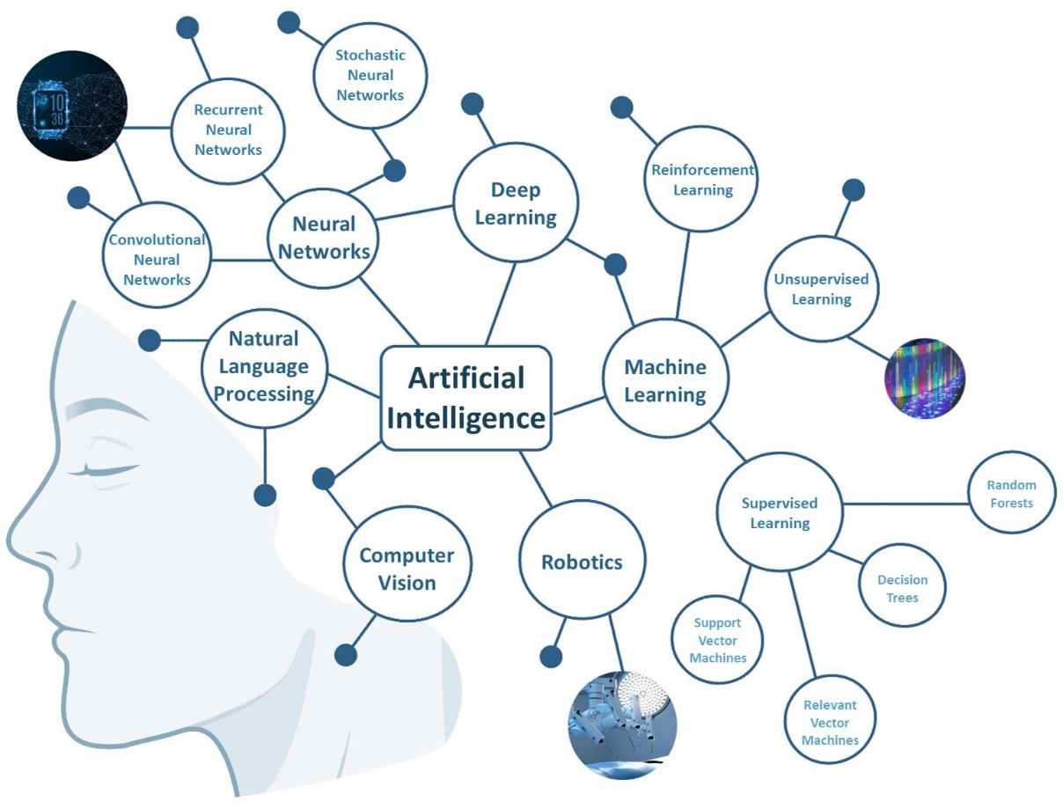
What is artificial intelligence?
Figure. The main fields and subfields of AI

Slide 5
What is the ecosystem of AI & МL?
The ecosystem of AI & ML algorithms consists of three key pillars:
Input data;
Output data;
Cost function.
Input data is essential for building accurate ML algorithms, requiring careful collection, cleaning, and encoding to reveal hidden patterns effectively. Often, too much focus is placed on developing algorithms rather than ensuring high-quality input data.
Output data reflects the results of ML models, such as class labels in classification or predicted values in regression. The cost function measures how well the model's predictions match the actual output, guiding the optimization of the model's performance.
The cost function represents the way of measuring how the AI & ML is performing. Basically, we would ideally want answers from the algorithms to match the output data, for a given input data. The cost function is also a feedback signal to the set of parameters that guide the algorithm's work, i.e., it allows the optimization of overall algorithm performance via the process of learning (finding the optimal set of parameters).

Slide 6
What is machine learning?
Machine learning is a subset of artificial intelligence (AI) that involves the development of algorithms and statistical models that enable computers to perform tasks without being explicitly programmed for those tasks. The primary goal of machine learning is to enable computers to learn from data and improve their performance over time without human intervention.
ML arises from this question: could a computer go beyond "what we know how to order it to perform" and learn on its own how to perform a specified task? Could a computer surprise us? Rather than programmers crafting data-processing rules by hand, could a computer automatically learn these rules by looking at data?

Slide 7
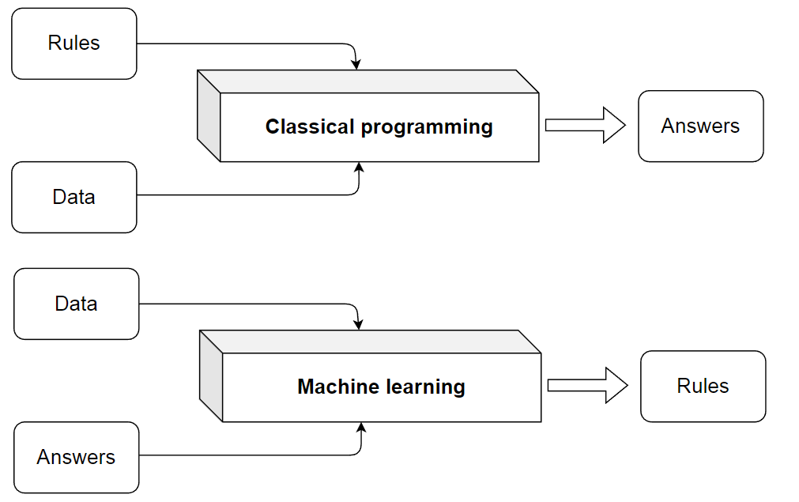
What is machine learning?
Figure. The classical programing vs. machine learning system training (Chollet, 2021).

Slide 8
Foundations and theoretical assumptions of ML
Machine learning's integration into business intelligence (BI) has transformed decision-making.
ML rooted in mathematics, especially statistics.
Ongoing debate: Is ML its field or part of statistics?
ML algorithms often operate beyond traditional mathematical boundaries.
ML vital in BI for data preprocessing, mining, and applying insights.
ML enhances decision-making in organizations.
Integration of ML into BI workflows for actionable insights.
Bridging mathematics and practice in ML for effective BI.
Strategies for optimizing ML algorithms for real-world BI applications.
Importance of using ML outputs in decision-making.

Slide 9
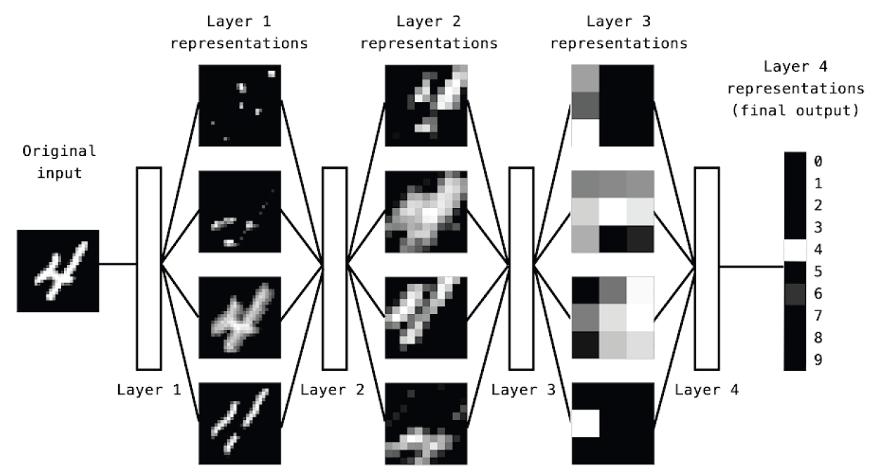
Architecture of ML Neural Network algorithm
Figure. Digit classifaction (Chollet, 2021).

Slide 10
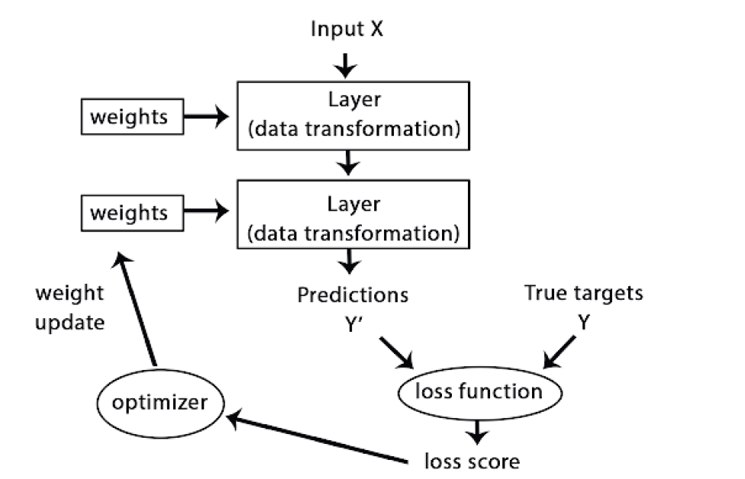
ML Neural Network algorithm
Figure. Updating loop (Chollet, 2021).

Slide 11
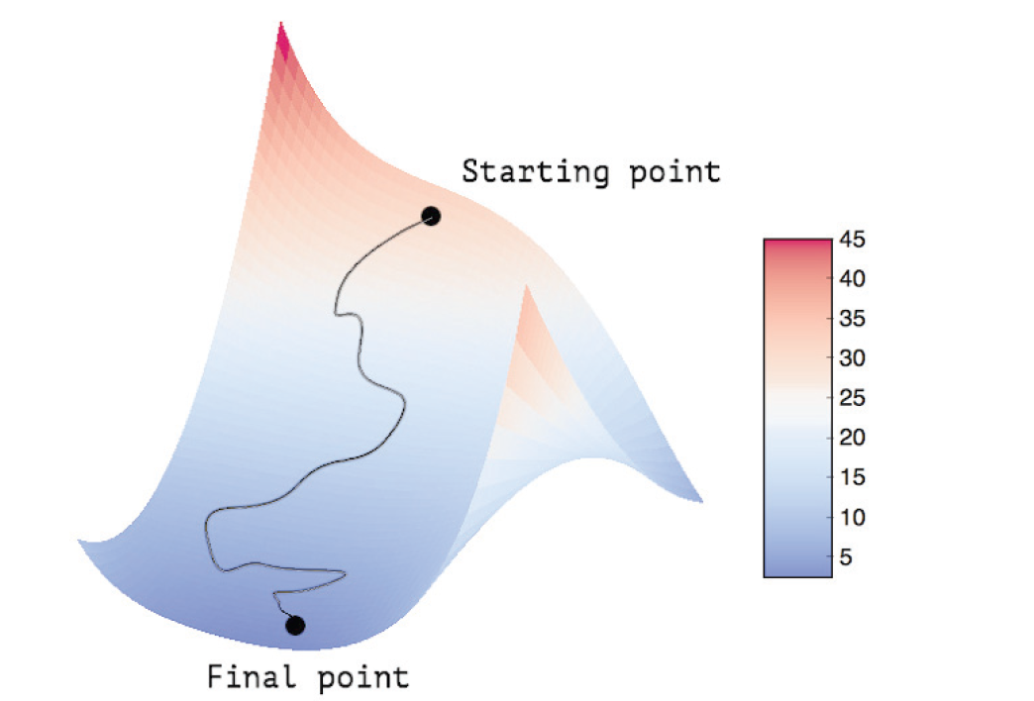
ML Neural Network gradient decent
Figure. Gradient decent (Chollet, 2021).

Slide 12
Case study
In the central warehouse of a food factory, AI and ML technologies optimize the use of 30 forklifts, essential for logistics tasks across production, warehousing, and dispatching (Mirčetić et al., 2016; Mircetic et al., 2014). The warehouse, with a capacity of 11,100 pallet places and an annual output of 300,000 to 350,000 pallets, services about 20,000 supermarkets.
The current decision-making process for forklift allocation relies on managerial expertise, which can be flawed under stress (Druzdzel & Flynn, 2002). This situation underscores the need for a decision-support system (DSS) to enhance decision-making.
A decision-making framework using ML algorithms has been developed as a DSS to assist managers. This AI platform continuously recalculates and suggests optimal forklift allocations based on real-time data and operator inputs.
Effective forklift management is critical to avoid disruptions, ensure timely task completion, and coordinate maintenance schedules. Misallocation can lead to resource underutilization, service level issues, and penalties for delays.
The DSS helps manage these factors by providing accurate recommendations, thereby improving decision-making confidence and operational efficiency.

Slide 13
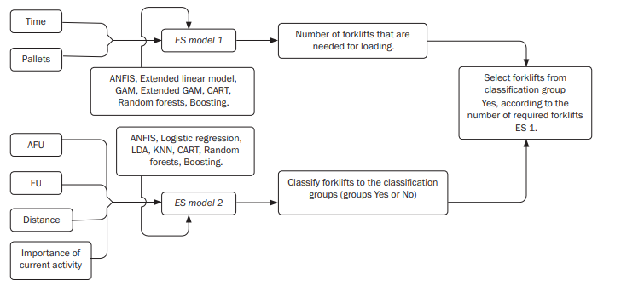
Case study
Figure. Building structure of warehouse DSS based on the AI & ML algorithms.

Slide 14
Case study
Problem Context:
Process involved: Searching through warehouse records and decision-making on forklift deployment.
Record-keeping challenges necessitate an Expert System (ES) for better management.
Knowledge Base Development:
Two separate knowledge bases were formed:
  Base 1: Decisions on the number of forklifts engaged in the loading zone (434 expert decisions).
  Base 2: Decisions on which forklifts were engaged (368 expert decisions).
Machine Learning for Knowledge Inferencing:
Applied techniques include:
  Extended Linear Regression
  Logistic Regression
  k-Nearest Neighbors (KNN)
  Linear Discriminant Analysis (LDA)
  CART
Software: MATLAB.
Best-performing models: ANFIS and CART, chosen for implementation.

Slide 15
Case study
Input Factors for Decision-making:
Number of forklifts deployment:
  Input variables:
    Loading time: Range from 15 to 135 minutes.
    Cargo amount: Range from 15 to 225 pallets.
Forklift selection:
  Considered factors:
    Activity importance (scale: 1–9 based on company policy).
    Forklift utilization (percentage of total working hours used).
    Distance from the loading dock.
    Average utilization of all forklifts.
Activity Importance Scale:
9: Assistance in full production activities.
8: Assistance in semi-production activities.
7: Shipment commissioning.
6: Loading/unloading.
5: Product rearrangement in the warehouse.
4: Miscellaneous tasks in the central warehouse.
3: Disposal of returned market products.
2: Tasks in the commercial/raw materials warehouse.
1: Other activities.

Slide 16
Case study
Forklift Constraints:
  Operating hours are capped by scheduled overhauls.
  Usage is prohibited beyond allowable working hours.
ES Deployment:
  Implemented through user-friendly interfaces.
  Models (ANFIS and CART) demonstrated superior knowledge inferencing and transfer properties.
Key Outputs and Insights:
  Models offer optimized forklift deployment strategies for varying operational scenarios.
  Addressed both efficiency and resource longevity in the decision-making process.

Slide 17
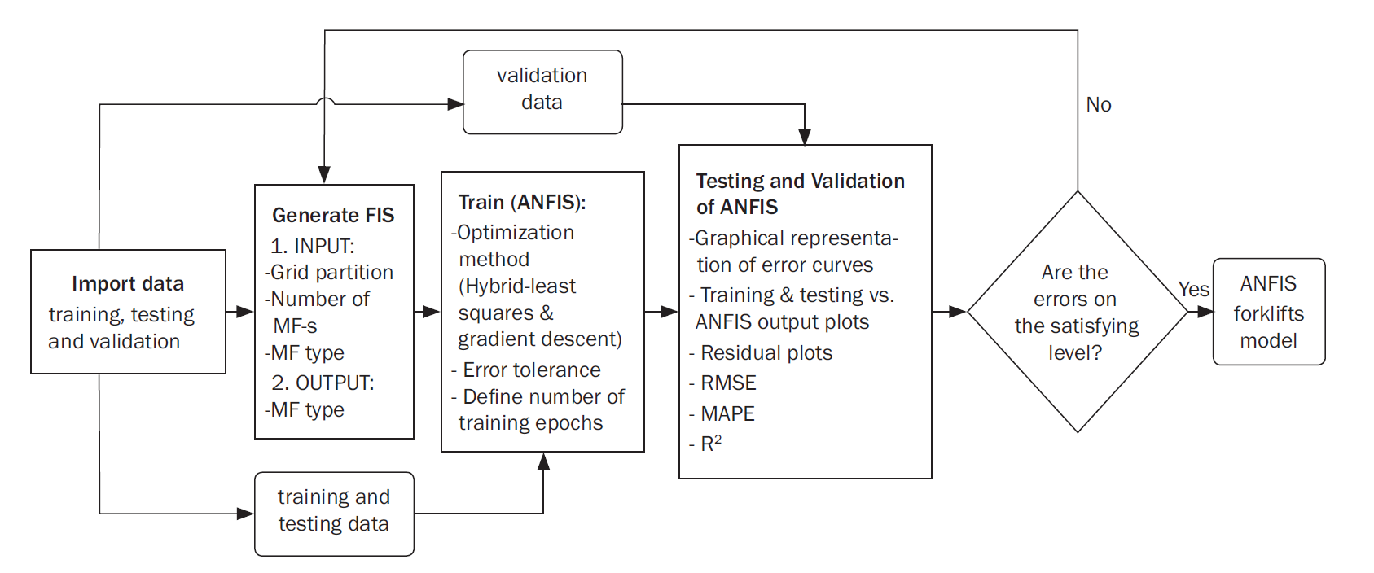
Case study
Figure. Methodology for bulding the ANFIS model.

Slide 18
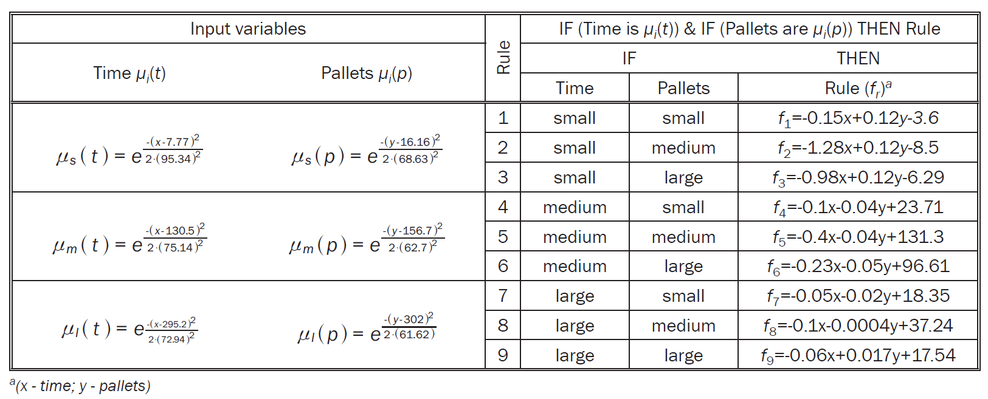
Case study
Table. Fuzzy inference system in ANFIS.

Slide 19
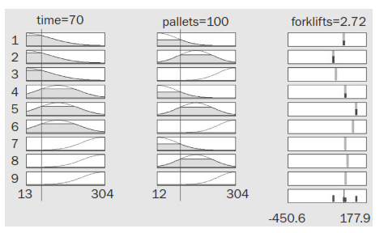
Case study
Figure. ES 1

Slide 20
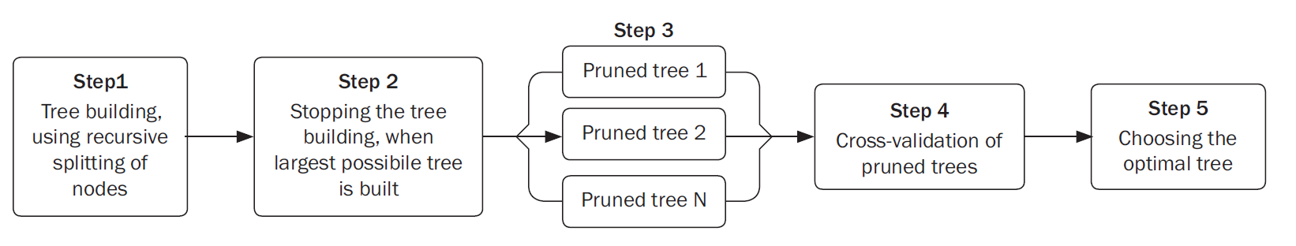
Case study
Figure. Methodology steps for buliding the optimal CART model.

Slide 21
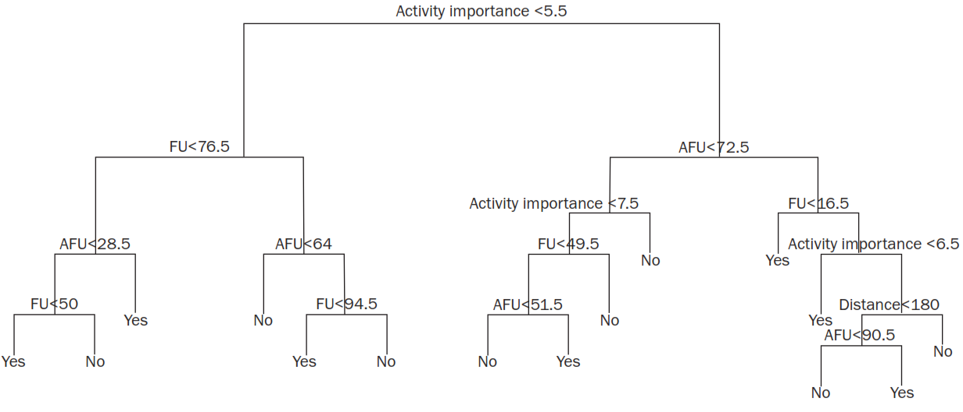
Case study
Figure. ES 2.

Slide 22
Summary
AI & ML Application: Utilized in a food factory's central warehouse to optimize forklift operations.
Warehouse Details: Manages 30 forklifts and handles up to 350,000 pallets annually.
Current Process: Decisions made manually by managers, which can be error-prone under stress.
Solution: Implementation of a decision-support system (DSS) with ML algorithms.
DSS Function: Provides data-driven recommendations for optimal forklift allocation.
Benefits: Enhances efficiency, reduces resource misallocation, and minimizes operational disruptions.

Slide 23
Thank you for your attention

