Slide 1




STATISTICAL METHODS FOR ANALYSING LOGISTICS DATA
Simulation modeling and analysis
Slides to examples
BAS4SC
Business Analytics Skills
for the Future-proofs Supply Chains
Project number – 2022-1-PL01-KA220-HED-000088856

Slide 2
Agenda
Simulation in logistics
Discrete event simulation
System dynamics
Agent-based simulation
Logistics simulation projects

Slide 3
Simulation in logistics
Simulation Modeling and Analysis (SMA) can provide valuable inputs to Supply Chain (SC) and traffic network (TN) optimization.
Simulation modelling can be used to graphically visualize temporal flows through complex SC and TN processes and resources, allowing the prediction and quantification of possible outcomes from different scenarios.
This helps SC and TN entities to gain valuable insights and understand the effects of their potential decisions on SC and TN performance including SC lead-times, TN travel times and costs.
Hence, SMA in SC and TN modelling can contribute to SC and TN analysis and to the improvement of their design toward achieving higher performance and sustainability.

Slide 4
Discrete event simulation (DES)
Four main product types are being produced (10%, 30%, 40%, 20% respectively).
Each product type has a dedicated production line.
After they are finalized, the products are checked for quality at a dedicated test site.
Products of insufficient quality are transported back to the original production line.
After they have successfully passed their quality control, the finished products are transported from the production site to the finished products warehouse.

Slide 5
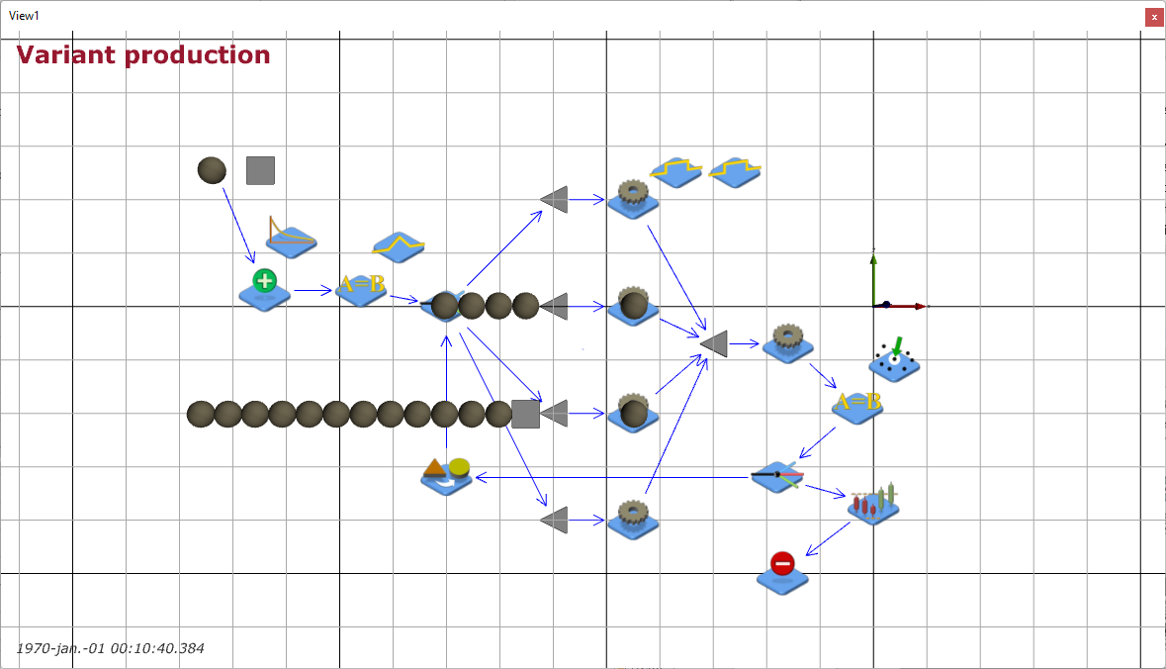
DES in production example
products
production lines
start
quality control
finish
Source: screenshot from JaamSim (Jaamsim, 2023)

Slide 6
Discrete event simulation
The following process parameters can be analysed and optimized by DES:
  Production cycle-time and performance;
  Utilization of production cells and spaces;
  Capacity of storage spaces as well as storage unit's dwell-times;
  Utilization of mobile resources (e.g., operators, conveyors, forklifts).
DES analysis offers the production manager the most detailed insight into a logistic (production) process by a consistent and coherent model.
Source: (Gumzej & Rakovska, 2020)

Slide 7
System dynamics (SD)
A company has multiple production sites: main site in Slovenia (SI) as well as affiliate firms in Germany (DE), Poland (PL), Hungary (H), and Bosnia–Herzegovina (BIH).
In addition to production sites, its gross-sales sites are situated in Russia (RUS), Ukraine (UKR), and Romania (RU).
The production sites supply their own markets with finished products and each other with product components.
The shipping rates are given as parameters of the simulation.

Slide 8
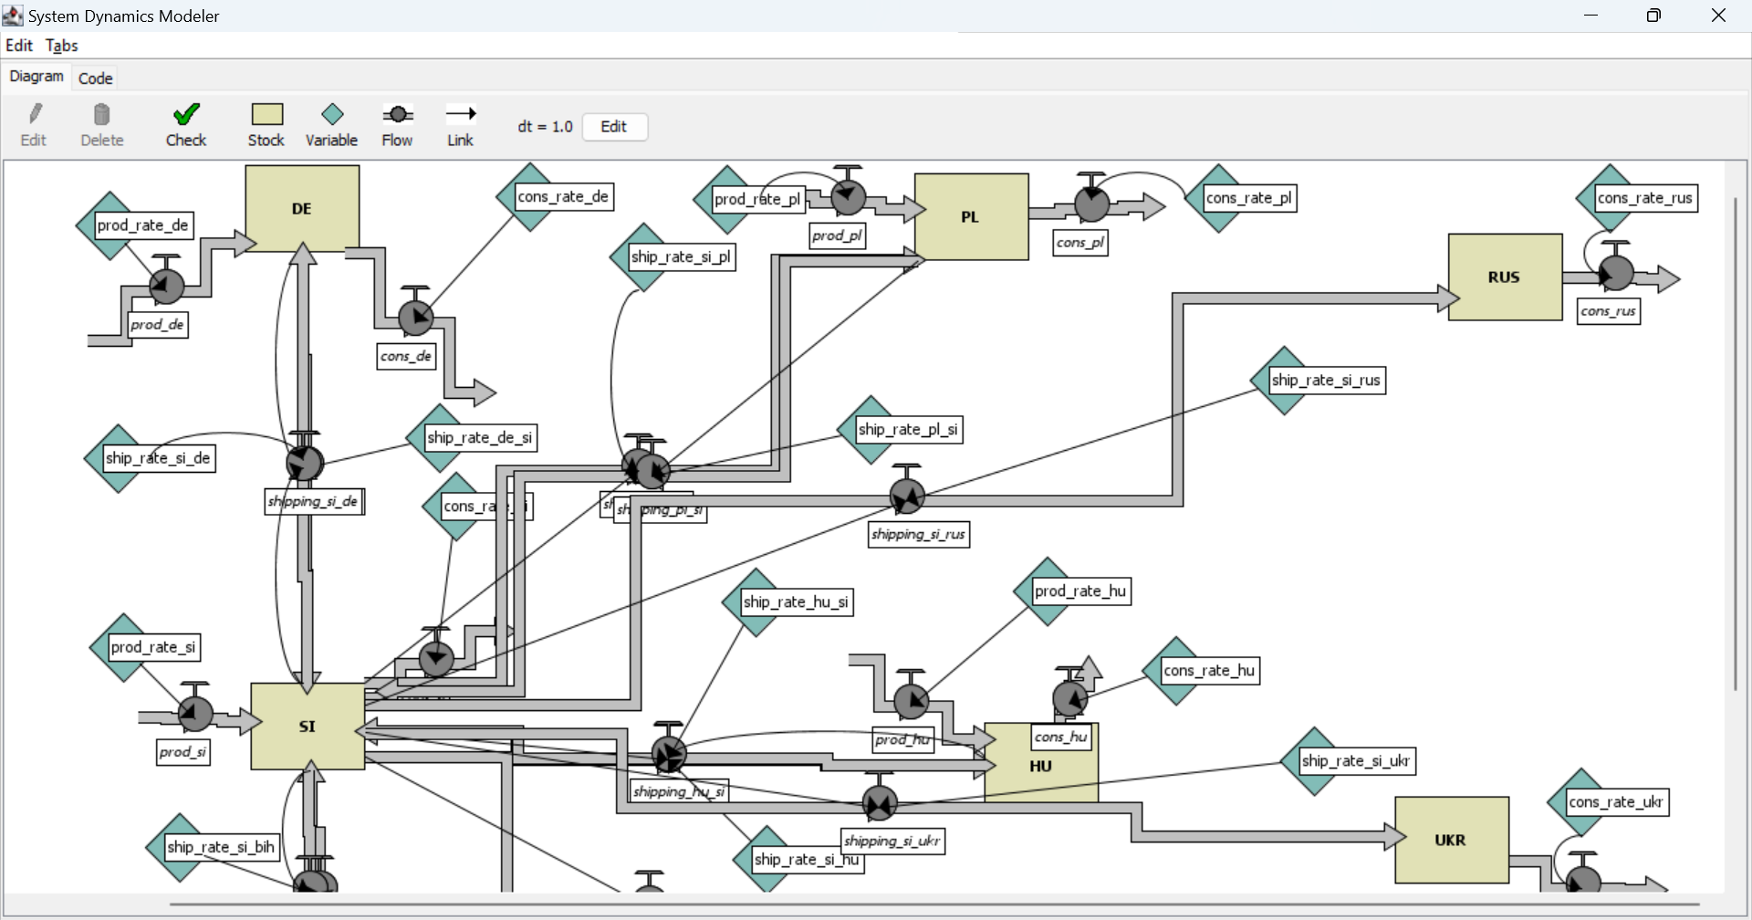
SD in SC example
production site
distribution channels
Source: screenshot from NetLogo (Wilenski, 1999)

Slide 9
System dynamics
Systems dynamics simulation allows for:
  Planning the layout of a SC;
  Optimization of production and distribution capacities;
  Estimation of distribution channels’ loads and associated costs.
SD is best suited to determine the structure as well as optimal volumes of SC node’s inputs, stocks, and outputs.
Source: (Gumzej & Rakovska, 2020)

Slide 10
Agent-based simulation (ABS)
ABS simulation was used to analyse the behaviour SC echelons in an open market with respect to their Quality of Service (QoS).
The different policies concerning the company’s total quality management were investigated by a model, comprising its suppliers, customers and market regulators.
The market practices, policies and numbers of SC nodes are given as parameters of the simulation.

Slide 11
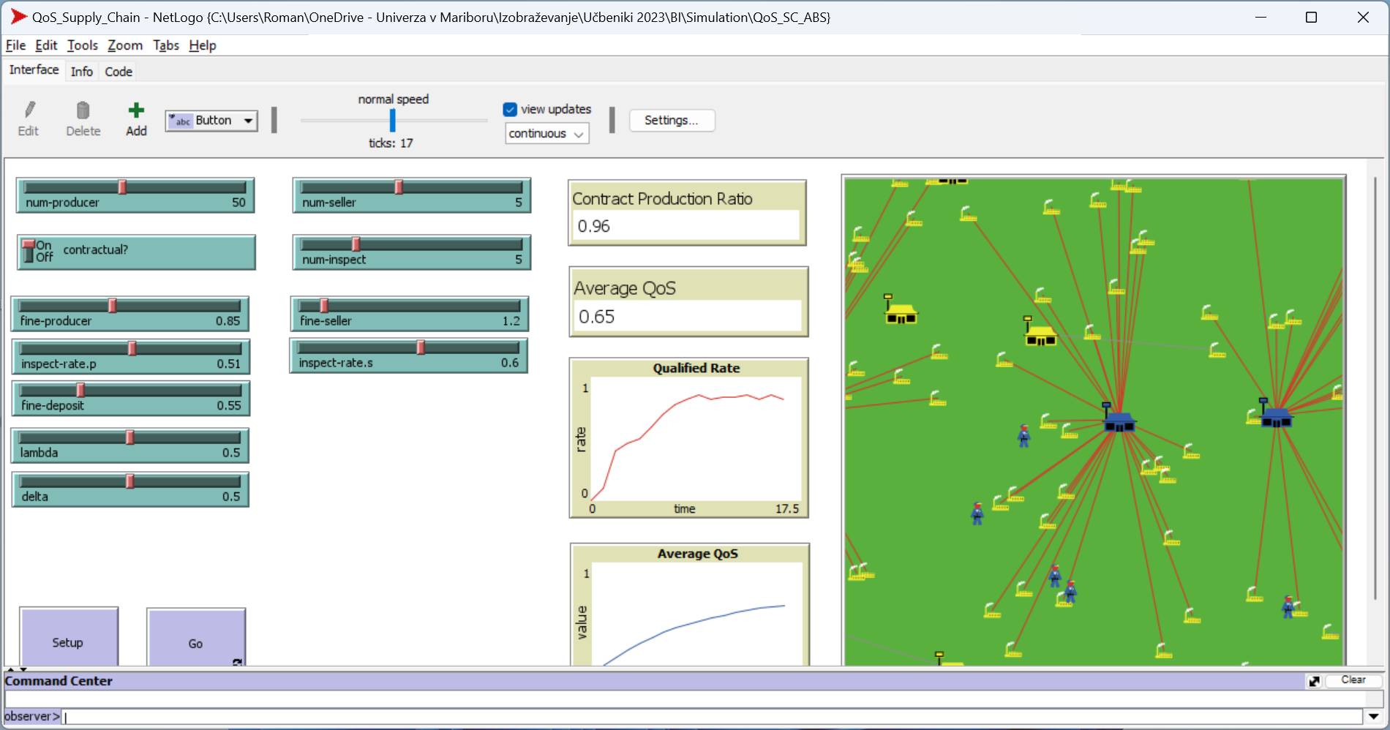
ABS SC example
Source: screenshot from NetLogo (Wilenski, 1999)

Slide 12
Agent-based simulation
Agent-based simulation allows for:
  Planning the layout of an SC;
  Modelling the dynamic growth of an SC;
  Modelling the behaviour of partners within SCs;
  Optimization of global indicators.
ABS analysis offers a strategic manager’s or market regulator’s view of the marketplace.
Source: (Gumzej & Rakovska, 2020)

Slide 13
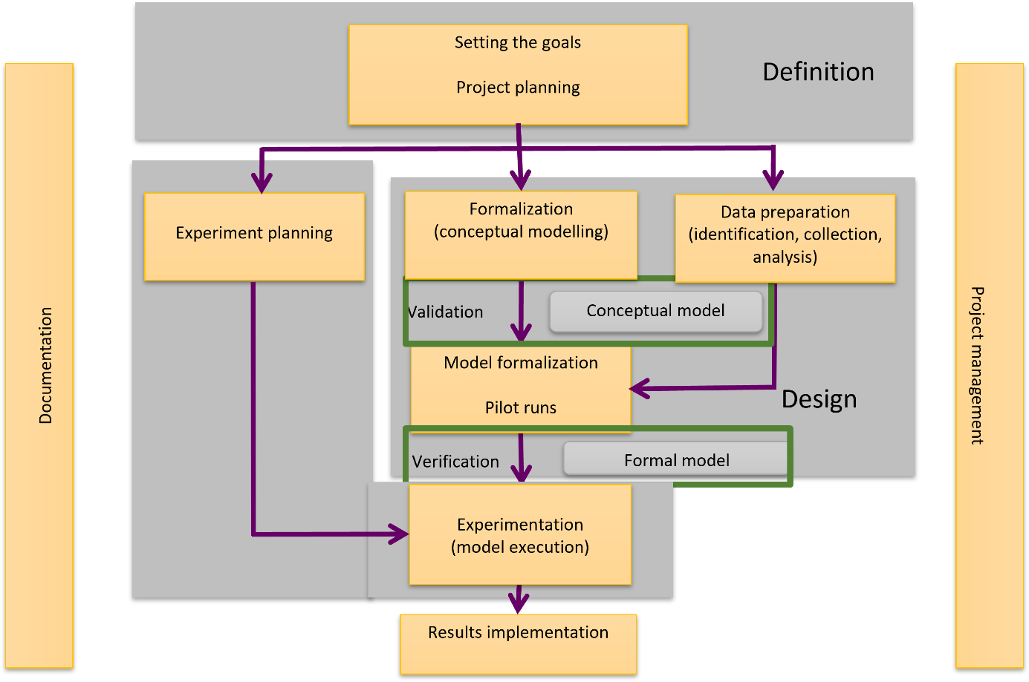
Overview of simulation projects

Slide 14
Simulation system
A model of the real world (good regulator).
A decision support system (DSS).
A laboratory (controlled environment).

Slide 15
Experiments, scenarios and replicas
Experiment
Scenario1
Scenario2
Scenario3
Replica1
Replica2
Replica3
Replica1
Replica2
Replica3
Replica1
Replica2
Replica3
Replica4
Replica4
Replica4

Slide 16
Simulation results
Each experiment needs to be carefully planned; it consists of scenarios and their replicas.
An experiment usually encompasses multiple scenarios being differentiated by the values of input variables, numbers of units in the system and/or temporal frames.
Each scenario is run multiple times - these replicas produce results, based on unique values of input variables, numbers of units in the system and duration.
The results of simulation runs (KPIs) need to be checked by sensitivity analysis, considering their standard deviation, minimum and maximum values, and joined (usually on median values).

Slide 17
Conclusions
ABS simulation is well suited on all levels of decision making; it is best suited in cases when simulation entities are intelligent agents.
In the ABS example the behaviour of SC echelons in an open market was analysed, with respect to their contractual relations and Quality of Service (QoS).
In the example, the different policies concerning the company’s total quality management were investigated by a model, comprising its suppliers, customers and market regulators.
The main conclusions:
  The increases in fines and numbers of inspectors have are building contractual relations,
  In the open market the market eventually regulates itself with about two-thirds of contractual relations.
Feel free to play with the parameters and observe their affect on the market structure and overall SC QoS.

Slide 18
Thank you for your attention

