Slide 1




STATISTICAL METHODS FOR ANALYSING LOGISTICS DATA
Introduction to Operations Research
Slides to exercises
BAS4SC
Business Analytics Skills
for the Future-proofs Supply Chains
Project number – 2022-1-PL01-KA220-HED-000088856

Slide 2
Agenda
OR in logistics
Business intelligence
Decision support systems
Multi-criteria decision making
Conclusion

Slide 3
Operations research in logistics
Operations research methods are used in strategic logistics planning to
  enable complex what-if analysis,
  manage complexity: interdependence + variability + dynamics,
  involve less costs and interference with the process than by experimentation with a real system,
  focus on details,
  improve the understanding of a system and
  improve communication between management and experts.
Source: (Robinson, 2004)

Slide 4
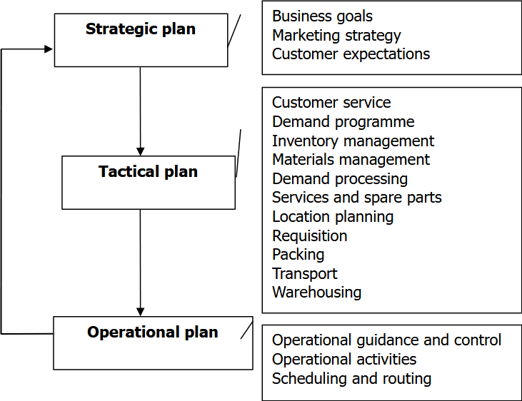
Strategic logistics planning
Source: (Ciampa, 1992)

Slide 5
Strategic logistics planning
Strategic logistics planning comprises all activities which need to be performed on the strategic, tactical and operational levels to provide for:
  Total quality management (TQM) and
  Just-in-time production (JIT).
Source: (Ciampa, 1992), (Britannica, 2023)

Slide 6
Simulation system
A model of the real world (good regulator).
A decision support system (DSS).
A laboratory (controlled environment).

Slide 7
Business intelligence and analytics
Business intelligence (BI) comprises all strategies and technologies used by enterprises for the data analysis of past and current business information.
Business analytics (BA) is a process based on BI, enabling new insights into the business process and better strategic decision making for the future; it builds on Data Mining (DM), being the process of finding anomalies, patterns, and correlations in larger data sets, to predict the results.
Example: Sales and operations planning (SOP) is a flexible tool based on BI to forecast and plan production activities; it comprises sales, production and capacity planning.
Source: (Tableau, 2023)

Slide 8
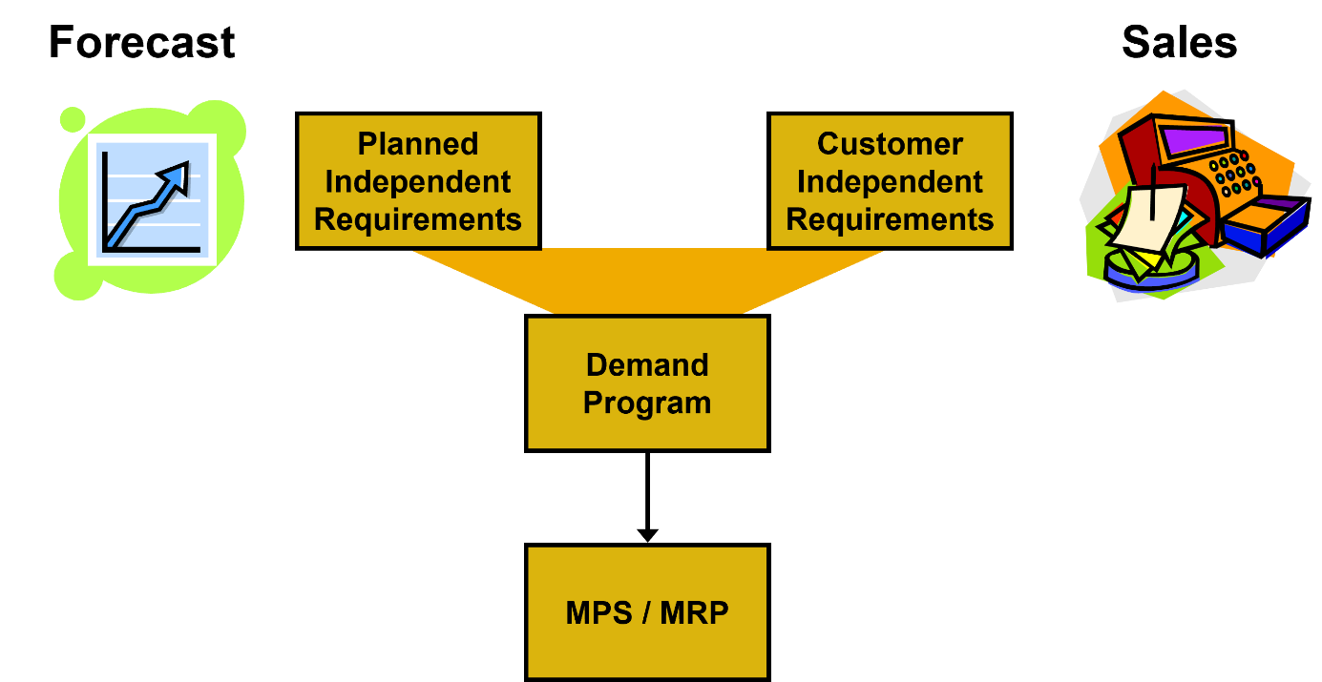
SOP (1/2)
Institutional knowledge

Slide 9
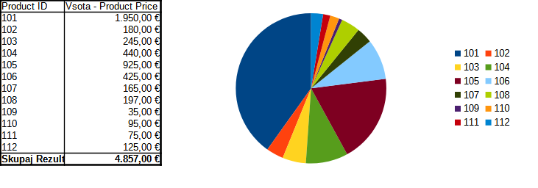
SOP (2/2)
Institutional knowledge
Source: dataset DM (2024) from Chapter 3

Slide 10
Decision support systems
Decision support systems (DSS) are interactive systems which assist decision makers in their use of the data and models for solving unstructured or partly structured problems.
Expert System (ES) is an application program or environment, which effectively supports problem solving in a specialized problem area, requiring expert knowledge and skills.
In addition to statistical and simulation methods, used in BA, DSS often include models that enable decision making, based on a set of distinctive criteria, weighs, utility functions and variant data.

Slide 11
Multicriteria Decision Making
Multicriteria decision making (MCDM) evaluates multiple (possibly) conflicting criteria in decision making over a set of candidate solutions or variants.
A MCDM decision model is composed of:
  Criteria – the parameters of input variants, critical for our design;
  Weighs – the relative importance of selected criteria;
  Utility function – the function that combines the weighted parameters of variants into a fitness value;
  Data – the data representing the variants; input data to our MCDM model.

Slide 12
MCDM example (1/2)
PARAMETERS
 | Price (€) | Grade* | Performance |  |  | Properties |  |  | Camera
Model |  | (1-10) | proc.speed (GHz) | RAM (GB) | int.mem. (GB) | weight (g) | size (mm3) | bat.cap. (mAh) | (MP)
Honor Magic Lite 5 | 263 € | 2 | 2,2 | 6 | 128 | 175 | 94344 | 5100 | 64
Honor X7a | 210 € | 2,5 | 2,3 | 4 | 128 | 196 | 106442 | 6000 | 50
Samsung A34 | 297 € | 1,8 | 2,6 | 8 | 256 | 199 | 103300 | 5000 | 48
Redmi Note 12 Pro | 240 € | 1,9 | 2,6 | 6 | 128 | 187 | 99104 | 5000 | 50
Redmi Note 12 S | 224 € | 1,7 | 2,05 | 8 | 256 | 176 | 95715 | 5000 | 108
PARAMETER WEIGHS
 | Price (€) | Grade | Performance |  |  | Properties |  |  | Camera
 |  |  | proc.speed (GHz) | RAM (GB) | int.mem. (GB) | weight (g) | size (mm3) | bat.cap. (mAh) | (MP)
 |  |  | 10 % | 5 % | 5 % | 10 % | 10 % | 10 %
Weigh | 20 % | 10 % | 20 % |  |  | 30 % |  |  | 20 %

Slide 13
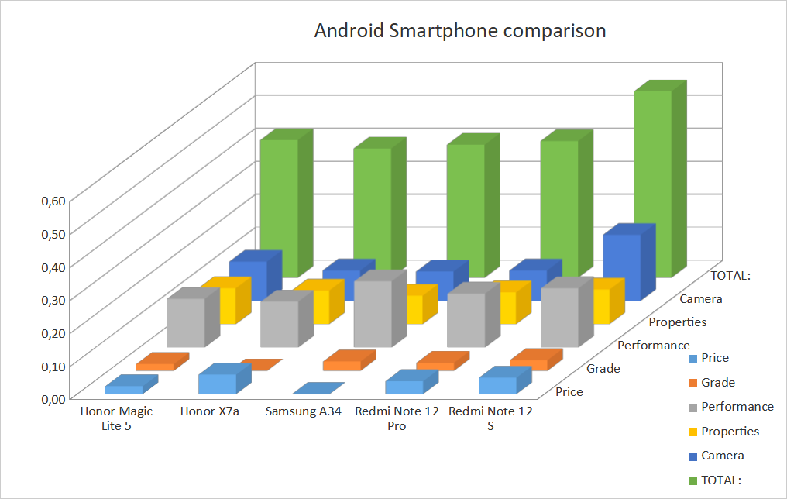
MCDM example (2/2)

Slide 14
MCDM procedure
Representation of variants (V) by their characteristic parameters (P): {V_{i} (P_{i,1}; P_{i,2}; … P_{i,n}); i=1...m};
Normalization of parameters by calculating the relative local grade p_{i,j} for each P_{i,j} (j=1...n), with reference to the j^{th} parameter maximum P_{i,j} value from all i samples:
  p_{i,j}=P_{i,j}/max {P_{i,j}} if a greater value of P_{i,j} is more beneficial;
  p_{i,j}=1 - P_{i,j}/max {P_{i,j}} if a smaller value of Pi,j is more beneficial;
The grades are weighted according to preferences: x_{i,j}=p_{i,j}*U_{j} for each j=1...n, by weighs U_{j} which need to sum-up to 1, i.e. 100%;
The weighted grades of all variants are summed up: X_{i}=∑ x_{i,j} for each i=1...m to obtain composite grades according to our utility function;
The best variant is chosen Y=max {X_{i}}.

Slide 15
Conclusion
In the example a decision model used in equipment modeling has been presented.
Often such decisions involve multiple providers and diverse products. Hence, it is crucial to identify common criteria to differentiate them among each other and to build an appropriate utility function.
It is important to note that services can also be included in the decision making, provided they can be differentiated on a set of common criteria.
Feel free to play with the draft model and build one for Your own use (e.g., computers, dishwashers, etc.).

Slide 16
Thank you for your attention

