Slide 1

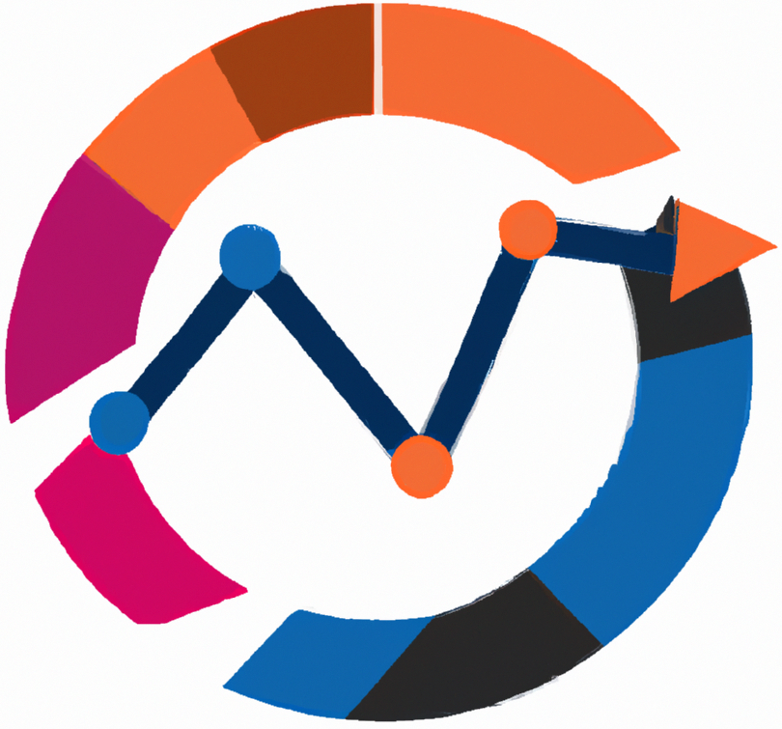


Statistical methods for analysing logistics data
Business analytics and Database operations
Teaching materials ​
for exercises
BAS4SC
Business Analytics Skills
for the Future-proofs Supply Chains
Project number – 2022-1-PL01-KA220-HED-000088856

Slide 2
Agenda
What is business analytics (BA)?
Database basic concepts-SQL
SQL & BA & R?
Quering the SQL
Redering SQL operations and reporting
Homework?
Summary

Slide 3
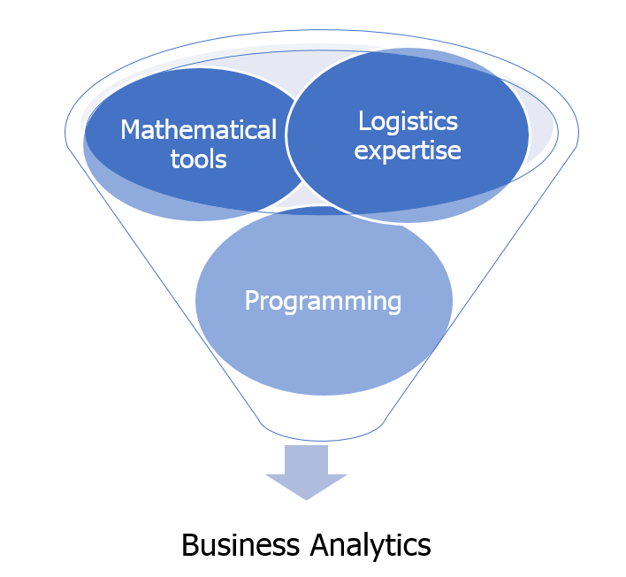
What is business analytics?
Figure. The key pillars of BA in the context of the supply chain and logistics.

Slide 4
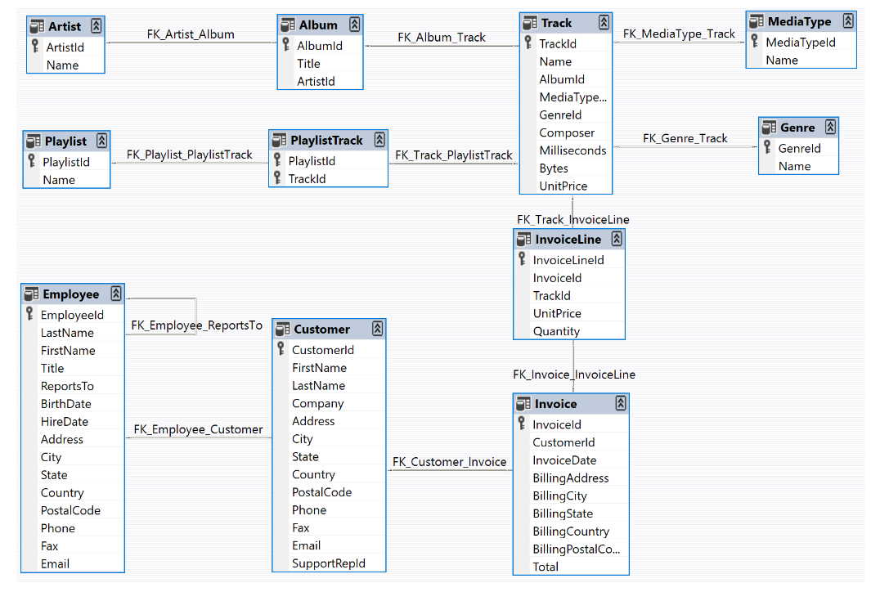
Database basic concepts-SQL
Figure. The data model of Chinook Database.

Slide 5
SQL and how is related to BA and R?
The integration of Business Analytics (BA), SQL, and R is essential for effective data management and analysis, particularly in large organizations where data is well-structured within SQL databases. While SMEs may still struggle with proper data management, larger companies have recognized the importance of organizing their business data, typically using SQL databases. SQL is ideal for storing and updating the ever-changing data driven by market realities and company activities, such as sales and revenue.
R complements SQL by providing powerful statistical tools tailored for data analysis, making it an excellent choice for automating tasks and developing custom analytical packages. Unlike general programming languages like Python, R is specifically designed for data analysis, making it a key player in BA. Together, SQL and R offer a robust framework for analyzing business data, enabling companies to make informed decisions based on accurate and up-to-date information.

Slide 6
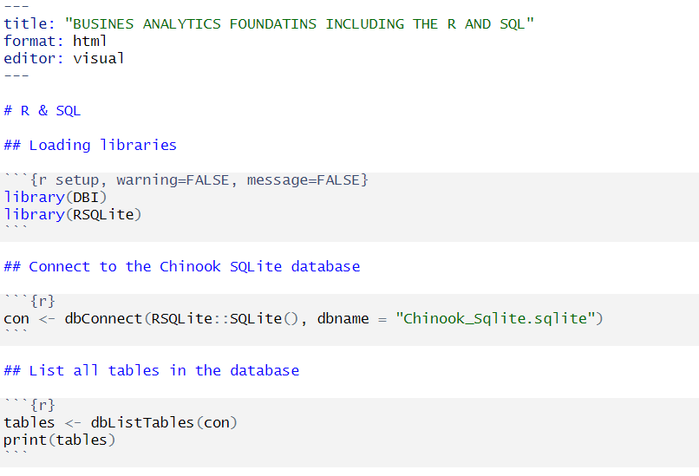
Querying the SQL database with R

Slide 7
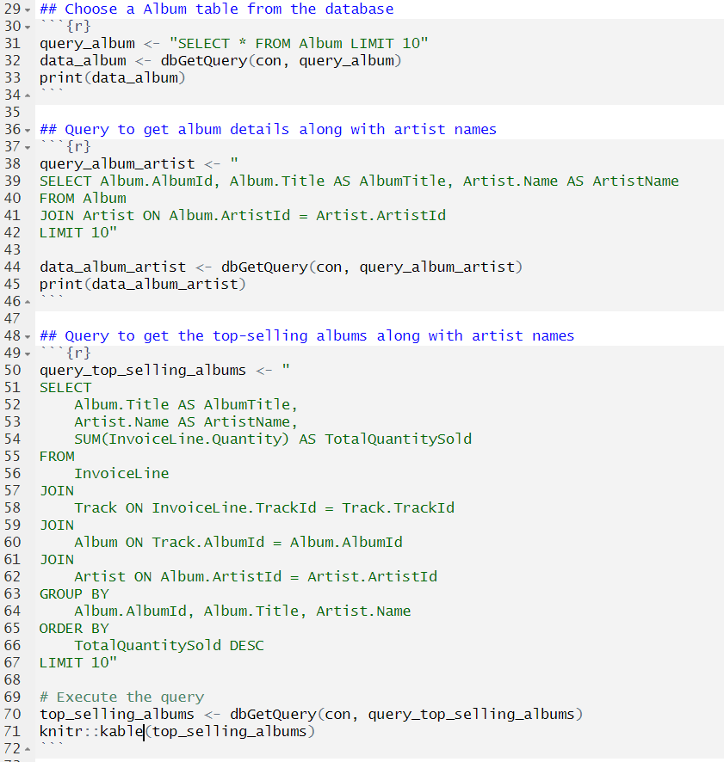
Querying the SQL database with R

Slide 8
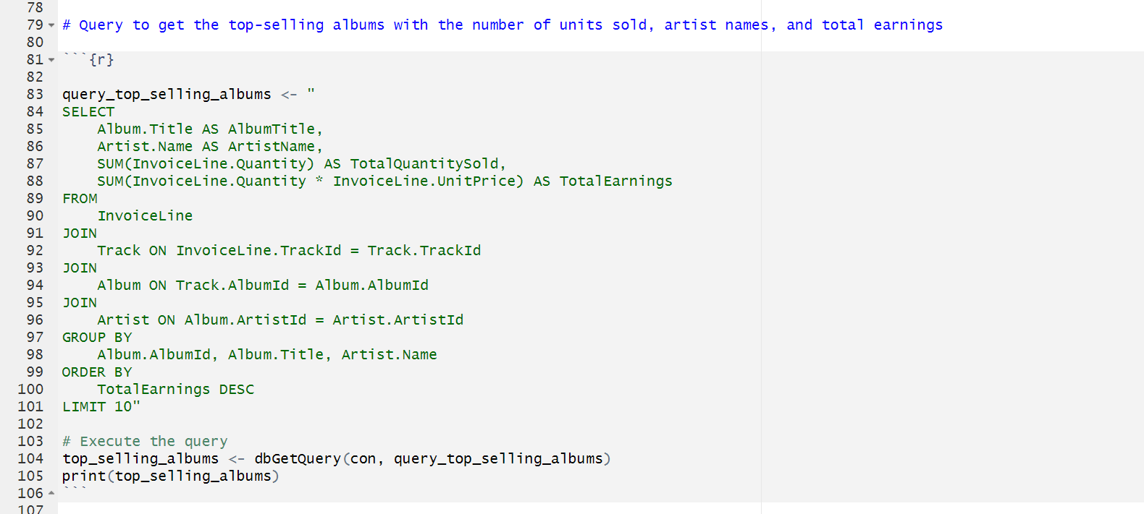
Querying the SQL database with R

Slide 9
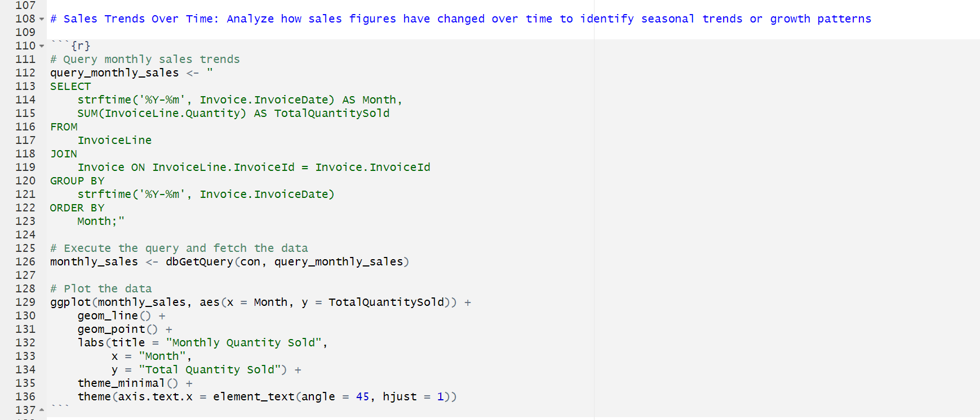
Querying the SQL database with R

Slide 10
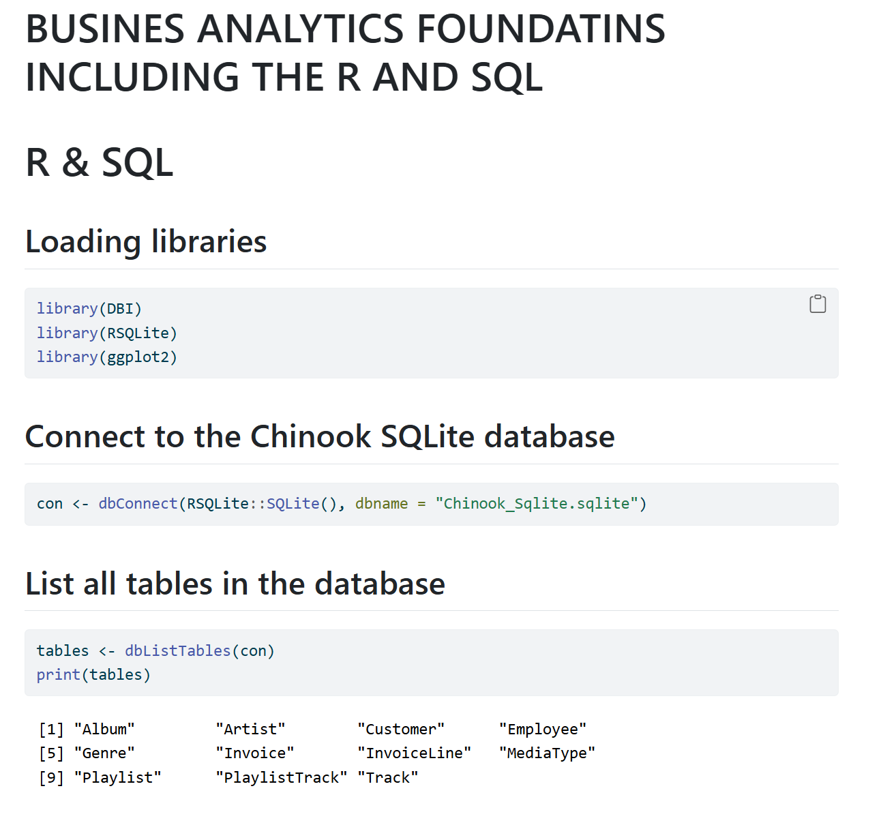
Rendering the SQL database and making report

Slide 11
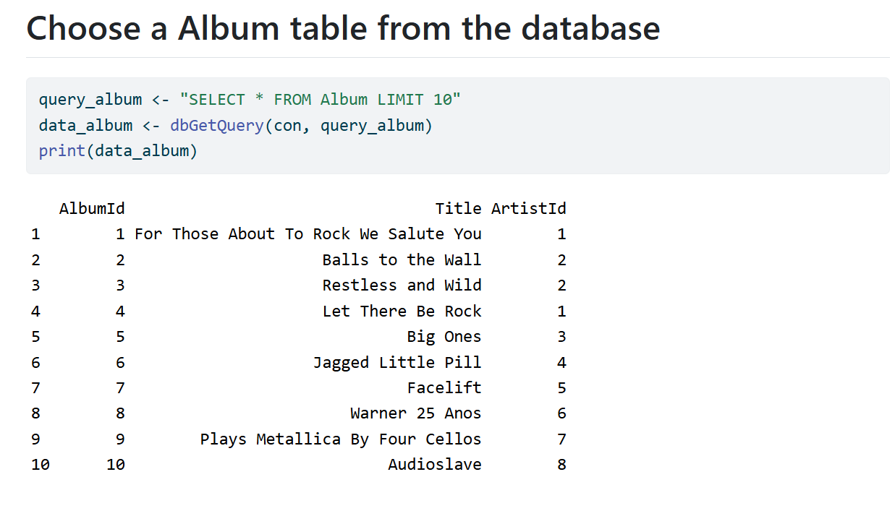
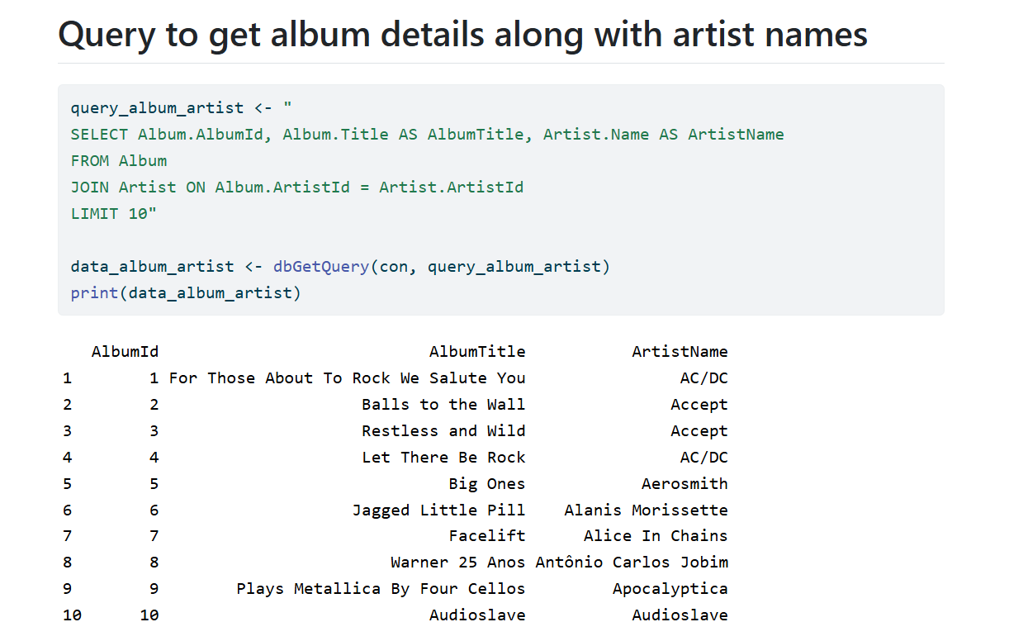
Rendering the SQL database and making report

Slide 12
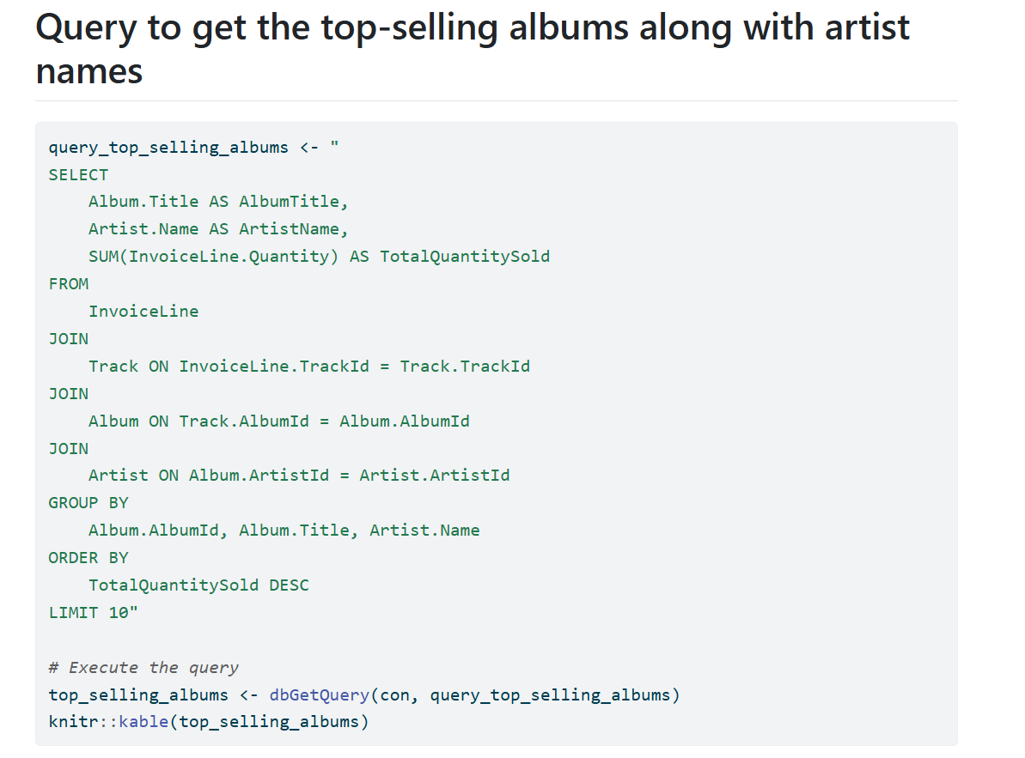
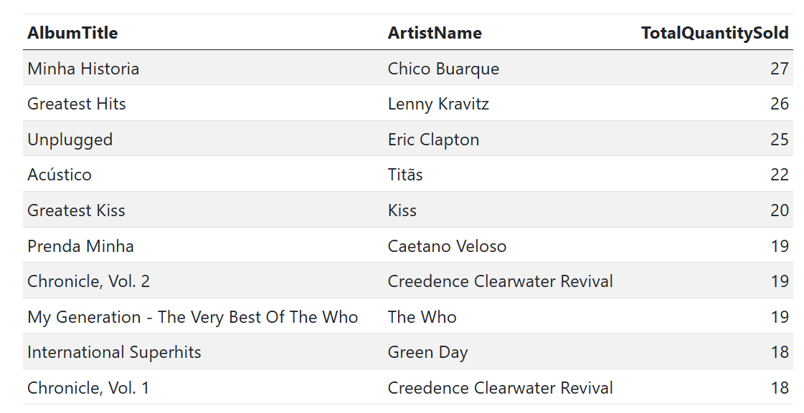
Rendering the SQL database and making report

Slide 13
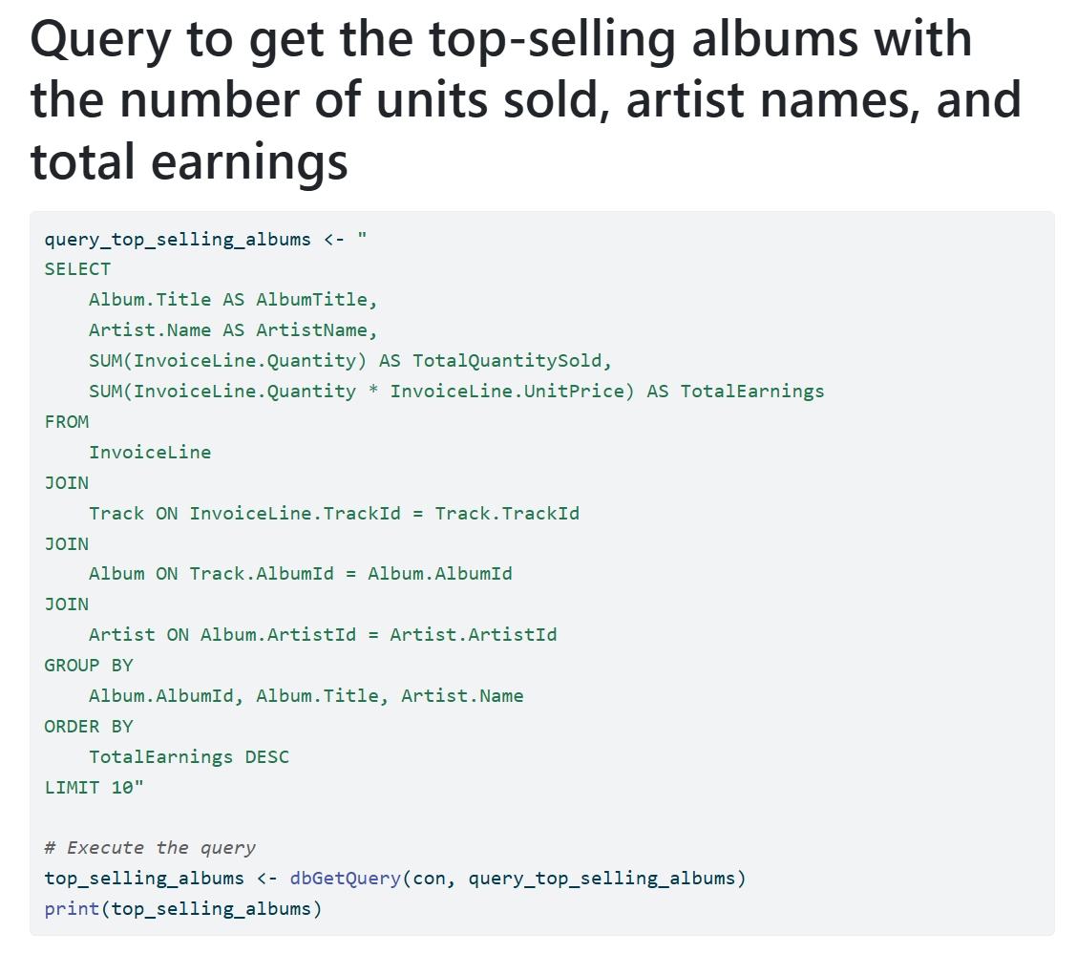
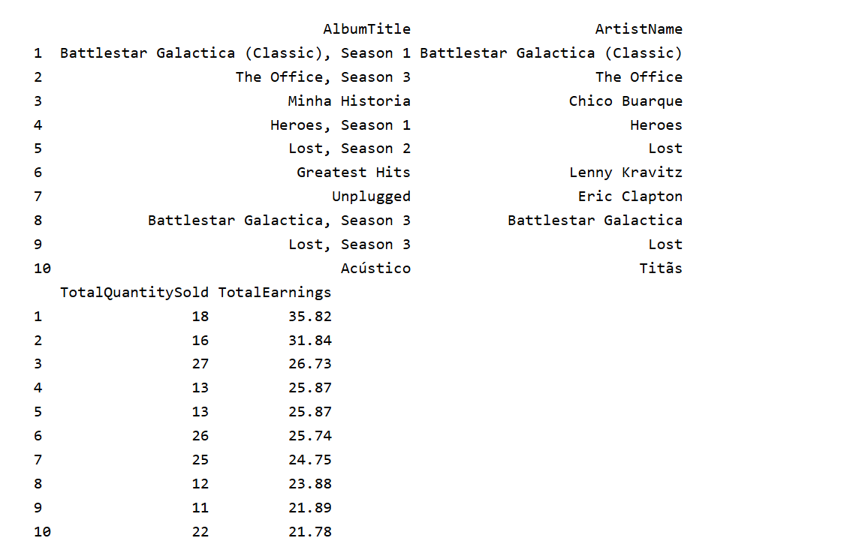
Rendering the SQL database and making report

Slide 14
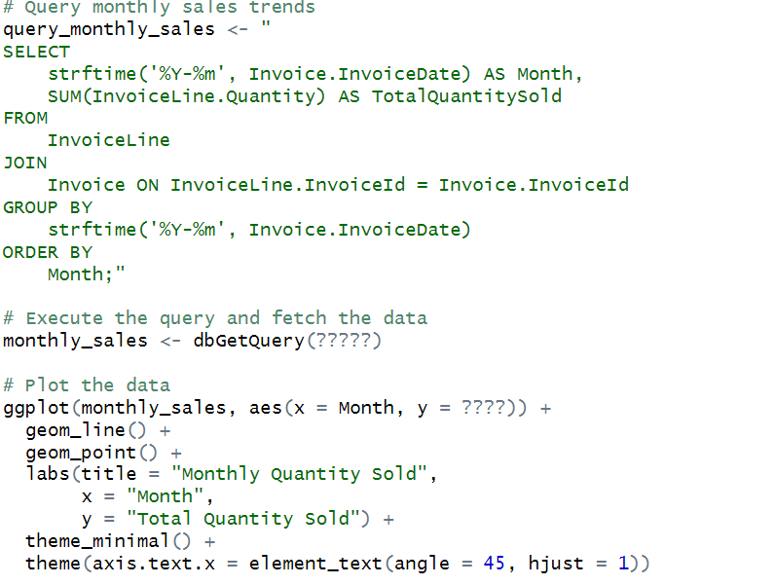
Homework?
Generate sales trends over time: Analyze how sales figures have changed over time to identify seasonal trends or growth patterns
Hint (use the code bellow and add missing parts ???):

Slide 15
Summary
Business Analytics (BA) is a data-driven approach that enhances business decision-making by linking raw data to actionable insights, improving company performance.
The connection between BA, SQL, and R is crucial, as SQL manages data storage and updates, while R provides statistical analysis capabilities.
Together, SQL and R offer a powerful combination for analyzing business data, enabling companies to make informed decisions based on accurate, real-time information.
SQL & R make powerfull tool for any logistics and busines data analysis. They use power of both softwares and make busines decisions much more reliable.

Slide 16
Thank you for your attention

