Slide 1

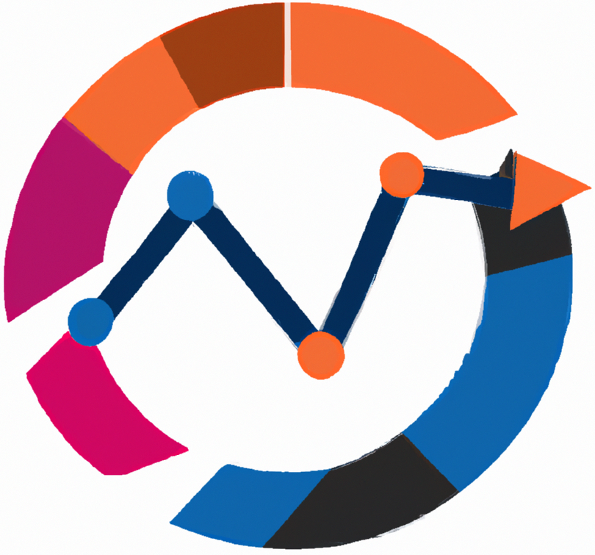


Business Intelligence
Data ethics and information security
Lecture
BAS4SC
Business Analytics Skills
for the Future-proofs Supply Chains
Project number – 2022-1-PL01-KA220-HED-000088856

Slide 2
Agenda
The importance of data ethics
Fundamentals of information security
Data breaches
Information security threats
Information security recommendations

Slide 3
Data ethics
In the era of digital transformation, the ethical handling and security of data have emerged as major issues for individuals and organizations
As vast amounts of personal and sensitive information are collected and processed daily, ensuring that this data is managed responsibly and securely is very important
Data ethics refers to the moral principles and practices guiding the collection, processing, sharing, and utilization of data to ensure respect for individuals' rights, societal well-being, and trust.
It encompasses transparency, accountability, fairness, and privacy, ensuring that data practices are aligned with ethical standards and legal frameworks to prevent harm and promote responsible innovation

Slide 4
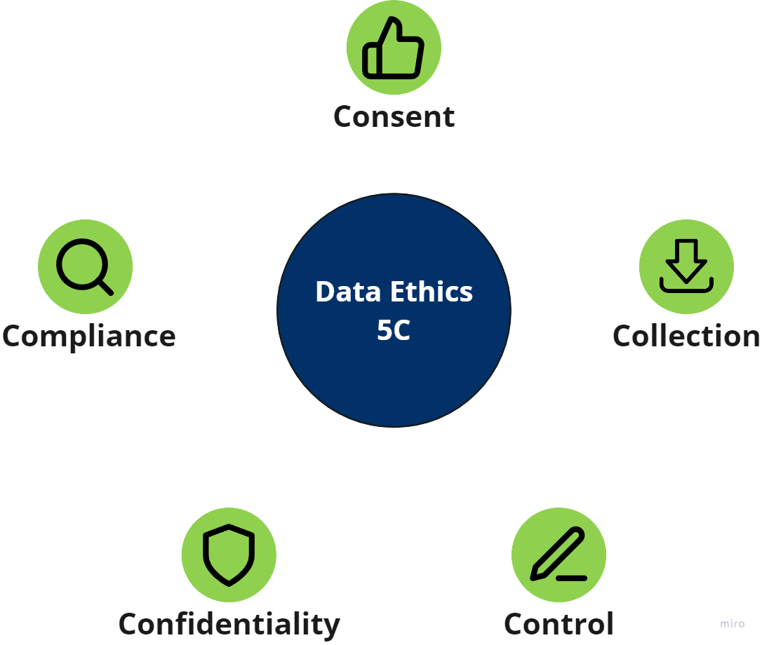
5C of data ethics
Principles of ethical data handling:
  Consent: Obtain informed, voluntary consent from individuals before collecting their data, ensuring transparency about data usage.
  Collection: Only collect data necessary for specific purposes, avoiding excessive data collection.
  Control: Allow individuals to access, review, and update their data, ensuring they have control over its use.
  Confidentiality: Protect data from unauthorized access and breaches through robust security measures.
  Compliance: Adhere to legal and regulatory requirements, conducting regular audits to ensure ongoing compliance.

Slide 5
Core principles of data ethics
Ownership emphasizes that individuals retain ownership over their personal information. It is both unlawful and unethical to collect personal data without explicit consent. Companies must obtain consent through clear agreements or digital privacy policies, ensuring that users are aware and agree to data collection practices.
Transparency involves clear communication regarding how data will be collected, stored, and used. Businesses must inform individuals about the methods and purposes of data collection. This transparency builds trust and allows users to make informed decisions about their data. Deceptive practices or withholding information about data usage are both unethical and unlawful.
Privacy focuses on the responsibility of businesses to protect the privacy of personal information. Even with consent, personal data should not be made publicly available without the individual's explicit permission. Companies must implement robust security measures to safeguard personal information from unauthorized access or breaches.
Intention pertains to the ethical motivations behind data collection and usage. Data should be collected and used for purposes that are beneficial and not harmful to individuals or society. Ethical data practices involve using data to enhance user experiences and improve services without exploiting or causing harm.
Outcome considers the broader impacts of data usage on individuals and society. Businesses must evaluate the potential consequences of their data practices and strive to avoid negative outcomes. This principle emphasizes the need for ethical foresight and responsibility in data-driven decision-making.

Slide 6
Information security
Information security refers to the comprehensive set of practices and principles aimed at safeguarding information and information systems from unauthorized access, use, disclosure, disruption, modification, or destruction.
It ensures the confidentiality, integrity, and availability of data through the implementation of protective measures, policies, and technologies.
These measures include access control, encryption, disaster recovery, and compliance with legal and regulatory standards to mitigate risks and protect against potential threats
Information security is now essential to an organization's credibility and integrity in the digital era

Slide 7
Importance of information security
Information security protects sensitive data from unauthorized access, breaches, and theft
This includes personal information, financial data, intellectual property, and confidential business communications.
As cyberattacks become more sophisticated, the risk of data breaches escalates, potentially leading to severe financial losses and reputational damage.
For instance, the 2017 Equifax breach exposed the personal information of 147 million people, resulting in a settlement of up to $425 million (Federal Trade Commission, 2022).

Slide 8
Importance of information security
Information security is critical for retaining consumer trust and confidence.
In an age when data privacy is crucial, customers are becoming more concerned about how their information is handled.
A strong information security architecture ensures that consumers' data is secure, which fosters loyalty and trust.
According to an IBM survey, 75% of customers would not buy from a firm that they do not trust to preserve their data (PR Newswire, 2018).
Thus, information security is both a technological need and a strategic business imperative

Slide 9
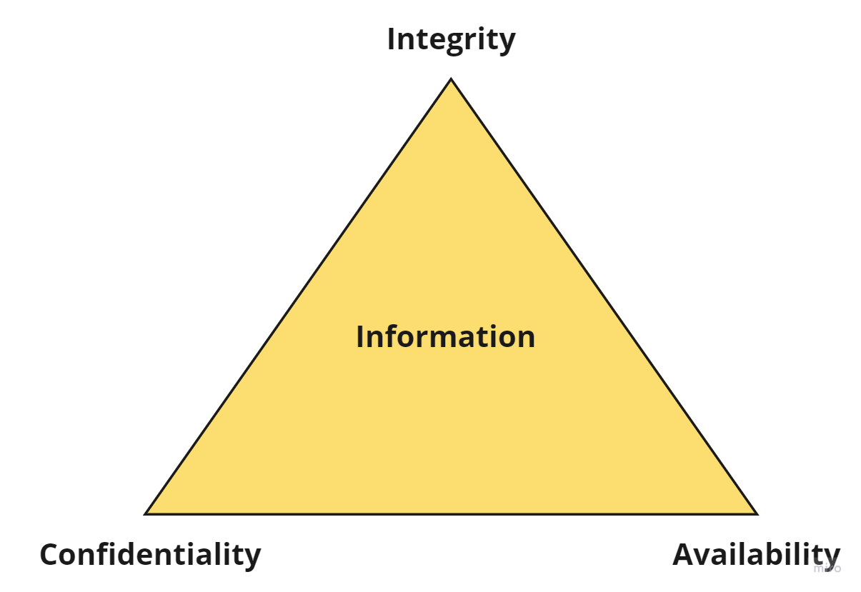
CIA triad
Information is considered secure if it meets three major tenets:
  Confidentiality: sensitive information is accessed only by authorized individuals
  Integrity: information can only be altered by those with permission
  Availability: information and resources are accessible to authorized users whenever needed
Those tenets are often called CIA triad, as shown in Figure

Slide 10
Risk/threats/vulnerability
In information security, the concepts of risk, threat, and vulnerability are central to understanding and managing security.
Risk is the likelihood that something bad will happen to an asset.
  In information security, risk is the probability of a harmful event affecting the confidentiality, integrity, or availability of information.
  For example, a company might assess the risk of a cyber-attack on its network by considering both the likelihood of such an attack and the potential damage it could cause.
Threat is any action that has the potential to cause harm to information systems or data.
  Threats can be intentional, such as cyber-attacks by hackers, or unintentional, such as natural disasters or human error.
Vulnerability refers to weaknesses or gaps in a system's defenses that can be exploited by threats to cause harm.
  These can be flaws in software, hardware, organizational processes, or human behavior

Slide 11
Data breaches
According to Fortinet (n.d.), a data breach “is an event that results in confidential, private, protected, or sensitive information being exposed to a person not authorized to access it”.
These breaches can happen in various ways (Kaspersky, n.d.a):
  Accidental insider: An employee unintentionally accesses sensitive information without proper authorization. For example, using a colleague's computer and viewing confidential files.
  Malicious insider: An individual with authorized access intentionally misuses data for harmful purposes. This could involve stealing or leaking sensitive information.
  Lost or stolen devices: Unencrypted and unsecured devices such as laptops or external drives containing sensitive data are lost or stolen, making the information vulnerable to unauthorized access.
  Malicious outside criminals: Hackers use various methods to breach systems, including phishing attacks, brute force attacks, and malware. These cybercriminals exploit vulnerabilities in software, networks, and user behavior to gain access to sensitive data.

Slide 12
Data breaches
According to Kaspersky (n.d.a), common methods used in data breaches include phishing, where cybercriminals impersonate trusted entities to trick individuals into divulging sensitive information.
Another method is brute force attacks, where hackers use software to repeatedly guess passwords, exploiting weak or reused credentials to gain unauthorized access to accounts.
Additionally, malware, such as spyware, is used to infiltrate systems and steal data undetected.
Human error accounts for 95% of all data breaches (Cybernews, 2022).

Slide 13
Data breaches - examples
Yahoo (2013-2014): one of the largest data breaches in history, with all three billion of its user accounts compromised in 2013. This breach exposed names, email addresses, dates of birth, and security questions and answers.
Marriott International (2018): Marriott announced a breach affecting approximately 500 million guests. Hackers had access to the Starwood guest reservation database, exposing personal information such as names, addresses, phone numbers, email addresses, and passport numbers.
Adult Friend Finder (2016): The Adult Friend Finder breach exposed the personal information of 412 million accounts, including names, email addresses, and passwords, many of which were poorly encrypted.
MySpace (2013): The MySpace data breach, which occurred in 2013, resulted in the exposure of over 360 million user accounts. The data included names, email addresses, and passwords.

Slide 14
Data breaches - examples
LinkedIn (2021): In 2021, personal data of 700 million LinkedIn users was posted on a dark web forum.
Equifax (2017): This breach exposed the personal data of nearly 148 million Americans, 15.2 million Brits, and 19,000 Canadians. The stolen data included social security numbers, birth dates, and addresses, leading to an estimated $1.7 billion in costs for Equifax.
eBay (2014): eBay disclosed a breach that affected 145 million users. The attack originated from compromised employee login credentials, leading to the exposure of names, email addresses, physical addresses, phone numbers, and encrypted passwords.
Target (2013): A breach affecting over 41 million payment card accounts and the contact information of more than 60 million customers. Target faced substantial legal and settlement costs, including a $10 million class-action lawsuit and an $18.5 million multistate settlement.

Slide 15
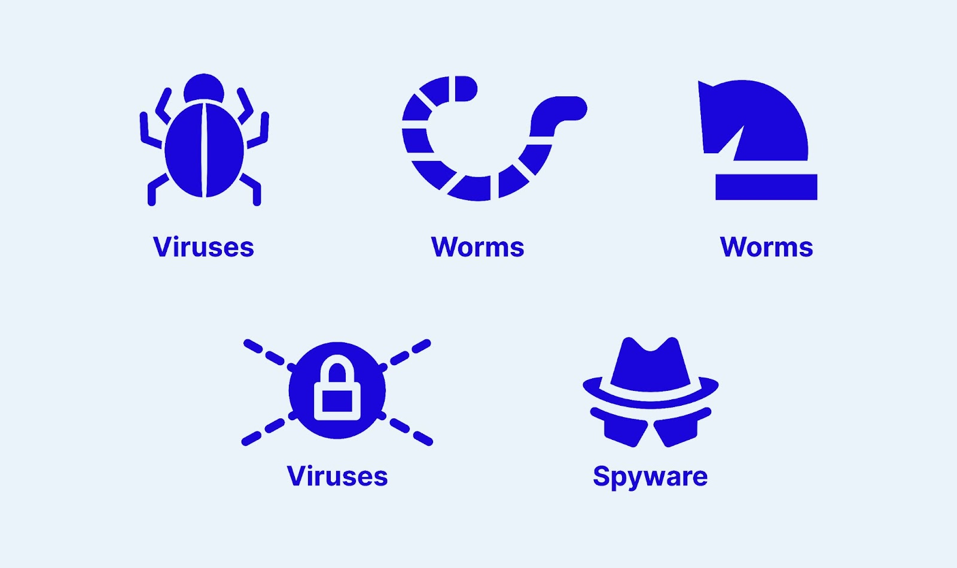
Information security threats
Security threat is a malicious act that attempts to corrupt or steal data, compromise an organization's systems, or compromise the company as a whole
Malware (malicious software) - designed to infiltrate, damage, or disable computers and networks
  Virus - type of malware that attaches itself to a legitimate program or file and spreads to other programs and files when the infected software is executed
  Worms - standalone malware that can self-replicate and spread independently across networks without needing to attach to a host program
  Trojan - malware disguised as legitimate software
  Ransomware - type of malware that encrypts the victim's data, rendering it inaccessible until a ransom is paid to the attacker
  Spyware - malware designed to gather information about a person or organization without their knowledge

Slide 16
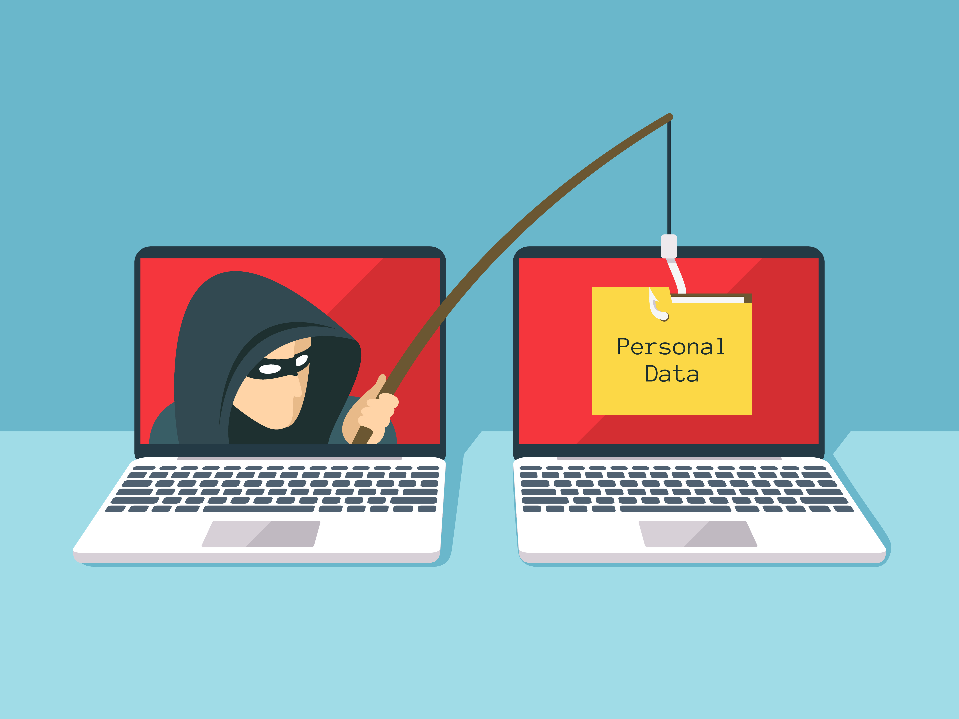
Phishing
phishing attacks involve fraudulent emails, texts, calls, or websites designed to deceive individuals into disclosing personal information or downloading malware
To combat phishing, organizations must use advanced threat detection tools and provide robust employee training to recognize and respond to these scams effectively
Phishing is the leading cause of data breaches, accounting for 16% and costing organizations an average of $4.76 million per breach (Kosinski, 2024)

Slide 17
Types of phishing
Email phishing: using email to steal sensitive information. Attackers may target large audiences by assuming the identity of reputable organizations.
Spear phishing: sending individualized emails, texts, or phone calls with the intent of gaining access to computer systems or sensitive information. When using this technique, attackers usually use data from open databases, social media, or past breaches to bolster their legitimacy.
Whaling: it focuses on high-ranking or senior personnel, including finance officers and chief executives. Attackers create very convincing, highly tailored communications to get sensitive data and information from a business.
Vishing: making phone calls or leaving voicemails under the guise of a reliable source. The goal is to get bank accounts, take advantage of personal information, and steal money.

Slide 18
Phishing
96% of phishing attacks are carried out via email
90% of data leaks are the result of phishing attacks
The age group that is most often "caught" is from 18 to 24
The most used phishing methods:
  simple request to the user to (in response) send his/her sensitive data by e-mail, the sender falsely presents himself as, for example, an administrator of a Web service that needs this data for data verification, system upgrades, etc.
  malicious links, often obtained in an email message, that lead the user to a malicious Web page. A malicious link can be distinguished from a legitimate one by only one letter. (eg cert[.]hr ≠ certt[.]hr)
  malicious website - may look like a legitimate website (e.g. banks or online stores), but serves to collect personal data, obtain financial benefits or some other malicious action
  a malicious pop-up window on legitimate websites ("pop-up" of a malicious pop-up window with fields for entering confidential data).

Slide 19
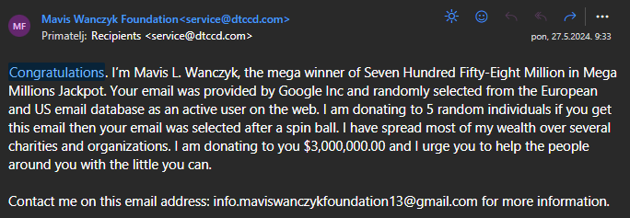
Phishing - examples

Slide 20
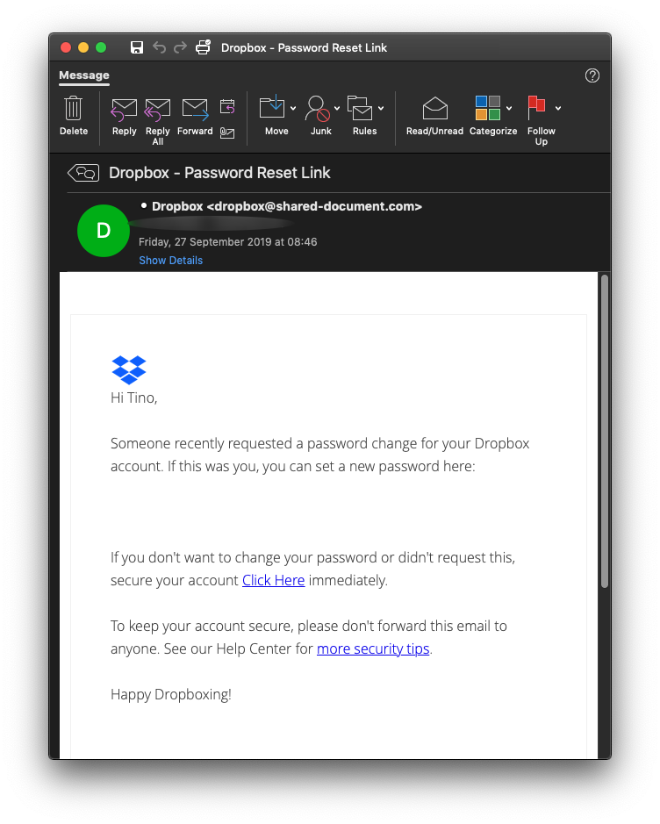
Phishing - examples

Slide 21
Other types of threats
Insider threats are security risks that originate from within the organization.
  They can be employees, contractors, or business partners who have access to the organization’s systems and data.
  These threats can be particularly dangerous because insiders often have legitimate access to sensitive information and systems, making their malicious activities harder to detect
Distributed Denial-of-Service (DDoS) attacks
  They aim to disrupt the normal traffic of a targeted server, service, or network by overwhelming it with a flood of internet traffic.
  This is achieved by using multiple compromised computer systems as sources of attack traffic.
  When these devices, often distributed globally, simultaneously send numerous requests to the target, they consume its available bandwidth and resources, leading to service outages and preventing legitimate users from accessing the service

Slide 22
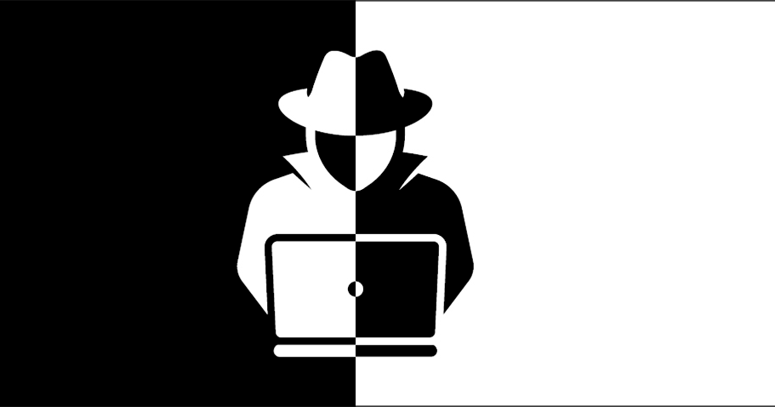
White hat vs. Black hat hackers
Internet security threats are closely tied to the actions of hackers, who exploit vulnerabilities in systems for various malicious purposes
Two primary categories are white hat hackers and black hat hackers
White hat hackers, also known as ethical hackers, use their skills for defensive purposes.
  They work to protect organizations from cyber threats by identifying and fixing security vulnerabilities before malicious hackers can exploit them.
Black hat hackers, in contrast, engage in illegal activities with malicious intent.
  They exploit security vulnerabilities for personal gain, which can include stealing data, spreading malware, or causing disruptions.

Slide 23
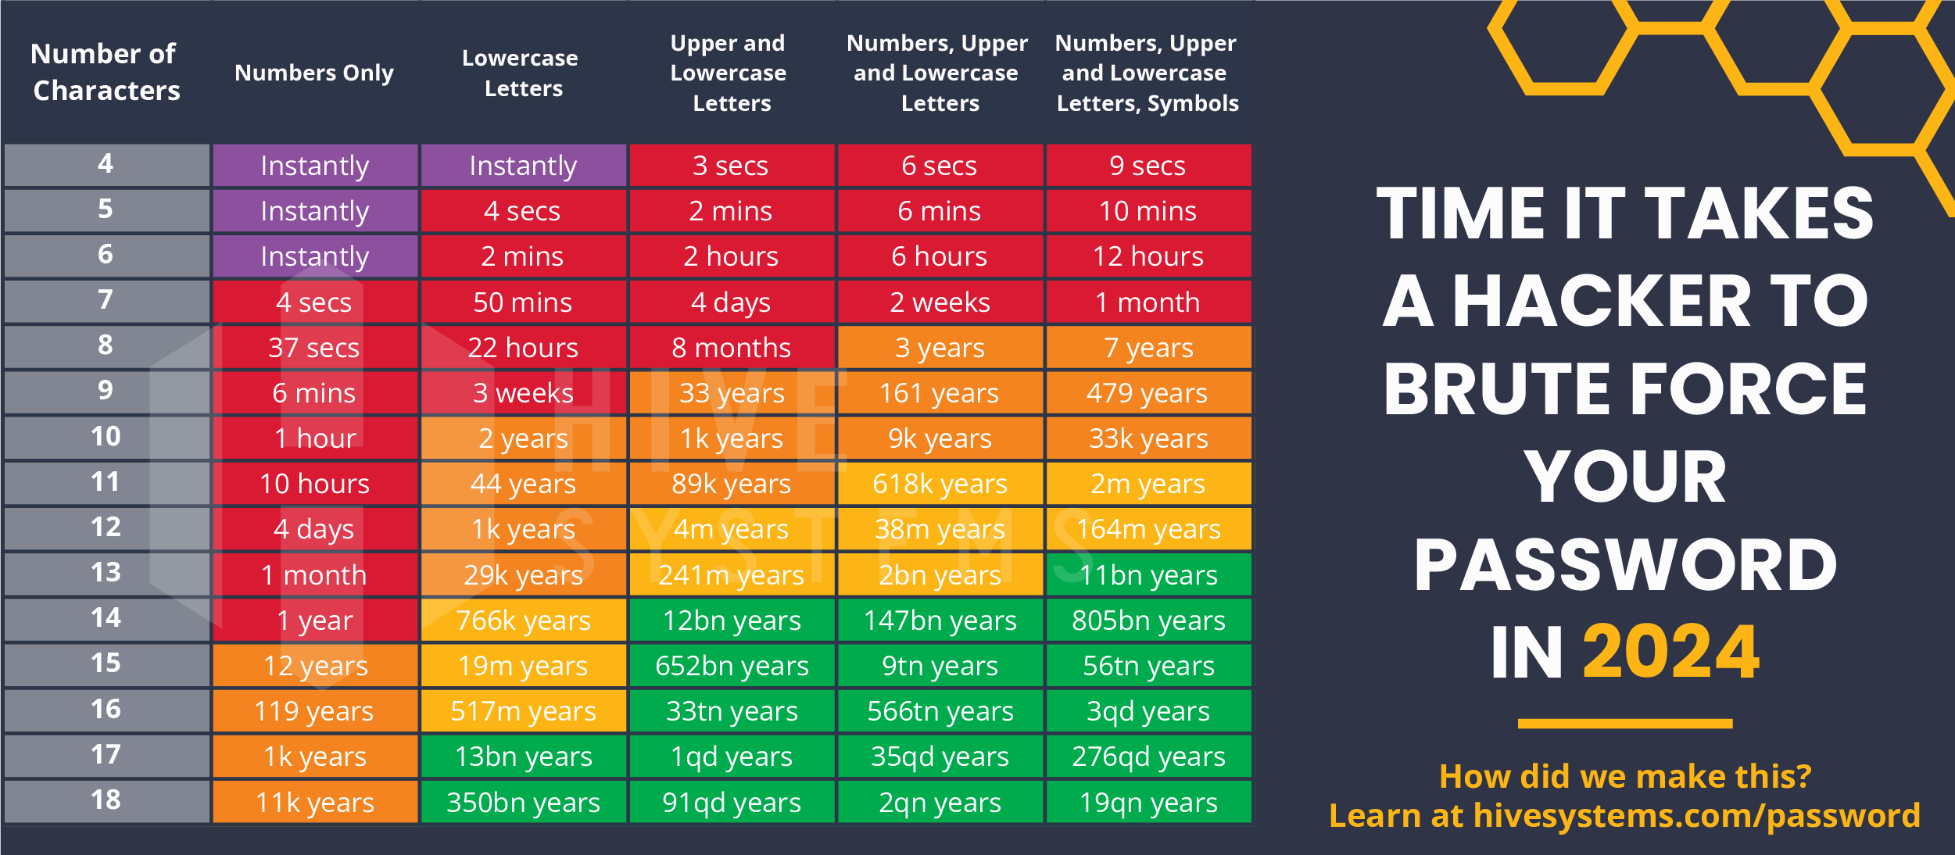
Time it takes a hacker to brute force a password in 2024
Source: https://www.hivesystems.com/blog/are-your-passwords-in-the-green?utm_source=tabletext

Slide 24
Information security recommendations
Use strong passwords
If possible, enable multi-factor authentication (MFA)
Keep software updated
Be aware of phishing scams
Use secure connections
Backup data regularly
Install antivirus software
Monitor accounts regularly

Slide 25
Summary
In the era of digital transformation, the ethical handling and security of data have emerged as major issues for individuals and organizations
As vast amounts of personal and sensitive information are collected and processed daily, ensuring that this data is managed responsibly and securely is very important.
Ethical challenges in data practices are not straightforward and often lack clear-cut solutions
Information security is now essential to an organization's credibility and integrity in the digital era
The 21st century has witnessed some of the most severe data breaches, highlighting the vulnerabilities in digital systems and the critical need for robust security measures
Security threat is a malicious act that attempts to corrupt or steal data, compromise an organization's systems, or compromise the company as a whole
By understanding the ethical implications of data handling and recognizing the security threats that exist, individuals and organizations can develop effective strategies to protect sensitive information

Slide 26
Thank you for your attention

