Slide 1




Statistics for Business Analytics
Type of the material
BAS4SC
Business Analytics Skills
for the Future-proofs Supply Chains
Project number – 2022-1-PL01-KA220-HED-000088856

Slide 2

Agenda
The role and importance of statistics in Business Analytics
Normal Distribution
Empirical rule
Formula of the normal curve
Standard normal distribution
Finding probability using the z-distribution
Sampling Distribution
Central Limit Theorem and Sampling Distribution
Types of Test statistics
Standard Error and confidence interval

Slide 3
The role and importance of statistics in Business Analytics
Welcome to the world of business statistics, where data transforms into meaningful insights, guiding decision-making and uncovering hidden truths. In this comprehensive exploration, we embark on a journey to demystify essential statistical concepts and techniques that underpin rigorous business data analysis. From understanding the intricacies of distributions to applying hypothesis testing and constructing confidence intervals, each chapter unfolds a new facet of statistical literacy.

Slide 4
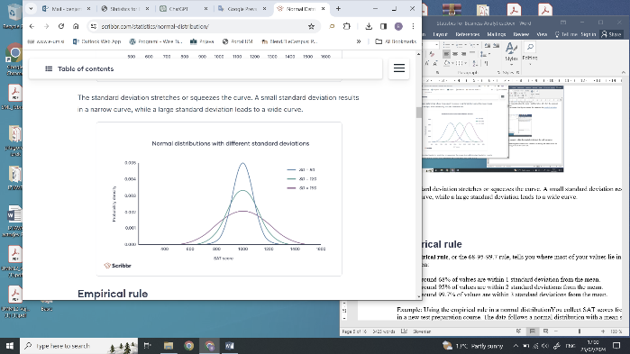
Normal Distribution
At the heart of statistical analysis lies the normal distribution, a ubiquitous probability distribution that serves as a benchmark for many statistical techniques. We will delve into its characteristics, its symmetrical bell-shaped curve, and its significance in understanding the distribution of data
Normal distributions have key characteristics that are easy to spot in graphs:
The mean, median and mode are exactly the same.
The distribution is symmetric about the mean—half the values fall below the mean and half above the mean.
The distribution can be described by two values: the mean and the standard deviation.

Slide 5
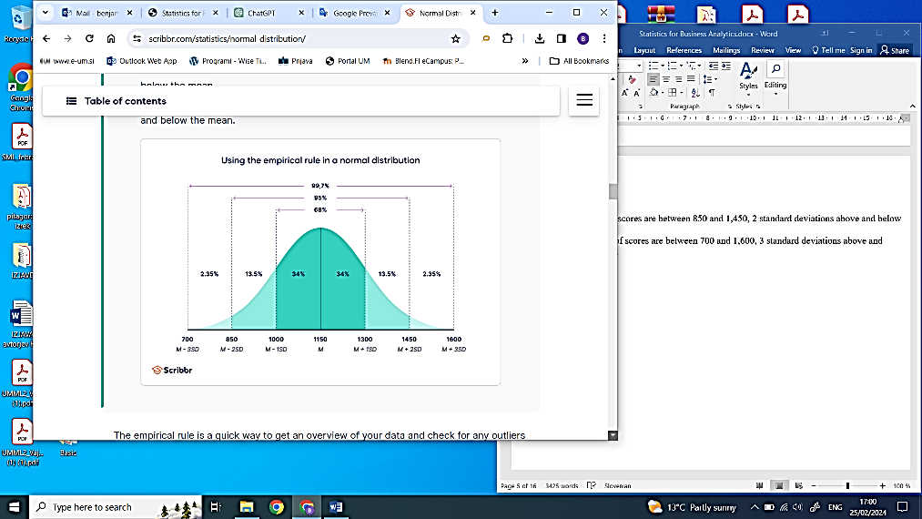
Empirical rule
The empirical rule, also known as the 68-95-99.7 rule, provides insight into the distribution of values within a normal distribution:
Approximately 68% of values fall within 1 standard deviation from the mean.
Roughly 95% of values lie within 2 standard deviations from the mean.
About 99.7% of values are encompassed within 3 standard deviations from the mean

Slide 6
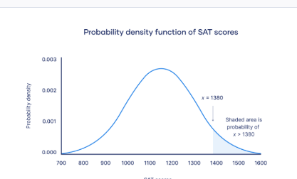

Formula of the normal curve
To construct a normal curve based on a given mean and standard deviation, one can employ a probability density function, thereby accurately representing the distribution of the data
Within a probability density function, the area beneath the curve represents probability. Given that the normal distribution serves as a probability distribution, the cumulative area under the curve invariably sums up to 1 or 100%. Although the formula for the normal probability density function may appear intricate, utilizing it merely necessitates knowledge of the population mean and standard deviation. By substituting these parameters into the formula, one can determine the probability density associated with any given value of x.
f(x) = probability density function
x = value of the variable
μ = mean
σ = standard deviation
σ² = variance

Slide 7

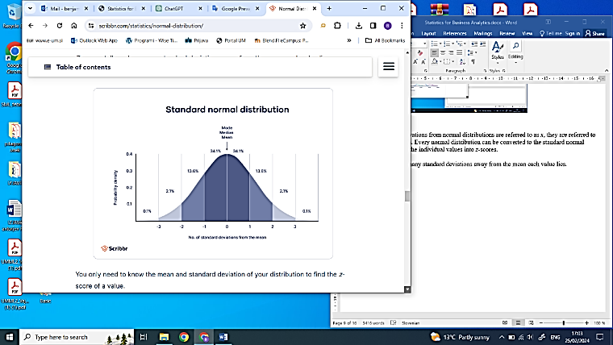
Standard normal distribution
The standard normal distribution, known as the z-distribution, is distinct for having a mean of 0 and a standard deviation of 1. Any normal distribution can be seen as a transformation of the standard normal distribution, undergoing adjustments in scale, position, or both.
You only need to know the mean and standard deviation of your distribution to find the z-score of a value.
x = individual value
μ = mean
σ = standard deviation

Slide 8
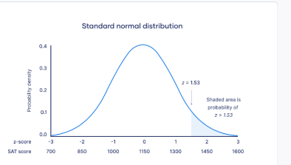
Finding probability using the z-distribution
Each z-score corresponds to a probability, often referred to as a p-value, indicating the likelihood of observing values below that specific z-score. By transforming an individual value into a z-score, one can determine the probability of all values up to that point occurring within a normal distribution.

Slide 9
Sampling Distribution
Sampling distributions form the backbone of statistical inference, enabling us to draw conclusions about populations based on sample data. We will delve into the intricacies of sampling distributions, understanding how they reflect the variability of sample statistics and their pivotal role in hypothesis testing.
Sampling distribution refers to the distribution of a statistic, such as the sample mean or sample proportion, obtained from multiple samples of the same size drawn from a population. It provides insights into the behaviour of sample statistics and their variability across different samples.

Slide 10
Central Limit Theorem and Sampling Distribution
The Central Limit Theorem (CLT) is a fundamental concept in statistics that underpins the behavior of sampling distributions. It states that the sampling distribution of the sample mean approaches a normal distribution as the sample size increases, regardless of the shape of the population distribution. This theorem enables us to make robust inferences about population parameters from sample data.
The central limit theorem delineates two key principles:
Law of Large Numbers: As the sample size or the number of samples increases, the sample mean tends to converge towards the population mean.
Normality of Sampling Distribution: Despite the original variable's distribution, when working with multiple large samples, the sampling distribution of the mean tends to approximate a normal distribution.

Slide 11
Test statistics
A test statistic represents a numerical value derived from a statistical hypothesis test, indicating the degree of alignment between your observed data and the distribution expected under the null hypothesis of that test.
This statistic plays a crucial role in computing the p-value of your findings, facilitating the determination of whether to accept or reject your null hypothesis.
A test statistic articulates the similarity between the distribution of your data and the distribution anticipated under the null hypothesis of the statistical test employed. The distribution of data elucidates the frequency of each observation, characterized by its central tendency and the variability around it. Since different statistical tests anticipate different distribution types, selecting the appropriate test aligns with your hypothesis.

Slide 12
Types of test statistics
Test statistic | Null and alternative hypotheses | Statistical tests that use it
t value | Null: The means of two groups are equal Alternative: The means of two groups are not equal | T test Regression tests
z value | Null: The means of two groups are equal Alternative:The means of two groups are not equal | Z test
F value | Null: The variation among two or more groups is greater than or equal to the variation between the groups Alternative: The variation among two or more groups is smaller than the variation between the groups | ANOVA ANCOVA MANOVA
X²-value | Null: Two samples are independent Alternative: Two samples are not independent (i.e., they are correlated) | Chi-squared test Non-parametric correlation tests

Slide 13

Standard Error and confidence interval
The standard error of the mean (SE or SEM) serves as an indicator of the probable disparity between the population mean and a sample mean. It offers insight into the degree of variability one would anticipate in the sample mean if the study were replicated using fresh samples drawn from the same population.
You can present the standard error alongside the mean or incorporate it into a confidence interval to convey the uncertainty surrounding the mean.

Slide 14
Standard Error and confidence interval
A confidence interval denotes a span of values where an unknown population parameter is anticipated to lie most frequently if the study were to be replicated with new random samples. At a 95% confidence level, it's expected that 95% of all sample means will fall within a confidence interval encompassing ± 1.96 standard errors of the sample mean. This interval serves as an estimate within which the true population parameter is believed to lie with 95% confidence.
Confidence interval formula
CI = x̄ ± (1.96 × SE) x̄ =sample mean = 550 SE = standard error = 12.8
Lower limit | Upper limit
x̄ − (1.96 × SE) 550 − (1.96 × 12.8) = 525 | x̄ + (1.96 × SE) 550 + (1.96 × 12.8) = 575
With random sampling, a 95% CI [525 575] tells you that there is a 0.95 probability that the population mean math SAT score is between 525 and 575.

Slide 15
Literature:
Introductory Statistics 2e, Openstax, Rice University, Houston, Texas 77005, Jun 23, senior contributing authors: Barbara Illowsky and Susan dean, De anza college, Publish Date: Dec 13, 2023, (https://openstax.org/details/books/introductory-statistics-2e);
Introductory Statistics 4th Edition, Susan Dean and Barbara Illowsky, Adapted by Riyanti Boyd & Natalia Casper (Published 2013 by OpenStax College) July 2021, (http://dept.clcillinois.edu/mth/oer/IntroductoryStatistics.pdf );
Introductory Statistics 7th Edition, Prem S. Mann, eastern Connecticut state university with the help of Christopher Jay Lacke, Rowan university, John Wiley & Sons, Inc., 111 River Street, Hoboken, NJ 07030-5774, 2011
Introduction to statistics, made easy second edition, Prof. Dr. Hamid Al-Oklah Dr. Said Titi Mr. Tareq Alodat, March 2014
Statistics for Business and Economics, Thirteenth Edition, David R. Anderson, Dennis J. Sweeney, Thomas A. Williams, Jeffrey D. Camm, James J. Cochran, 2017, 2015 Cengage Learning®
Statistics for Business, First edition, Derek L Waller, 2008 Copyright © 2008, Derek L Waller, Published by Elsevier Inc. All rights reserved

Slide 16
Internet pages:
https://open.umn.edu/opentextbooks/textbooks/196
https://www.scribbr.com/category/statistics/
https://stats.libretexts.org/Bookshelves/Introductory_Statistics
https://assets.openstax.org/oscms-prodcms/media/documents/IntroductoryStatistics-OP_i6tAI7e.pdf
https://saylordotorg.github.io/text_introductory-statistics/
https://drive.uqu.edu.sa/_/mskhayat/files/MySubjects/20178FS%20Elementary%20Statistics/Introductory%20Statistics%20(7th%20Ed).pdf
https://dept.clcillinois.edu/mth/oer/IntroductoryStatistics.pdf
https://www.geeksforgeeks.org/introduction-of-statistics-and-its-types/
https://onlinestatbook.com/Online_Statistics_Education.pdf
https://www.researchgate.net/profile/Tareq-Alodat-2/publication/340511098_INTRODUCTION_TO_STATISTICS_MADE_EASY/links/5e8de3dc4585150839c7b58a/INTRODUCTION-TO-STATISTICS-MADE-EASY.pdf
https://byjus.com/maths/statistics/
https://www.khanacademy.org/math/statistics-probability
Youtube links (Business statistics):
https://youtu.be/BWbgiJz0_TA?si=wTNnNud2uKSF_9Mg
https://youtu.be/ImpxCMX2i_k?si=BBBpkMw-T7bKABMJ
https://youtu.be/-k0pZa201Ck?si=CC49sVstpo1V7RfC
https://youtu.be/kyjlxsLW1Is?si=5_VSJrzMKo38tS4-
https://youtu.be/8JIe_cz6qGA?si=5512orwSjxsCPNCs
https://youtu.be/eYTumjgE2IY?si=eIP6yIGbaJHMMSwv
https://www.youtube.com/watch?v=LMSyiAJm99g
https://www.youtube.com/watch?v=VPZD_aij8H0

Slide 17
Thank you for your attention

