Slide 1

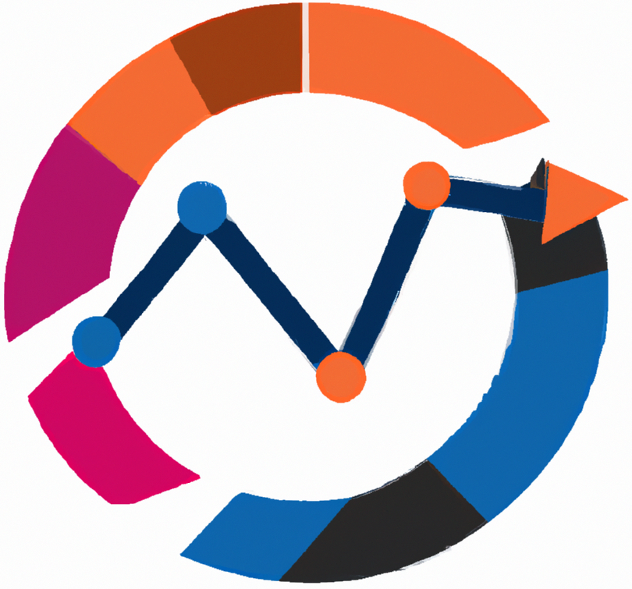


Statistical methods for analysing logistics data
Business analytics foundations including the R and SQL
Lecture
BAS4SC
Business Analytics Skills
for the Future-proofs Supply Chains
Project number – 2022-1-PL01-KA220-HED-000088856

Slide 2
Agenda
What is business analytics (BA)?
What problems does it solve and what tools does it use?
What are R and SQL? How is BA related to R and SQL?
Are there any examples of good practices where these softwares are used to solve logistic business problems?

Slide 3
What is business analytics?
Business Analytics (BA) offers a comprehensive approach to data analysis and decision-making within businesses. By fostering a data-driven environment, BA aims to enhance business performance by enabling more informed decisions. The core objective of BA is to establish a knowledge pipeline that effectively connects raw data to business decisions, ultimately improving business effectiveness through better integration with operational systems.
BA is versatile, with applications spanning multiple areas such as Financial Analytics, Supply Chain Analytics, Crisis Analytics, Knowledge Analytics, Marketing Analytics, Customer Analytics, Service Analytics, Human Resource Analytics, Talent Analytics, Process Analytics, and Risk Analytics. These various branches demonstrate BA's broad utility across different business functions.

Slide 4
What is business analytics?
There are three types of Business Analytics platforms:
Descriptive – They look at existing data and provide summary statistics and basic visualization.
Predictive – They use existing data to estimate the most likely future scenarios.
Prescriptive – They automatically process big data, business rules, market conditions, etc. These platforms utilize machine learning and artificial intelligence methods. The goal is fully automated decision-making on which actions a company should take considering the current situation to achieve the desired business objectives.
Modern BA is deeply rooted in advancements that support decision-making processes. These advancements include powerful tools for generating, selecting, and applying knowledge crucial for decisions. BA operates on both qualitative and quantitative knowledge, depending on what is needed for the specific decision at hand. This dual focus allows BA to be highly adaptable to different business challenges.

Slide 5
What is business analytics?
The application of BA is driven by its ability to solve critical management problems. It provides several key benefits, including achieving competitive advantage, supporting strategic and tactical goals, enhancing organizational performance, improving decision outcomes, refining decision processes, producing valuable knowledge, and deriving value from data.
Regardless of the BA platform used, there are three essential pillars for any BA solution: mathematical tools, programming tools, and logistics expertise. Mathematical tools are vital for identifying and representing insights in various formats such as tables and graphs. Programming tools support these activities by ensuring fast and accurate computations. Finally, logistics expertise is crucial for identifying key factors and understanding the ecosystem related to the business problem.

Slide 6
What is business analytics?
The application of BA is driven by its ability to solve critical management problems. It provides several key benefits, including achieving competitive advantage, supporting strategic and tactical goals, enhancing organizational performance, improving decision outcomes, refining decision processes, producing valuable knowledge, and deriving value from data.
Regardless of the BA platform used, there are three essential pillars for any BA solution: mathematical tools, programming tools, and logistics expertise. Mathematical tools are vital for identifying and representing insights in various formats such as tables and graphs. Programming tools support these activities by ensuring fast and accurate computations. Finally, logistics expertise is crucial for identifying key factors and understanding the ecosystem related to the business problem.

Slide 7
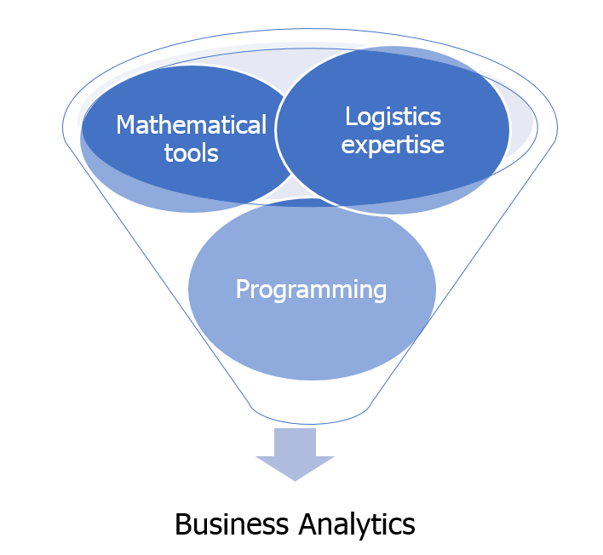
What is business analytics?
Figure. The key pillars of BA in the context of the supply chain and logistics.

Slide 8
What is R?
R is an integrated suite of software facilities for data manipulation, calculation and graphical display (R Core Team, 2019). Among other things it has:
an effective data handling and storage facility,
a suite of operators for calculations on arrays, in particular matrices,
a large, coherent, integrated collection of intermediate tools for data analysis,
Graphical facilities for data analysis and display either directly at the computer or on hard-copy, and a well-developed, simple and effective programming language (called ‘S’) which includes conditionals, loops, user defined recursive functions and input and output facilities. (Indeed most of the system supplied functions are themselves written in the S language.)

Slide 9
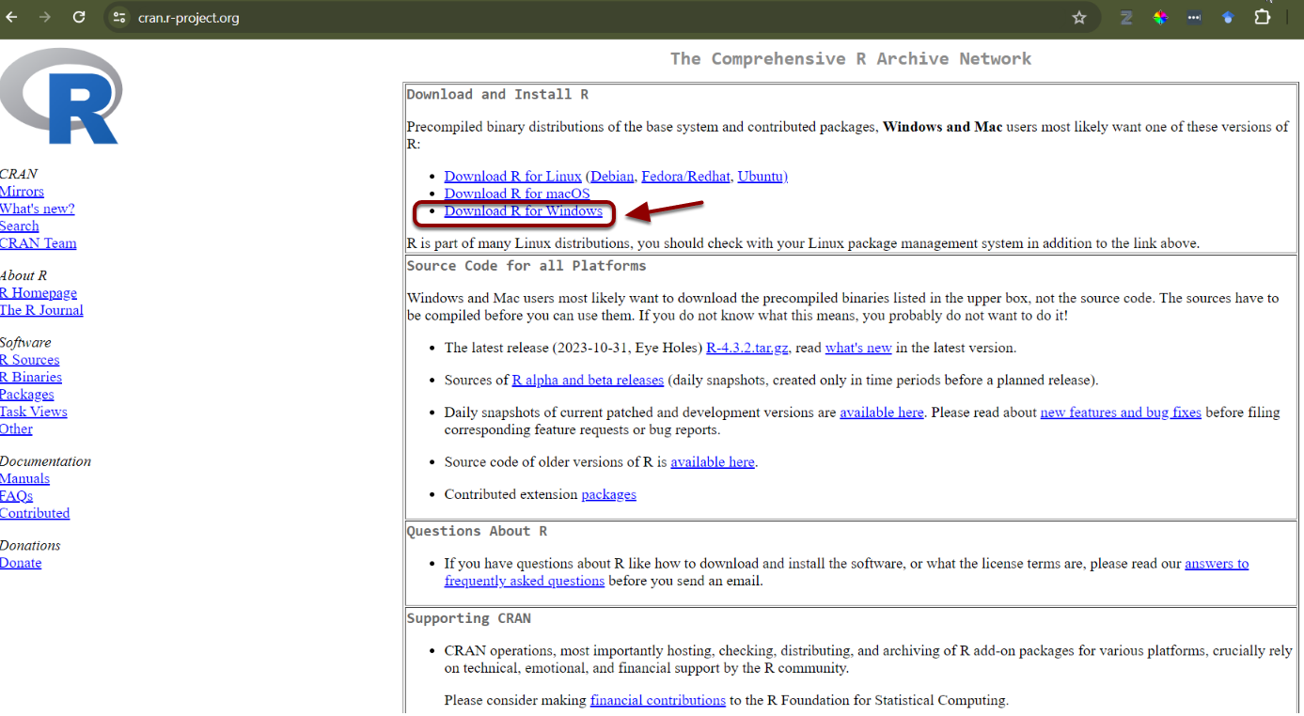
Instal R and R Studio
Figure. Download page for R software.

Slide 10

Instal R and R Studio
https://www.youtube.com/watch?v=H9EBlFDGG4k
Figure. The user interface and the R & RStudio.

Slide 11
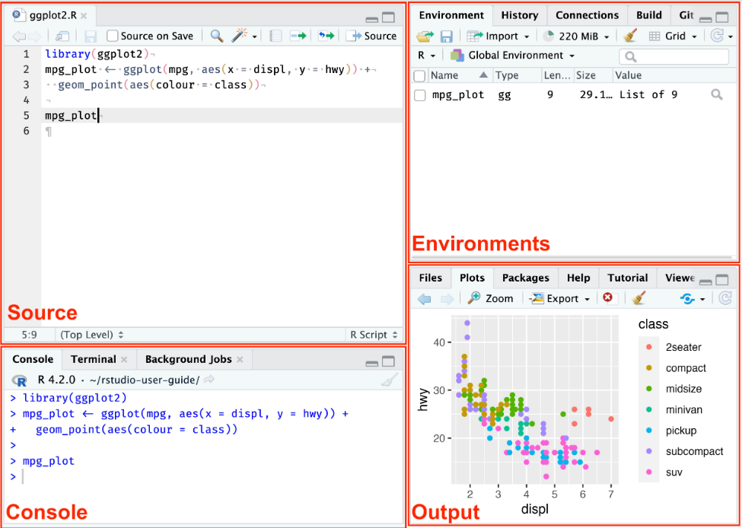
Instal R and R Studio
Figure. The user interface and the R & RStudio.

Slide 12
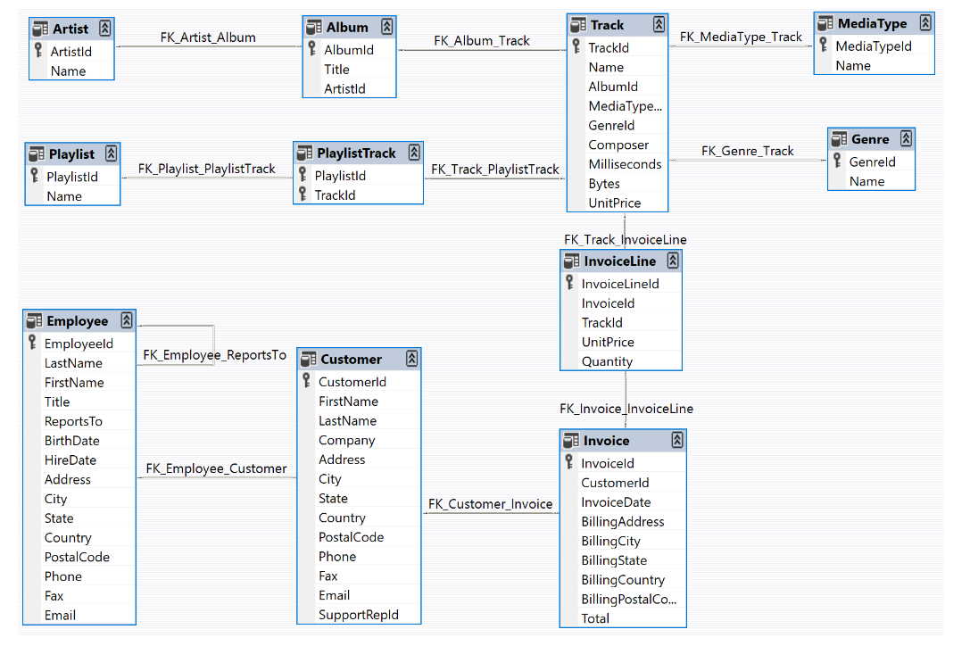
SQL and how is related to BA and R?
Figure. The data model of Chinook Database.

Slide 13
SQL and how is related to BA and R?
The integration of Business Analytics (BA), SQL, and R is essential for effective data management and analysis, particularly in large organizations where data is well-structured within SQL databases. While SMEs may still struggle with proper data management, larger companies have recognized the importance of organizing their business data, typically using SQL databases. SQL is ideal for storing and updating the ever-changing data driven by market realities and company activities, such as sales and revenue.
R complements SQL by providing powerful statistical tools tailored for data analysis, making it an excellent choice for automating tasks and developing custom analytical packages. Unlike general programming languages like Python, R is specifically designed for data analysis, making it a key player in BA. Together, SQL and R offer a robust framework for analyzing business data, enabling companies to make informed decisions based on accurate and up-to-date information.

Slide 14
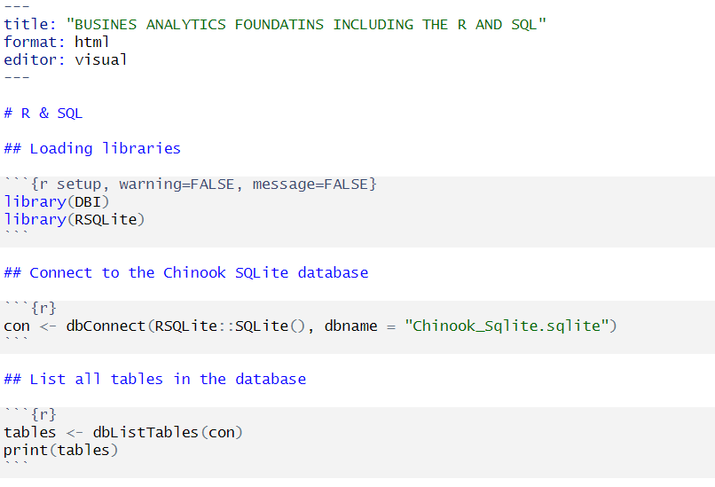
Querying the SQL database with R

Slide 15
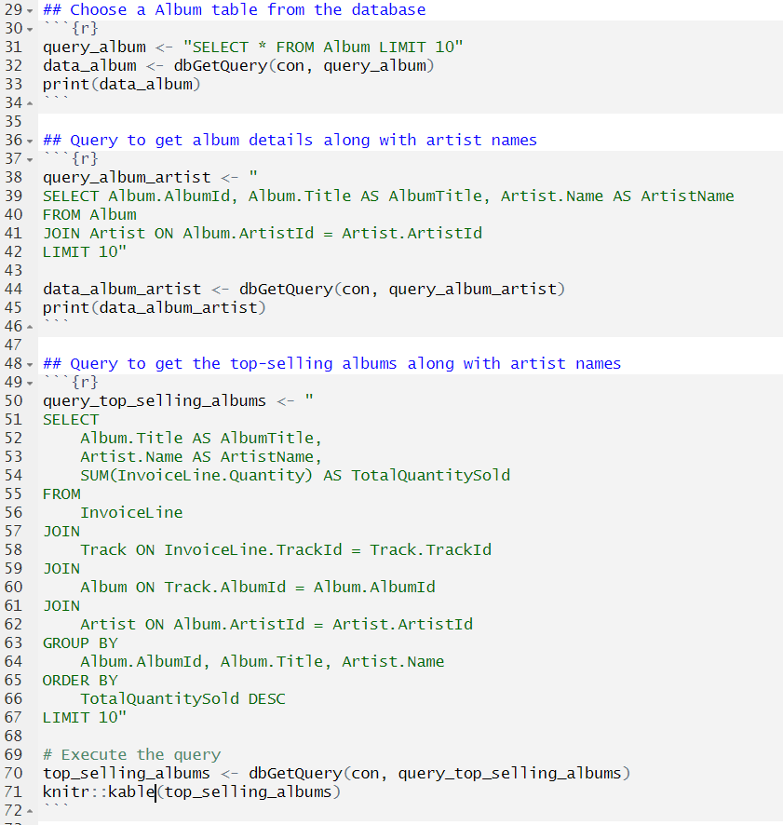
Querying the SQL database with R

Slide 16
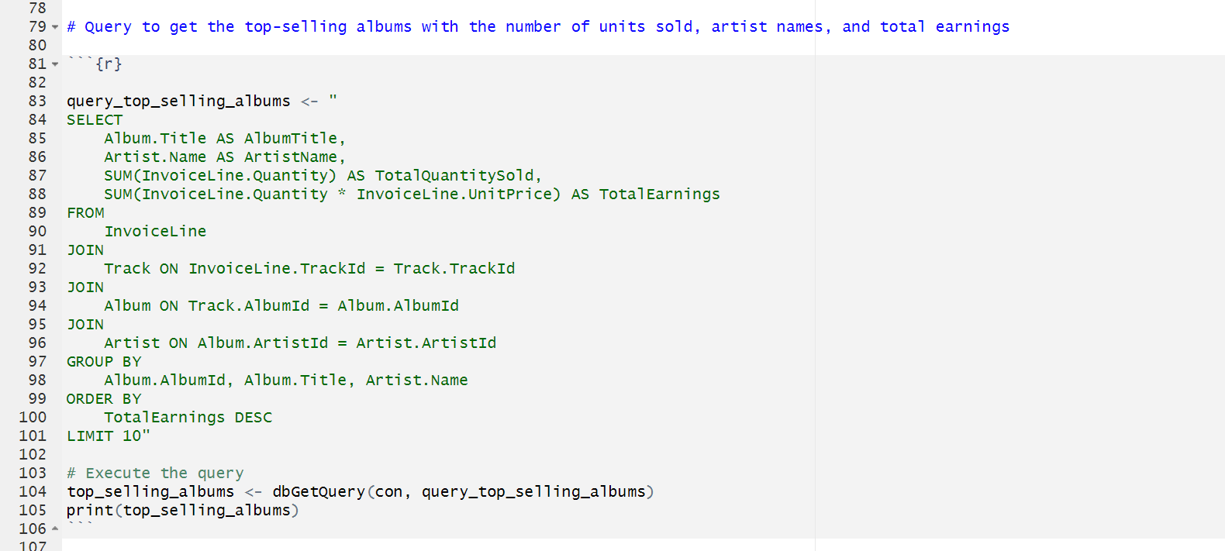
Querying the SQL database with R

Slide 17
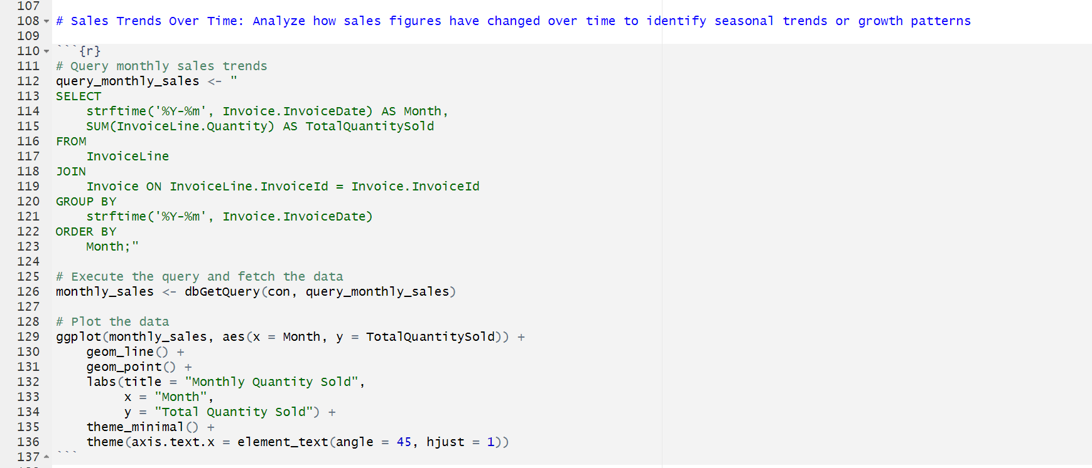
Querying the SQL database with R

Slide 18
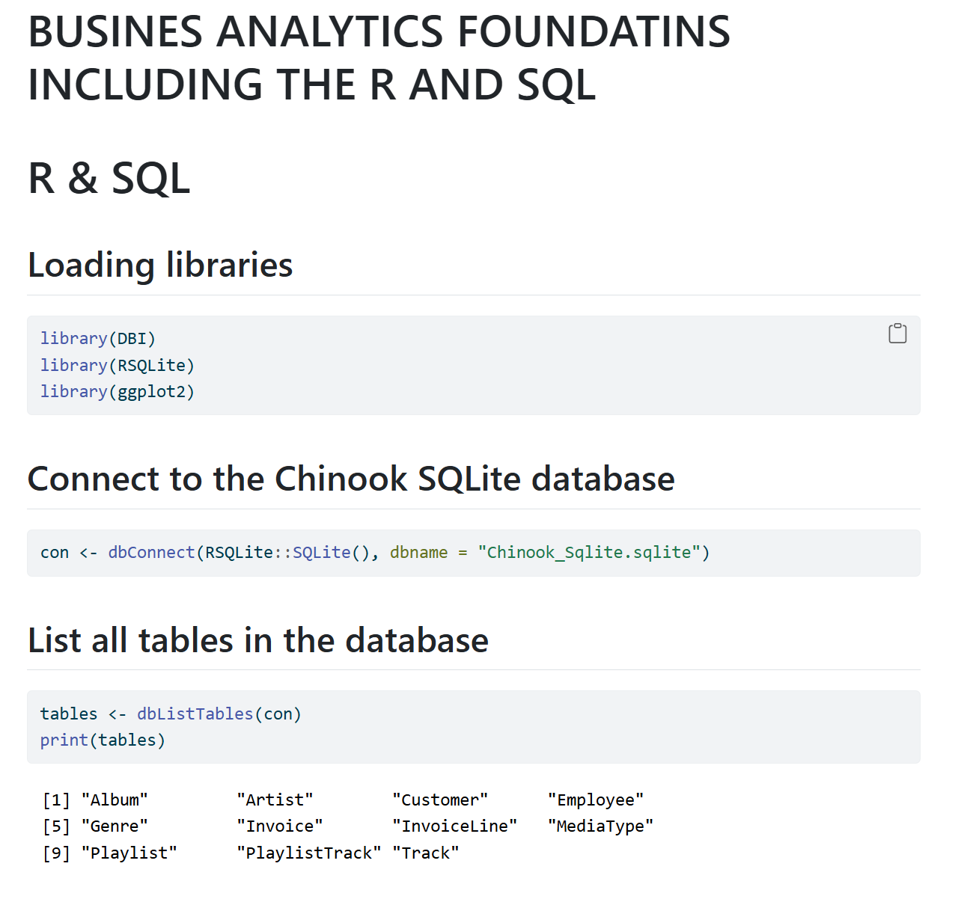
Rendering the SQL database and making report

Slide 19
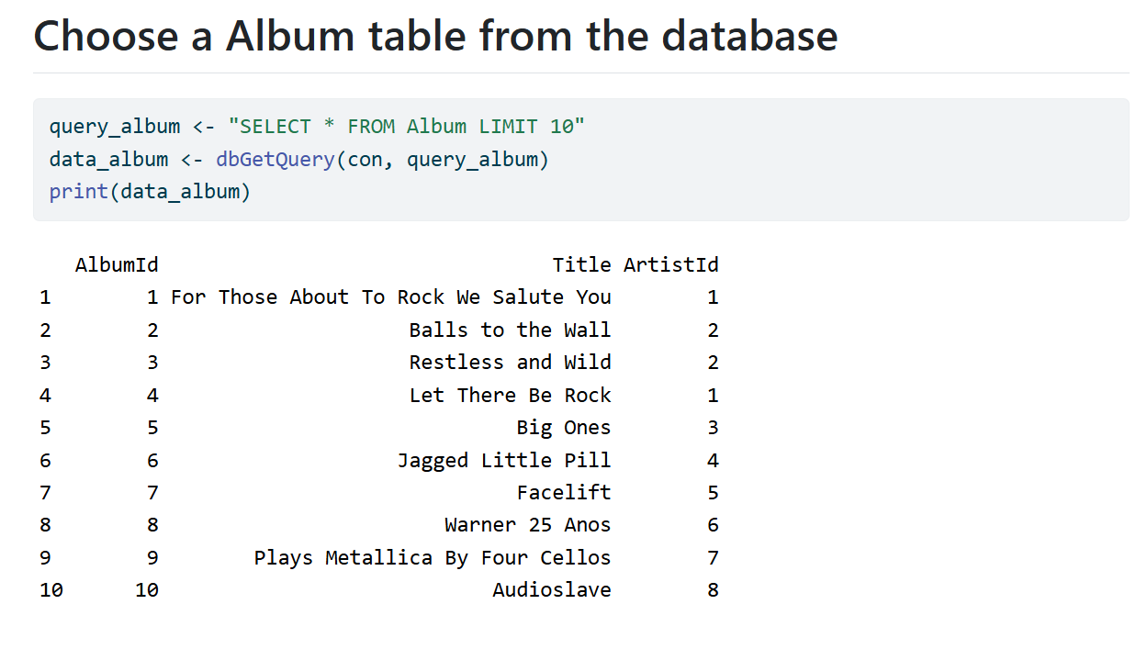
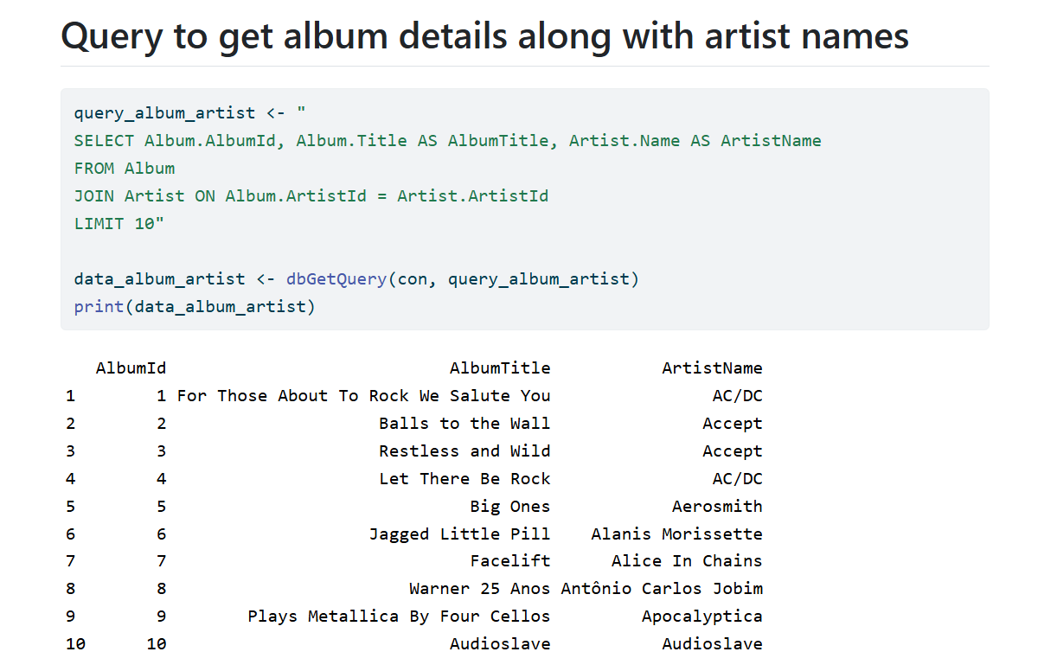
Rendering the SQL database and making report

Slide 20
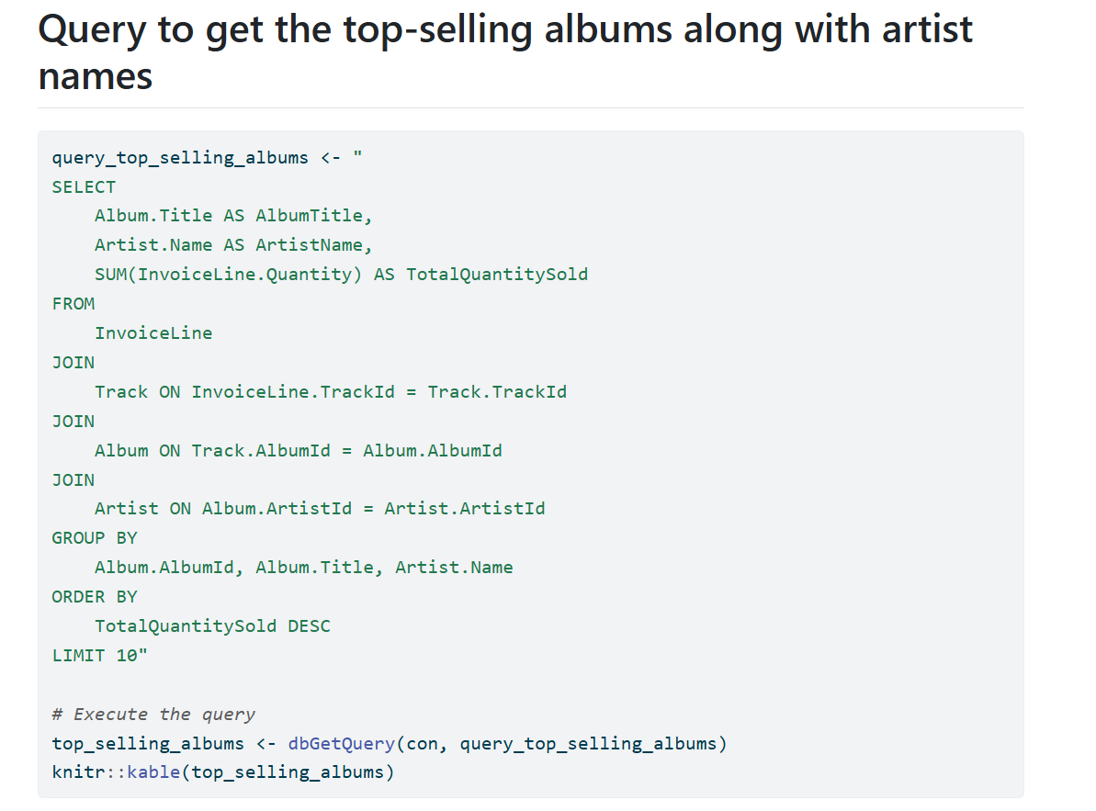
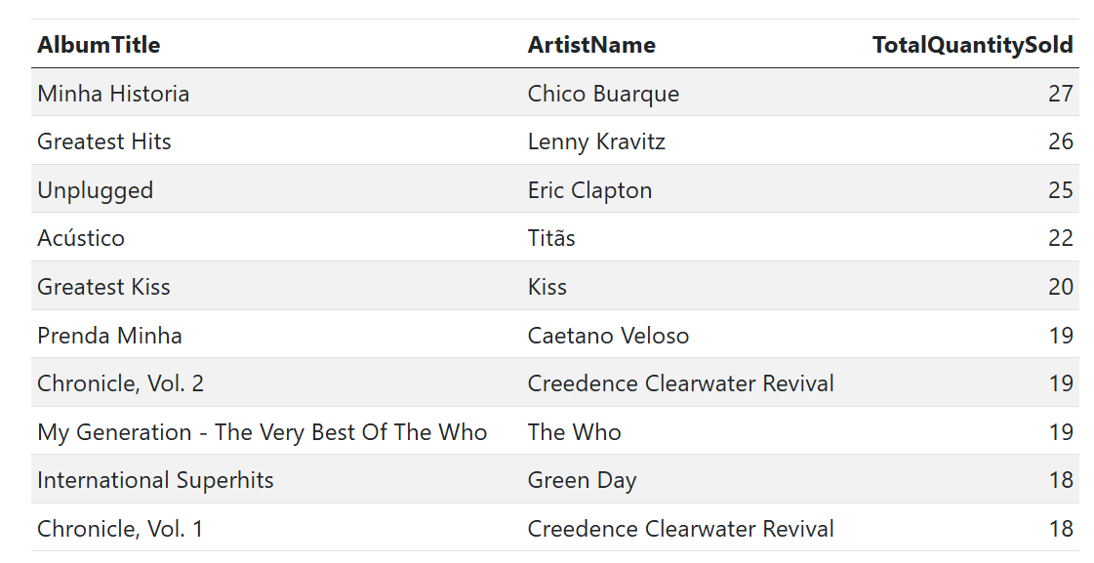
Rendering the SQL database and making report

Slide 21
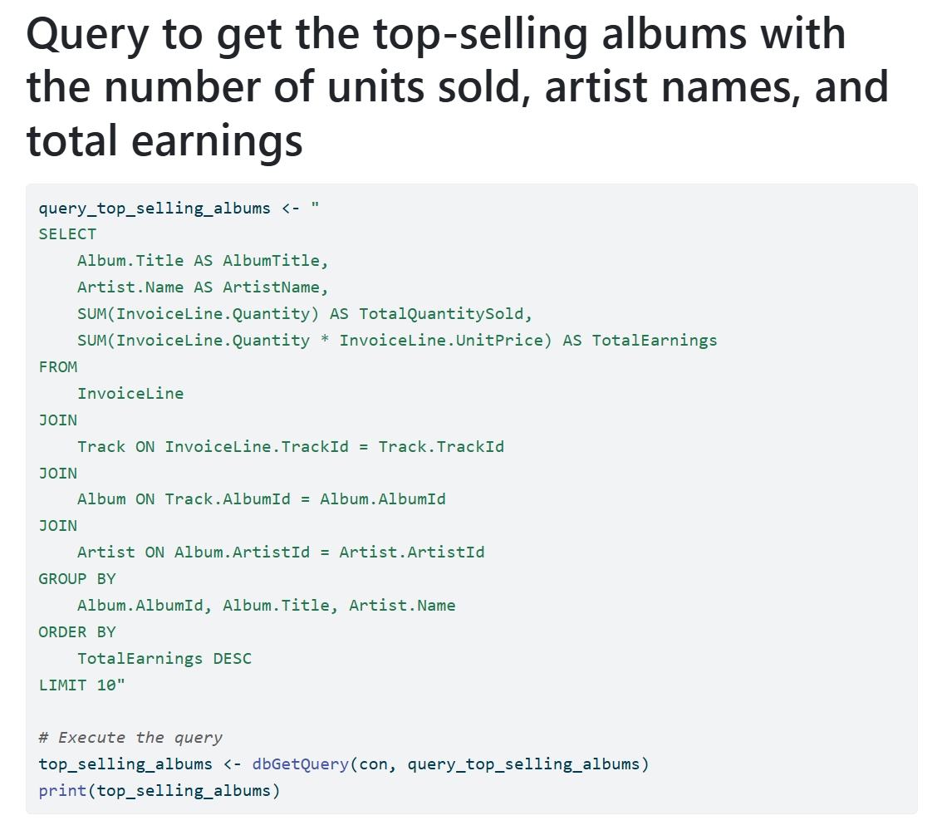
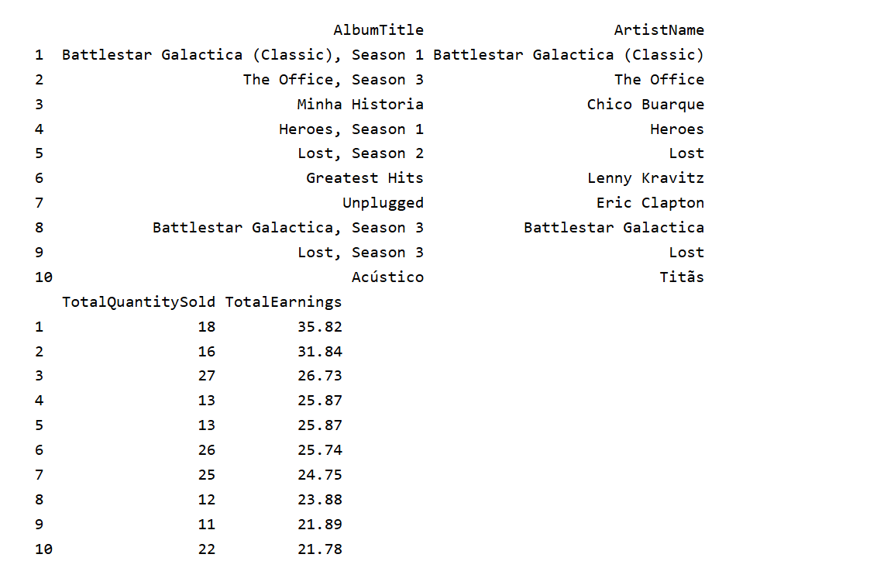
Rendering the SQL database and making report

Slide 22
Summary
Business Analytics (BA) is a data-driven approach that enhances business decision-making by linking raw data to actionable insights, improving company performance.
BA encompasses various application areas like Financial Analytics, Supply Chain Analytics, Marketing Analytics, and more, each contributing to different aspects of business strategy.
There are three main types of BA platforms: Descriptive, Predictive, and Prescriptive, each offering different levels of data analysis and decision-making support.
Modern BA leverages advanced systems and technologies, including machine learning and artificial intelligence, to support decision-making and optimize business processes.
The primary goals of BA include achieving competitive advantage, enhancing organizational performance, and improving decision-making processes by extracting value from data.
Regardless of the BA platform, successful implementation relies on mathematical tools, programming support, and domain-specific expertise.
The connection between BA, SQL, and R is crucial, as SQL manages data storage and updates, while R provides statistical analysis capabilities.
Together, SQL and R offer a powerful combination for analyzing business data, enabling companies to make informed decisions based on accurate, real-time information.

Slide 23
Thank you for your attention

